Slide 1
T-Craft Aero Club
Annual Report
2019
"Putting Wings On Your Dreams"

Slide 2
President
Ben Brandt

Slide 3
Membership Fee
and Aircraft Rate Review
(February Meeting)

Slide 4
Treasurer
Dennis Wheeler

Slide 5
KEY BANK ACCOUNTS- End of 2019
Checking: $ 12,992.15
Savings (Engine replace, Member refunds): $ 48,167.84
Savings (New Aircraft): $ 100,055.76
Total Cash: $ 161,215.75
2018: $ 82,019.50
2017: $ 234,017.10
Major Purchases
New engines ½ 64R, ½ 686 deposit: $25,380.66
New Hanger Project: Loan Balance: $155,314.77
Monthly Loan Payments $2,207.60
Fuel Savings
Currently our cost $4.25 FBO $4.75
Approximately 16,000 Gal purchased from FBO 2019
$0.50/gal Savings over FBO = $ 8,000

Slide 6
Secretary/Newsletter
Jim Manley

Slide 7
Records
12 Newsletters on T-CRAFT.ORG site
Provides detailed minutes of all proceedings.
9 Membership Meetings
14 Board and special board meetings.
Membership and Board meeting minutes in the file cabinets. Electronic version available on request

Slide 8
Contributions
Always looking for newsletter input
Article ideas
Interesting destinations
Flight experiences
Lessons learned
Photos

Slide 9
Billing Director
Reggie Sellers
2019 T-Craft Billing
From 12/26/18 through 12/25/19

Slide 10
Flight Log System
Benefits
-Billing Accuracy
-Convenience
-Paperless
-Maintenance Tracking
-Review Data to Nov. 2010
-Multiple Monthly Reports
Logging Tips
-Log Before and After Flights
-Please Check Hobbs Time
-Enter Fuel and Oil Information
-Enter Destination
-Report Issues to 208-861-6274
-Email regluvs2fly@gmail.com

Slide 11
2019 Hours/Dollars Billed
Aircraft | Hours Flown | Dollars Billed
13686 | 702.1 | 52,658
4464R | 407.8 | 29,769
67375 | 310.8 | 20,086
9989E | 329.6 | 42,189
1293F | 277.6 | 24,919
7593S | 179.5 | 22,976
1891X | 142.4 | 17,862
2019 | 2349.8 | 210,459
2018 | 2305.8 | 202,715
2017 | 2103.7 | 176,696

Slide 12
2019 Monthly Income from Billing (Dues, Must Fly, New Member Fees, Tax, Flight Hrs, Hanger Rental & Misc)
January 18,916
February 22,639
March 25,388
April 25,570
May 37,877
June 26,583
July 33,977
August 30,924
September 35,936
October 48,930
November 17,078
December 30,549
_______
Totals 2019/2018 354,371 / 306,135

Slide 13
2018 2019
Total Flight Dollars Collected 195,104 209,530
Minimum Use it or Lose it 24,936 27,565
Monthly Dues 74,816 81,550
Club Membership
(New Members, Class I , Class II and upgrades) 11,335 14,100
Late Member Fees / Interest 889 1062
Hanger Rental (Includes damage deposit) 18,756
Aircraft Tug Raffle 2,960
Total 307,080 354,371
Sales Tax Collected and Paid - 7,562 - 7,838
Net Total 299,518 346,533
Monthly Board Credit - 9,707 - 13,901
Oil Change Credits - 1,485 - 1,980
Board Approved Credits - 1,878 - 1,549

Slide 14
Top Ten Flyers 2019 - Hours Flown
1 | ? ? ? | 168.8
2 | Elizabeth Carter | 114.9
3 | James Patterson | 114.2
4 | Bill Howard | 97.4
5 | Slay Windham | 95.6
6 | Clay Conner | 68.9
7 | Jim Reed | 64.8
8 | Kent Murri | 64.0
9 | David Nejely | 61.0
10 | David Thomas | 59.0

Slide 15
Top Flyer for 2019
“Chris Nebrigich"

Slide 16
VP/Safety Director
David Thomas

Slide 17
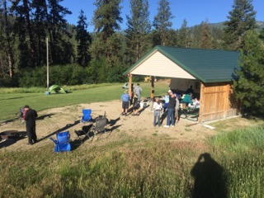
Training & Events 2019
January – Annual Review / Elections
March –Heli Ops at KEUL– Pete Glick
April –Presentation on weather by Elizabeth Padian, NOAA
AOPA Safety Seminar “Peaks to Pavement” – Jim Hudson
Poker Run, Emmett Wings & Wheels
May – T-Craft Backcountry Presentation – Jim Hudson
(2) ATC Tours 5/15/19 - David Thomas
(2) ATC Tours 5/23/19
Plane Wash – 15 members
June – Garden Valley Fly-In
September - (2) ATC Tours 9/2719
October – Plane Wash – 36 members
IDT Aviation Safety Standdown – 18 members in attendance

Slide 18
Training & Events for 2020
January – Annual Review / Elections
February – MAF Experiences – Jim Manley
March –Backcountry Weather – Roland Steadham
April –T-Craft Backcountry Presentation – Jim Hudson
Poker Run, Emmett Wings & Wheels
May – US Dept of Interior Aviation Experiences - Arlyn Miller DPE
Plane Wash
June – Garden Valley Fly-In
October – Plane Wash
IDT Aviation Safety Standdown
Tower Tours – Schedules TBD
Other Events – open for suggestions

Slide 19
Membership Director
Jim Hudson

Slide 20
Membership Status
Year End 2019
106 Members (104/18, 105/17,105/16, 83/15, 60/14)
24 People on wait list
20 New members (13/2018 16/2017, 34/2016, 29/2015)
18 Resigned (14/2017,16/2017, 11/2016, 6/2015)
22 Suspended and/or Inactive
36 Class I (34%) / 71 Class II (66%)

Slide 21
Member Ratings
End of 2019
(Previous
Year)
11 (13) Student Pilot Rating
65 (67) Private Pilot Rating
18 (11) Commercial Rating
12 (13) ATP Rating
38 (34) Instrument Rated Pilots

Slide 22
20 New Members 2019
First Name | Last Name | Joined | Class
Benny | Wells | 1/8/19 | II
Lorena | Correa | 1/8/19 | I
Sean | Rando | 1/8/19 | I
Jason | Reisinger | 2/11/19 | II
Jim | Reed | 2/11/19 | II
Byron | Schmidt | 2/11/19 | I
John | Barness | 2/11/19 | II
Ken | Windley | 2/11/19 | II
Rex | Lewis | 3/12/2019 | II
Jeff | Norris | 3/12/2019 | I
Gaetan | Ertle | 4/9/2019 | I
Chris | Moeness | 5/14/2019 | I
Regis | Deglans | 7/9/2019 | I
Scott | Henscheid | 7/9/2019 | I
Daniel | Sigler | 8/8/2019 | I
Eric | Bridges | 8/13/2019 | II
Ken | Woller | 8/27/2019 | II
Clay | Conner | 8/27/2019 | I
Clay | Grigg | 9/10/2019 | I
Clark | Brenisholtz | 10/8/2019 | I

Slide 23
18 Members Resigned 2019
First Name | Last Name | Joined | Resigned | Class
Wyatt | Gibson | 5/13/2014 | 01/11/19 | I
Michael | Hunt | 8/14/18 | 02/25/19 | I
Cassidy | Brown | 11/29/16 | 02/25/19 | I
Chris | Anderson | 1/12/16 | 04/24/19 | I
Chris | Moeness | 5/14/2019 | 06/13/19 | I
Lucas | Wilhite | 1/13/15 | 06/25/19 | II
Ken | Windley | 5/18/19 | 07/25/19 | I
John | Larson | 1/9/18 | 08/16/19 | II
Ben | Jantzi | 7/12/16 | 08/18/19 | II
Stephanie | Harrison | 12/12/17 | 08/27/19 | I
Brian | Glenn | 8/5/18 | 08/28/19 | II
Jeff | Vanhoozer | 9/9/03 | 09/17/19 | II
Lan | Smith | 5/10/2016 | 09/19/19 | II
Regis | Ertle | 8/26/2018 | 09/22/19 | II
Gaetan | Ertle | 4/9/2019 | 09/22/19 | I
Byron | Schmidt | 2/11/19 | 09/25/19 | I
Scott | Cagle | 12/13/2011 | 10/25/19 | I
Scott | Marshall | 9/29/15 | 12/10/19 | II

Slide 24
Schedule Master &
Webpage Updates
Members need to keep email, phone, change of address updated on SM.
Members need to provide copies of updated to drivers licenses, medicals, flight reviews, flight certificates for the club records
Webpage – Aircraft Fleet pdf -POH, Avionics documents, training video’s, other documents in “Index” tab.

Slide 25
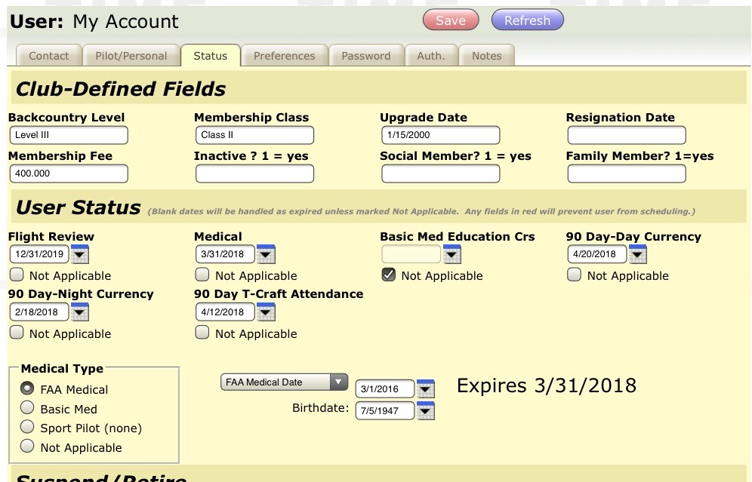
Fields have been provided in the “Status” tab of Schedule master to keep track of Day & Night 90 day Currency, and T-Craft attendance 90 day currency. The dates to be entered are the expiration date.

Slide 26
Top Attendance
(33 Club Events in 2019)
? | ? | 18
Jim | Reed | 14
Gérard | Cattin | 13
Gordon | Hall | 13
Chris | Nebrigich | 13
Mike | Bracke | 11
Patrick | Charlton | 11
Cale | Dobson | 10
Kevin | Harvey | 10
Jeff | Adams | 9
John | Baglien | 9
John | Barsness | 9
Len | Erickson | 9
David | Nejely | 9
Sean | Rando | 9
Brett | Sipes | 9

Slide 27
Top Attendance for 2019
“Bill Howard"

Slide 28
Fly Smart, Fly Safe
And Have Fun !
AND - Don't forget the mission abort button

Slide 29
Maintenance Director
Jim Eyre

