Slide 1
T-Craft Aero Club
Annual Report
2022
"Putting Wings On Your Dreams"

Slide 2
President
Ivan Sudac

Slide 3
Membership Fee
and Aircraft Rate Review

Slide 4
Membership Dues
Copies of club P& L Statement are available upon request

Slide 5
Membership Dues
The Monthly Dues remain the same @ $65/mo.

Slide 6
Hourly Rate Calculations
Based on the last 3 years averages.
The new rates will go into effect at the start of the February billing cycle.

Slide 7
Treasurer
Ken Kaae

Slide 8
Club Cash Assets – 12/31/2022
Key Bank Accounts
Checking: $ 99,723.23
Savings (Engine Reserves): $ 92,399.29
Savings (Hull, Avionics & Paint): $ 41,978.28
Idaho Central Credit Union Accounts
Checking: $ 11,634.09
MM Savings: $ 502,793.49
Savings: $ 25.00
Total Cash on hand 2023: $ 748,553.38 2022: $ 189,027.26
The Club Has NO Debt!!!!

Slide 9
New Hangar Sale
Hangar Sold 9/2022: $ 700,000.00
Appraisal: $ -4,000.00
Real Estate Fees and Closing Costs: $ -48,504.65
21M Payoff: -37,689.05
Hangar Loan Payoff: -99,679.76
Interest Earned 2022: 536.31
Total of All Hangar Sale Accounts: 510,662.85

Slide 10
Billing Director
Reggie Sellers
2022 T-Craft Billing
From 12/26/2021 through 12/25/2022

Slide 11
Flight Log System
Benefits
-Billing Accuracy
-Continuing Improvements
-Paperless
-Users Can Review to 2010
-Multiple Monthly Reports
-Remote Maintenance Notification
Logging Helps
-Log Before and After Flights
-Enter Hobbs and Tach Time
-Enter Fuel and Oil Information
-Enter Specific Destination
-Report Issues to 208-861-6274
-Please Read Preface Letters

Slide 12
2022 Hours and Dollars Billed
Aircraft | Hours Flown | Dollars Billed
4464R | 559.0 | 51,519
9989E | 288.5 | 42,635
13686 | 463.2 | 42,185
7593S | 203.7 | 30,322
1293F | 232.5 | 24,677
121M | 151.0 | 22,799
67375 | 253.5 | 19,735
2022 | 2,151.4 | 233,871
2021 | 1,973.8 | 186,540
2020 | 1,841.0 | 152,313

Slide 13
NOTEWORTHY INCOME and CREDITS
2021 2022
Total Flight Dollars Billed 186,540 233,871
Minimum Use it or Lose it 34,943 41,652
Monthly Dues 103,649 103,496
Membership (New Members and upgrades) 16,900 15,800
Member Late Fees and Finance Charges 661 691
Hangar Rent (Ended 9/22) 18,445 14,966
Monthly Board Credit -14,865 -14,735
Oil Change Credits -1,170 -2,461
Board Approved Credits (Sponsorship, misc) -1,118 -1,062

Slide 14
Top Ten Flyers 2022 - Hours Flown
1 | ? ? ? | 117.1
2 | Dan Harris | 110.5
3 | Michael Lloyd | 103.5
4 | Gerard Cattin | 90.5
5 | Slay Windham | 82.7
6 | Joe Rowley | 72.5
7 | Daniel Sigler | 69.2
8 | Ted Chester | 59.3
9 | Chris Nebrigich | 55.6
10 | John Szanto | 53.9

Slide 15

Top Flyer for 2022
David Nejely

Slide 16
Secretary/Newsletter
Jim Manley

Slide 17
Records
12 Newsletters on T-CRAFT.ORG site
Provided detailed minutes of all proceedings.
9 Membership Meetings
15 Board and special board meetings.
Membership and Board meeting minutes in the file cabinets. Electronic version available on request
Photos of Garden Valley Fly-In
Photos of May and September Plane Washes

Slide 18
Contributions
Always looking for newsletter input
  Article ideas
  Interesting destinations
  Flight experiences
  Lessons learned
  Photos

Slide 19
Director of Hanger & Safety
David Thomas

Slide 20
Hangar Activities
  James Eyre Monument
  New Front Door & Lock
  New Mini Split Heat Pump in Office
  Continued LED Lamp Install
  Deployment (Approx 90% Complete).
  (3) new circuits added for aircraft preheat.
  New camera system installed
  Remote control of aircraft heat installed.

Slide 21
Safety Activities
  4/09/2022: IDT Safety Standdown
  4/26/2022: Backcountry Seminar by Jim Hudson.
  5/17/2022: Plane Wash
  8/30/2022: Round table safety meeting with members regarding accident in Lewiston, ID.
  9/26/2022: Plane Wash
  11/17/2022: Boise Tower Tour

Slide 22
Maintenance Director
Len Erickson

Slide 23

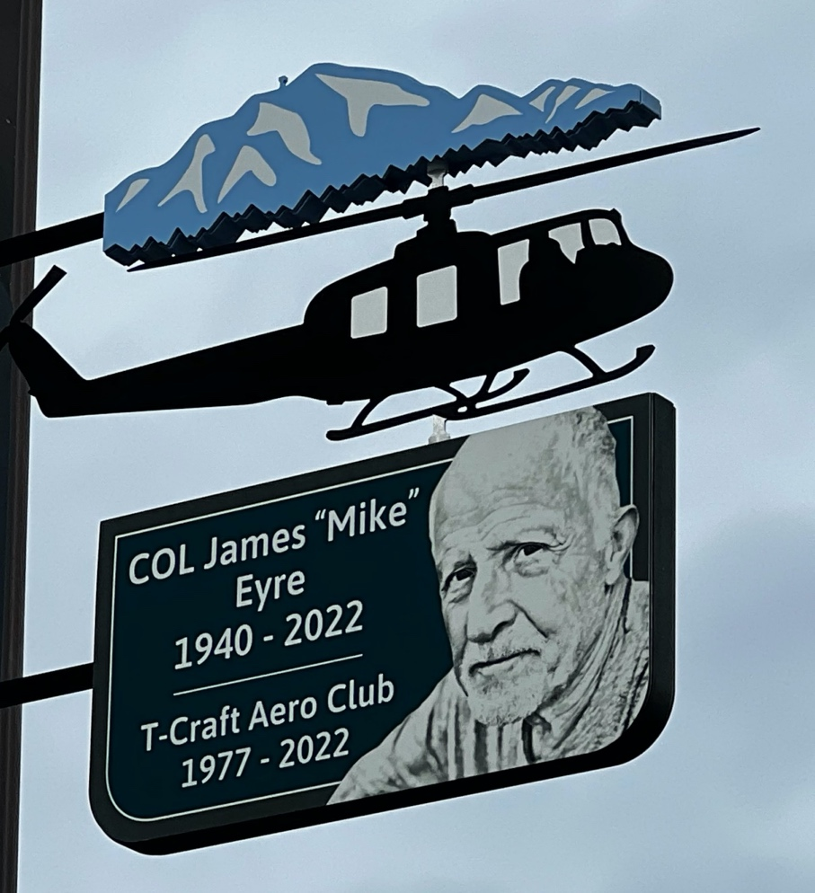
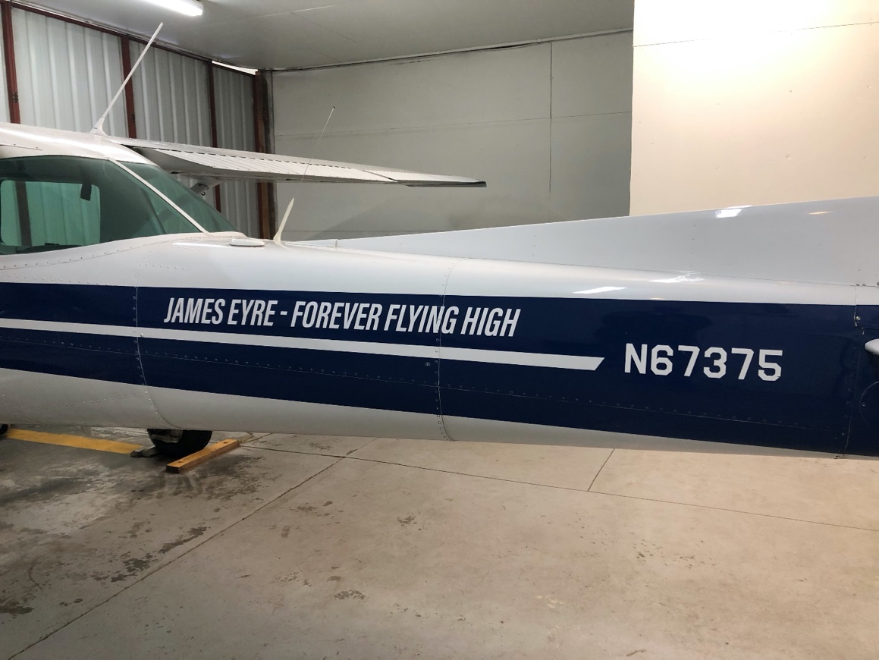

Slide 24

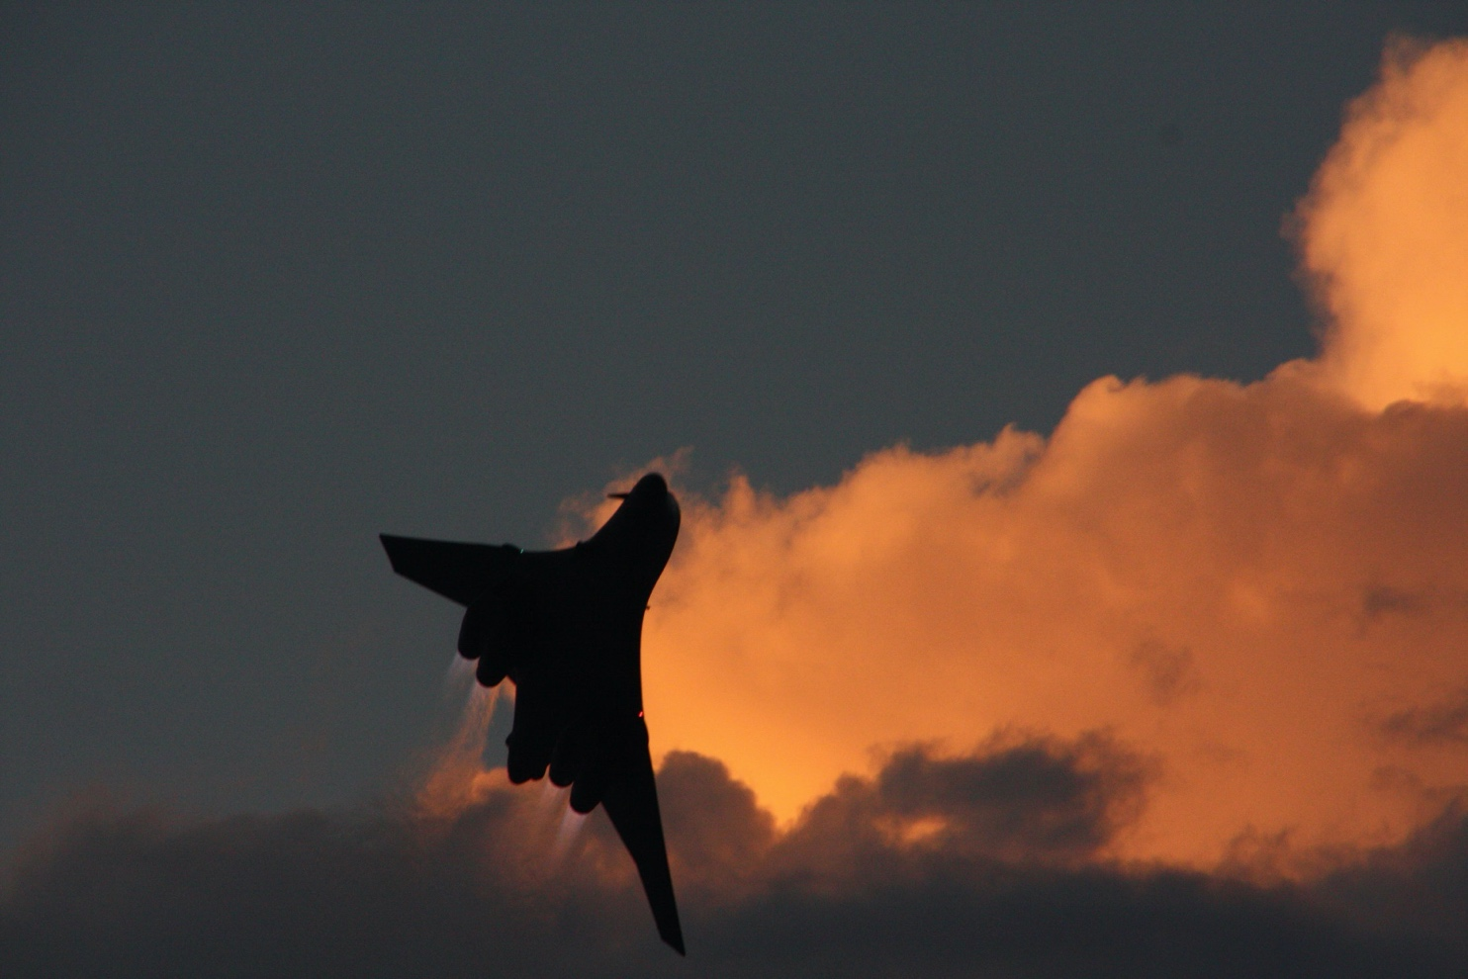
Maintenance 2023

Slide 25
Engine and Prop overhaul table
Aircraft |  |  |  | Engine |  |  |  |  |  |  |  |  | Prop
Aircraft | Type | Year | TTAF | Engine | Eng. Yr | Mfg | HP | TBO | SMOH | Est hrs to TBO | Est OH Date | Forecast Eng OH | PSO Hours | TBO | Est OH YR | Forecast Prop OH cost | Annual
67375 | C-152 | 1978 | 11452.9 | O-235-L2C | 2013 | Lycom | 110 | 2400 | 2307.5 | 92.5 | 2024 | $ 34,863 | 2295.9 | 2000 | 2024 | $ 1,040 | Feb
13686 | C172M | 1974 | 15553.8 | O-320-E2D | 2020 | Lycom | 160 | 2000 | 997.5 | 1002.5 | 2026 | $ 40,884 | 4632.8 | 2000 | 2023 | $ 1,000 | Apr
4464R | C172M | 1974 | 9921.4 | O-320-E2D | 2019 | Lycom | 160 | 2000 | 1420.2 | 579.8 | 2025 | $ 38,657 | 4840.4 | 2000 | 2023 | $ 1,000 | Jan
1293F | C172N | 1980 | 3342.1 | O-360-A4M | 1996 | Lycom | 180 | 2000 | 1981.9 | 18.1 | 2024 | $ 33,449 | 2018.1 | 2000 | 2024 | $ 1,040 | Jan
7593S | C-182Q | 1977 | 5851.9 | O-470-U-13 | 2019 | Cont. | 230 | 2000 | 644.8 | 1355.2 | 2032 | $ 65,451 | 645.9 | 2400 | 2033 | $ 5,969 | Mar
9989E | C-182P | 1975 | 6128.4 | O-470-U-S | 2020 | Cont. | 230 | 1500 | 646.0 | 854.0 | 2027 | $ 53,636 | 2142.4 | 2400 | 2024 | $ 4,155 | Jun
121M | C-182Q | 1977 | 4692.7 | O-470-U-13 | 2021 | Cont. | 230 | 2000 | 288.5 | 1711.6 | 2036 | $ 75,738 | 953.7 | 2400 | 2033 | $ 5,843 | Jan
 |  | Hours Based on Tachometer - as of 1/2/2023 |  |  |  |  |  |  |  | Dates are based on 2022 flying rates
 |  | Engine/Prop $$ does not include R&R or Shippng |  |  |  |  |  |  |  | 4% per year escallation is assumed
 |  | Prop $$ assumes Overhauled prop and prop governor on 182's |  |  |  |  |  |  |  | Assumes engines & props are run to TBO + 200

Slide 26
Squawks

Slide 27
Oil Usage 2021 & 2022
(Based on Hobbs Readings)
Does not consider Oil Changes or amount of oil below full @ OC
Some aircraft may be more sensitive to “over-Filling”

Slide 28
2022 Challenges
Oil Filter shortage
  3+ month deliveries
  Had to purchase several on e-bay @ extreme prices
  Shortage continues, 110 day deliveries.
Short term oil shortage
Trying to fill the shoes of a highly respected and experienced Person
  I have come to respect infinitely more the job that our friend Jim did as DOM.
Transition to a new Maintenance team, Aero-Services to Return To Service (RTS)

Slide 29
2022 (& earlier) Successes
Successful Transition as DOM (At least I think so ).
KASA controlled heaters
Transition to G-5’s and the elimination of the vacuum pumps

Slide 30
Priorities
Provide the safest aircraft for the membership to fly
Minimize the time aircraft are not available to the membership to fly.
  Schedule annuals in the off season
  Fit oil changes and 100 hr inspections into the schedule
Continue to improve availability and reliability by economically upgrading components. (e.g. magnetos with electronic ignitions for one mag. Note that magnetos continue to be a reliability issue industry wide as well as for T-Craft)
Work to keep costs down.
  Alternative suppliers (using PMA / certified components).
  Use membership to help with not critical items.
We don’t always get the low priority items repaired immediately, however we put them on a to-do list and track them.

Slide 31
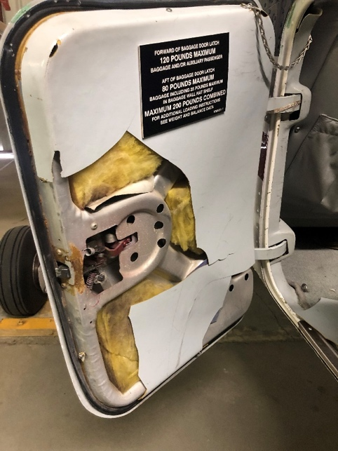
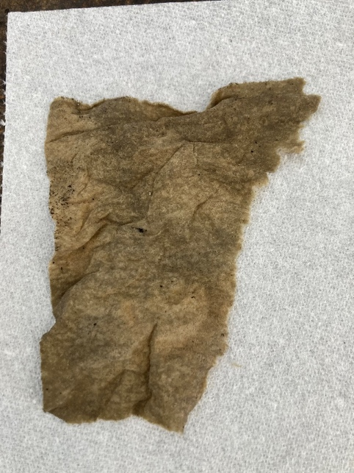
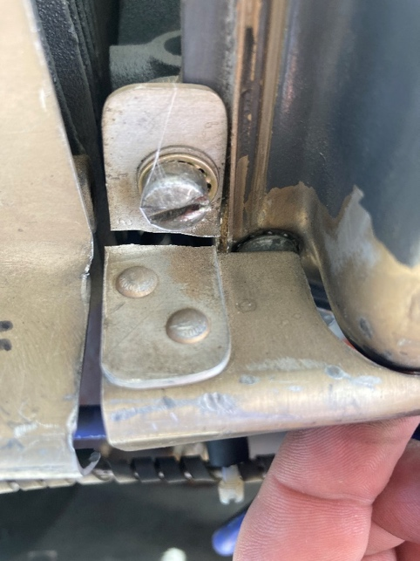
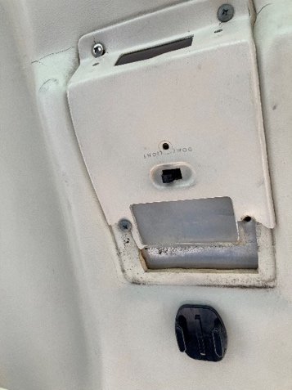
89E Baggage door
89E oil filler FO(d)
375 LR Cylinder Baffle
64R Overhead light panel

Slide 32

Questions?

Slide 33


Slide 34
Membership Director
Jim Hudson

Slide 35
Membership Status
Year End 2022
120 Members: (104/18, 105/17,105/16, 83/15, 60/14)
26 Wait list: (34 last year)
14 New members: (avg 18 last 5 years)
13 Resigned: (avg 18 last 5 years)
22 Suspended: (18%) and/or Inactive (11)
39 Class I (32%) / 81 Class II (68%)

Slide 36
Member Ratings
End of 2022
(Previous
Year)
13 (12) Student Pilot Rating
66 (69) Private Pilot Rating
29 (28) Commercial Rating
12 (11) ATP Rating
49 (47) Instrument Rated Pilots

Slide 37
14 New Members 2022

Slide 38
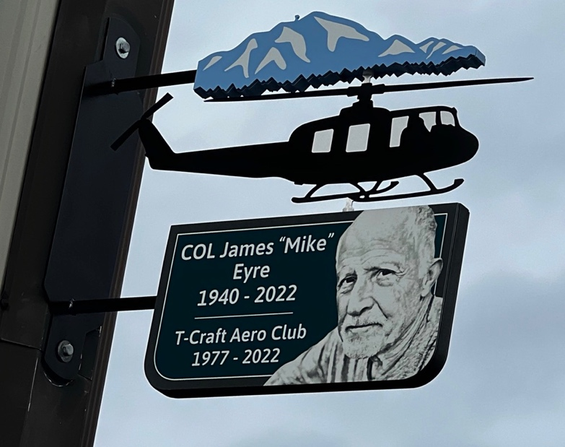
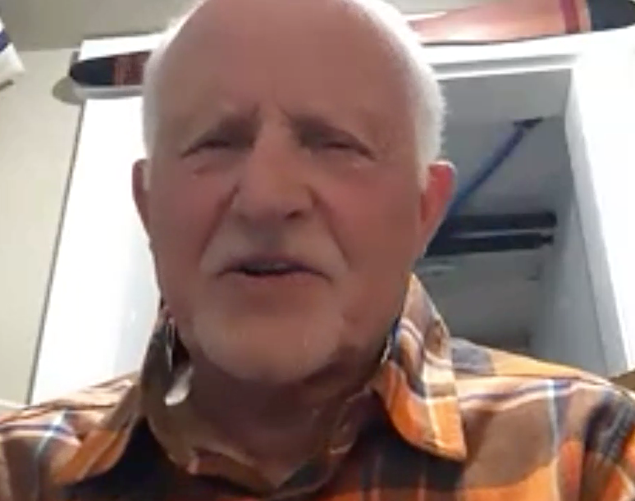
13 Members Resigned 2022

Slide 39
Schedule Master &
Webpage Updates
Members need to keep email, phone, change of address updated.
Members need to provide copies of updated to driver licenses, medicals, flight reviews, flight certificates for the club records
Webpage – Aircraft Fleet pdf -POH, Avionics documents, training video’s, other documents in Resources/ “Index” tab or ”Presentations”.
Continued Webpage improvements by Scott Henscheid - THANKS Scott
Board public emails changed to xxxxx@t-craft.org and phone numbers removed from our public webpage. (Can look up on Scheduelmaster)
Club club member AME’s: Dr. Mark Turner and Dr. Jon Miller.

Slide 40
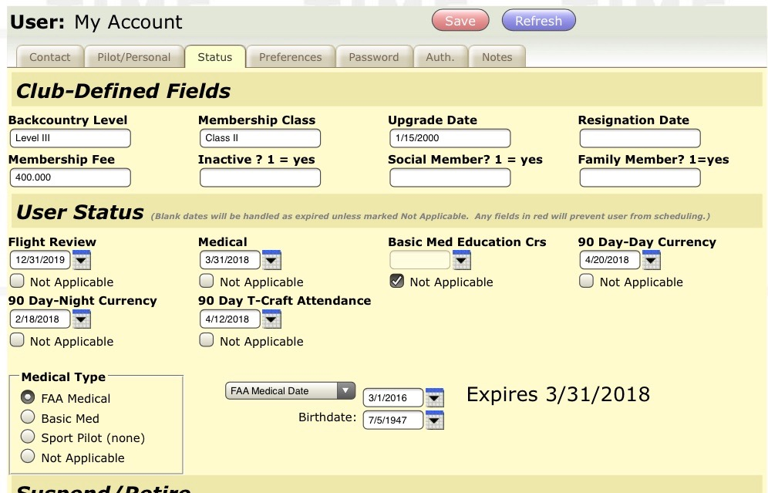
Fields have been provided in the “Status” tab of Schedule master to keep track of Day & Night 90 day Currency, and T-Craft attendance 90 day currency. The dates to be entered are the expiration date.

Slide 41
Top Attendance
(30 Club Events in 2022)

Slide 42
Top Attendance for 2022
Pete Glick

Slide 43
Club Events 2022
April 9th Division of Aero - Safety Standdown
(Backcountry Presentation – JH), 23
April 16th – Poker Run, 20
April 26 – BC Country Presentation – Jim Hudson, 45
May 17, – Spring Plane Wash, Record 75 Attendees !
June 18, – Garden Valley Fly-In, 52 Attendees
September 22, – Fall Plane Wash, 70 Attendees !
October 8th – 50th Anniversary
General Membership Meetings – Average between 50-70

Slide 44
Club Events for 2023
January 24th – Annual Review / Elections
April 13th –T-Craft Backcountry Presentation
April 16-22nd, Poker Run
May 11th – Spring Plane Wash
June 16-17th – Garden Valley Fly-In
September 21st – Plane Wash

Slide 45
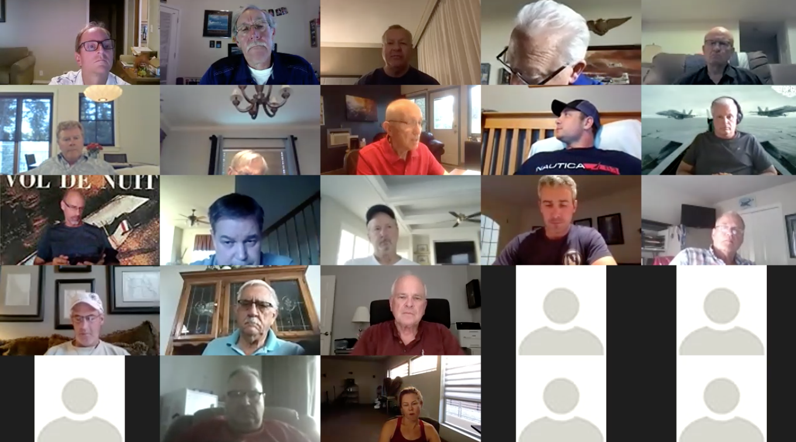
2022 Meetings

Slide 46
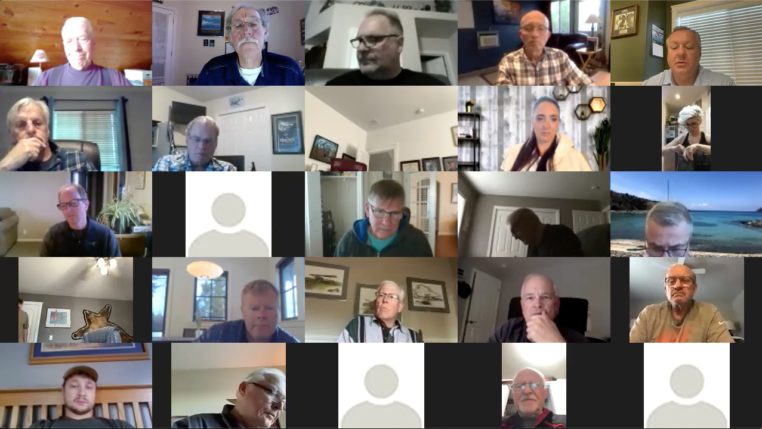
2022 Meetings

Slide 47
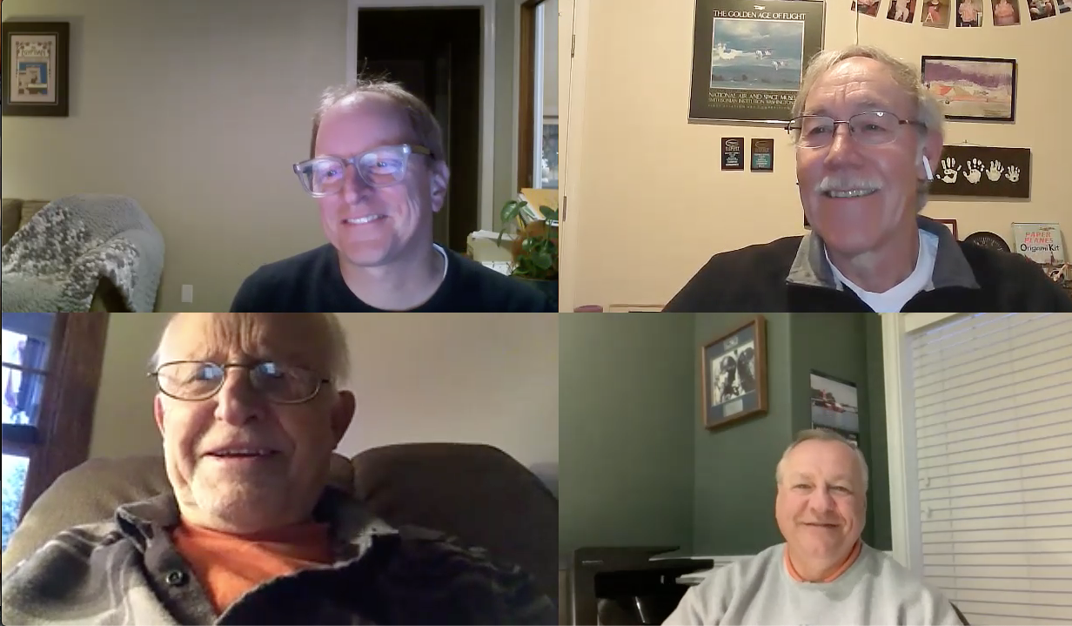

Slide 48
Spring Plane Wash – 75 ! helpers

Slide 53
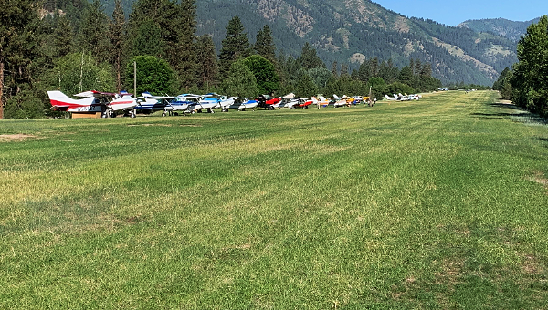
Garden Valley Fly-in

Slide 54
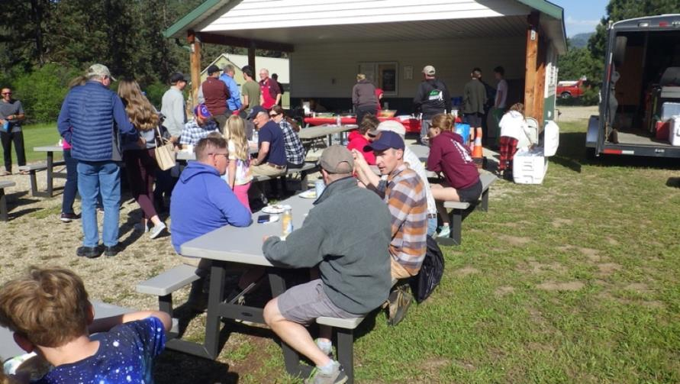
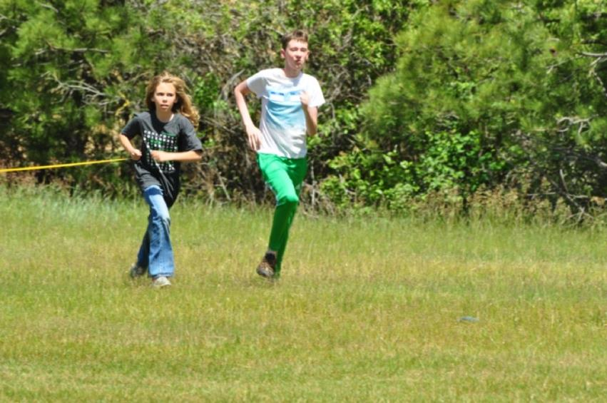
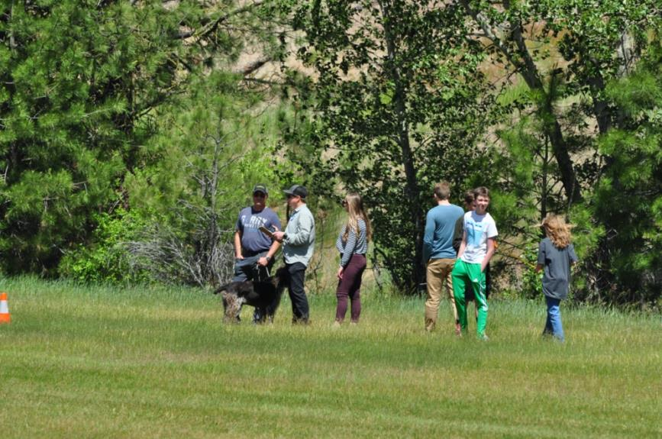

Slide 55
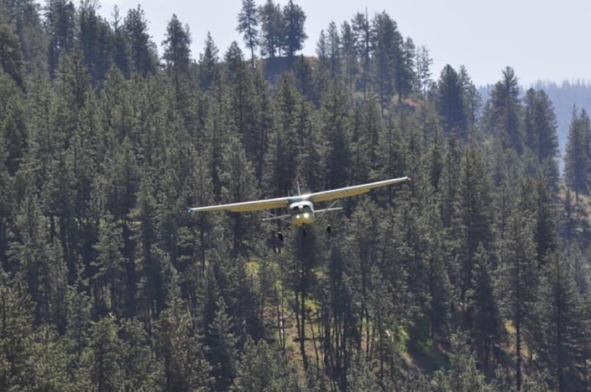
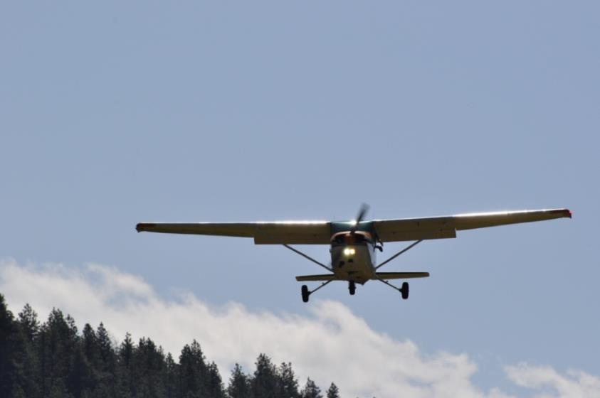
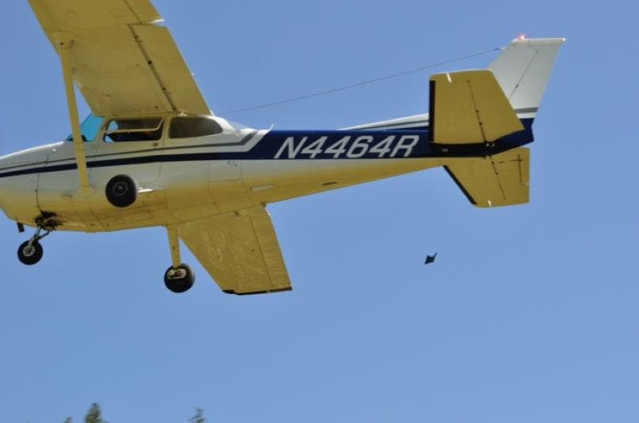

Slide 56
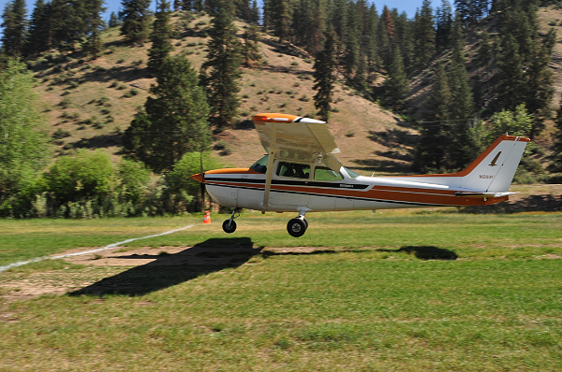
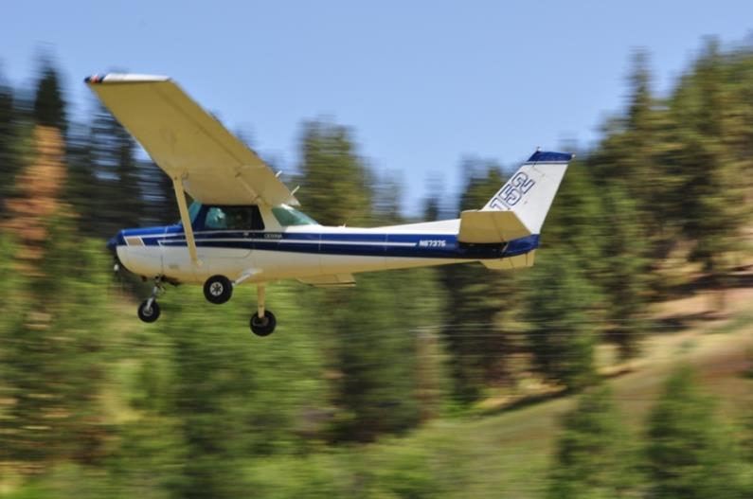
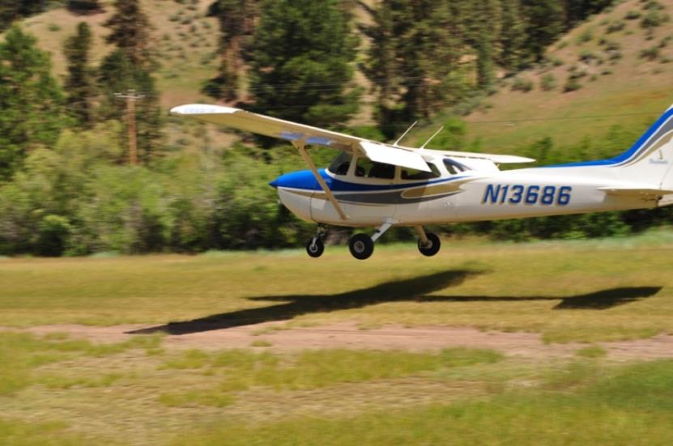
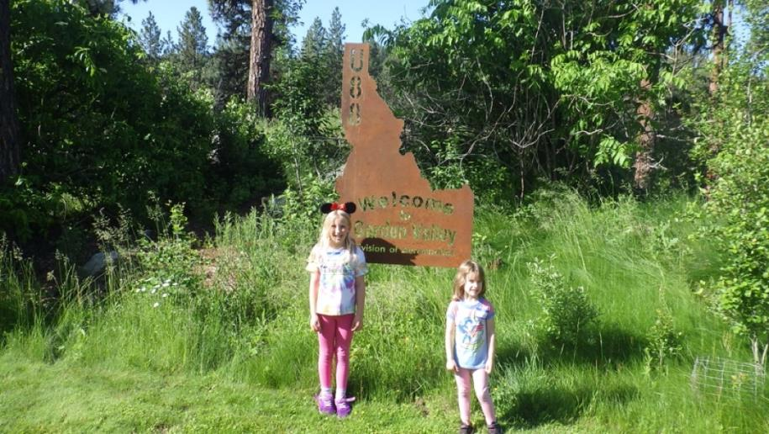

Slide 57
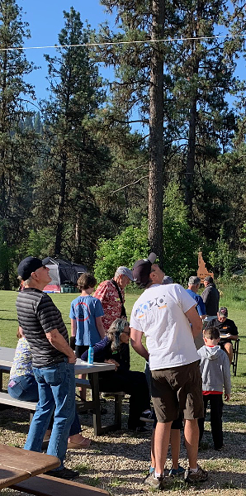
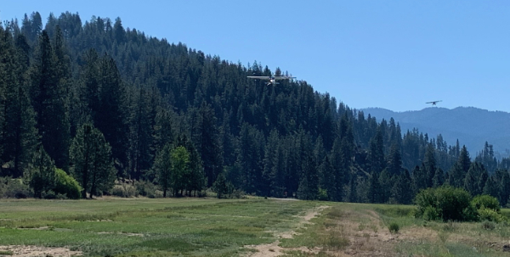
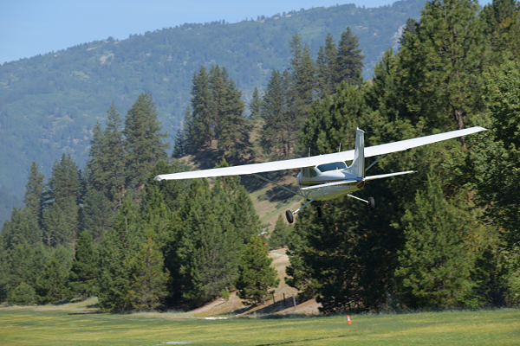

Slide 58
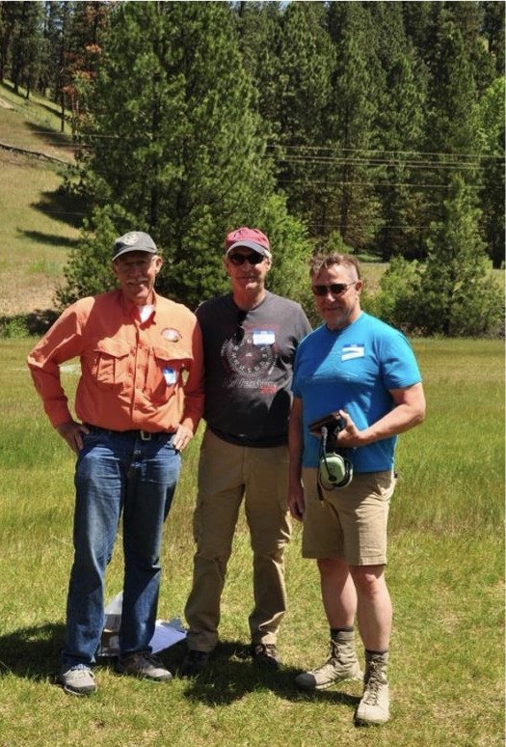
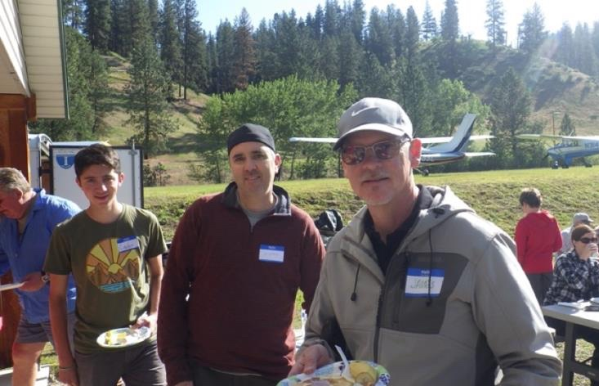
Garden Valley Fly-in
Spot Landing - Top Gun - Kevin Harvey
Bomb Drop – James Patterson/Caden Lewis (Bombardier)

Slide 64
50th Anniversary

Slide 66

Fly Smart, Fly Safe
And Have Fun !
AND - Don't forget the mission abort button

