Slide 1
T-Craft Aero Club
Annual Report
2018
"Putting Wings On Your Dreams"

Slide 2
President
Ben Brandt

Slide 3
Membership Fee
and Aircraft Rate Review

Slide 4
Membership Rate
 | Fixed Costs (annually) | 2019 Projected | 2018 Actual | 2018 Projected
1 | Aircraft Insurance | $ 30,000 | $ 24,594 | $ 30,000
2 | Board Compensation | $ 12,000 | $ 9,710 | $ 11,500
3 | Base Annual ($1,750) | $ 12,250 | $ 12,250 | $ 12,250
4 | New H anger Loan | $ 20,682 | $ 3,521 | $ 15,000
5 | New Aircraft | $ 32,000
6 | Paint/Interior/Avionics |  | $ 18,571 | $ 15,000
7 | 91X Upgrade |  | $ 30,000 | $ -
8 | Member Refuned (Resigning Memb) | $ 5,000 | $ 6,090 | $ 3,000
9 | Property Taxes | $ 800 | $ 1,861 | $ 800
10 | Lease / Hangars - Rent | $ 3,200 | $ 2,403 | $ 1,435
11 | Electric Power | $ 2,500 | $ 1,480 | $ 1,500
12 | Phone/Internet | $ 900 | $ 908 | $ 900
13 | Director & Officers Ins | $ 1,620 | $ 498 | $ 1,620
14 | Schedule Master | $ 923 | $ 923 | $ 923
15 | Accounting/Legal Fees | $ 850 | $ 850 | $ 850
16 | Marketing | $ - | $ - | $ 50
17 | Hangar Insurance | $ 1,200 | $ 483 | $ 576

Slide 5
Membership Rate
Copies of club P& L Statement are available upon request
 | Fixed Costs (annually) | 2019 Projected | 2018 Actual | 2018 Projected
18 | Operation Supplies & Club Picnic | $ 800 | $ 817 | $ 500
19 | Aircraft Registration | $ 530 | $ 530 | $ 530
20 | Hangar Maintenance | $ 1,000 | $ 387 | $ 1,000
21 | Hourly Credit and Sponsorship | $ 2,000 | $ 2,797 | $ 1,500
22 | Internet Hosting | $ 130 | $ 130 | $ 130
23 | Dues & Subscriptions | $ 224 | $ 224 | $ 250
24 | Aircraft Search/Replacement | $ 3,000 | $ 130 | $ 3,000
 | TOTAL | $ 131,609 | $ 119,156 | $ 102,314
25 | New Member Join-Upgrades | $ (12,600) | $ (11,335) | $ (9,400)
26 | New Hanger Income | $ (17,040)
27 | Un-flown Hours Billed-Late Fees | $ (21,688) | $ (25,826) | $ (17,083)
28 | Net Annual Requirement | $ 80,281 | $ 81,996 | $ 75,831
 | Price / Member / Month | $ 60 | $ 65 | $ 60
 | TOTAL AVE MEMBERS | $ 112 | $ 105 | $ 105
The board recommends to increase Monthly Dues - $60/mo.

Slide 6
Monthly Dues History
 | 2012 | 2013 | 2014 | 2015 | 2016 | 2017 | 2018
Total Cost | $ 66,354 | $ 76,866 | $ 71,357 | $ 79,091 | $ 79,299 | $ 112,215 | $ 119,156
Un-flown Hours Billed | $ 11,878 | $ 13,318 | $ 13,601 | $ 12,012 | $ 17,172 | $ 22,066 | $ 25,826
New Member Join | $ 3,800 | $ 7,800 | $ 3,465 | $ 19,630 | $ 22,000 | $ 12,705 | $ 11,335
Net Annual Requirement | $ 50,676 | $ 55,748 | $ 54,291 | $ 47,449 | $ 40,127 | $ 77,444 | $ 81,996
Avionics/Paint Assessment | $ - | $ - | $ - | $ - | $ 19,553
Members (avg per year) | 72 | 69 | 63 | 72 | 95 | 105 | 105
Price / Member / Month | $ 58.65 | $ 67.33 | $ 71.81 | $ 54.92 | $ 52.35 | $ 62.00 | $ 65.00
Actual Charged | $ 70.00 | $ 70.00 | $ 70.00 | $ 70.00 | $ 60.00 | $ 60.00 | $ 60.00

Slide 7
Hourly Rate Calculations
 | 1891X | 9989E | 7593S | 13686 | 4464R | 1293F | 67375
Fuel @ current rate | $61.10 | $61.10 | $61.10 | $37.60 | $37.60 | $47.00 | $28.20
Oil Change @ / 100 hours Tach + 25% (extra oil between changes) | $0.56 | $0.56 | $0.56 | $0.40 | $0.40 | $0.40 | $0.30
Oil Filter / 100 hours Tach | $0.19 | $0.19 | $0.19 | $0.17 | $0.17 | $0.17 | $0.17
Oil Change Labor T-Craft Reimbursement - applied pro/rata | $0.81 | $0.81 | $0.81 | $0.72 | $0.72 | $0.72 | $0.72
Engine / Prop Fund | $18.96 | $25.20 | $18.00 | $8.16 | $8.16 | $10.40 | $9.13
Maintenance (Does not include Annuals) | $45.03 | $32.49 | $29.50 | $22.50 | $14.80 | $37.77 | $22.31
Jeppesen Data |  | $1.56 | $1.74 | $0.94
Hull Fund | $5.00 | $7.00 | $7.00 | $6.00 | $6.00 | $6.00 | $4.00
Total Hourly Rate | $131.66 | $128.92 | $118.91 | $76.49 | $67.85 | $102.46 | $64.83
 | $ 126.50 |  |  | $ 72
Rate at the end of 2018 | $121.00 | $128.00 | $128.00 | $75.00 | $73.00 | $86.00 | $62.00
Recommended NEW Rates | $125.00 | $128.00 | $128.00 | $75.00 | $73.00 | $90.00 | $65.00
The new rates will go into effect at the beginning of the February billing cycle.

Slide 8
Hourly Rate History
 | 05/10 | 11/10 | 12/11 | 1/13 | 1/14 | 7/14 | 6/15 | 9/16 | 2/17 | 2/18 | 7/18
$/GAL | $ 4.13 | $ 4.03 | $ 4.89 | $ 4.87 | $ 5.47 | $ 5.26 | $ 4.32 | $ 4.17 | $ 4.17 | $ 4.26 | $ 4.70
1891X | $ 109 | $ 109 | $ 121 | $ 117 | $ 125 | $ 123 | $ 111 | $ 108 | $ 106 | $ 116 | $ 121
7593S | $ 112 | $ 112 | $ 124 | $ 121 | $ 128 | $ 126 | $ 114 | $ 116 | $ 112 | $ 122 | $ 128
800YD | $ 109 | $ 109 | $ 121 | 9989E | $ 128 | $ 126 | $ 114 | $ 118 | $ 116 | $ 122 | $ 128
1293F |  |  |  |  |  |  |  |  |  | $ 82 | $ 86
4464R | $ 79 | $ 79 | $ 84 | $ 79 | $ 84 | $ 83 | $ 75 | $ 73 | $ 71 | $ 69 | $ 73
13686 | $ 77 | $ 77 | $ 86 | $ 81 | $ 86 | $ 85 | $ 77 | $ 75 | $ 73 | $ 71 | $ 75
67375 | $ 52 | $ 52 | $ 58 | $ 57 | $ 62 | $ 61 | $ 55 | $ 59 | $ 60 | $ 60 | $ 62
1227G |  |  |  |  |  | $ 55 | $ 50 | $ 52 | $ 60

Slide 9
Treasurer
Dennis Wheeler

Slide 10
KEY BANK ACCOUNTS- End of 2018
Checking $ 20,901.04 Savings (Engine, Hull) $ 50,083.18
Savings (New Aircraft) $11,035.28
TOTAL $ 82,019.50
TOTAL ASSETS
2017 $ 234,017.10
2018 $ 82,019.50
Change - $151,997.60
Major Purchases
Avionics Upgrades: 15,200
91X upgrades: $30,000
Three new engines and props: $86,500
New Hanger Project: $$$
Fuel Savings
Currently our cost $4.70 FBO $5.12
Approximately 20,000 Gal Burned 2018
$0.42/gal Savings over FBO = $ 8,400 !

Slide 11
Secretary
Bert Osborn

Slide 12
Records
12 Newsletters on T-CRAFT.ORG site
Provides detailed minutes of all proceedings.
9 Membership Meetings
14 Board and special board meetings.
Membership and Board meeting minutes in the file cabinets. Electronic version available on request

Slide 13
Billing Director
Reggie Sellers
2018 T-Craft Billing
From 12/26/17 through 12/25/18

Slide 14
Flight Log System
Benefits
-Billing Accuracy
-Convenience
-Paperless
-Maintenance Tracking
-Review Data to Nov. 2010
-Multiple Month Reports
Logging Tips
-Log Before and After Flights
-Please Check Hobbs Time
-Enter Fuel and Oil Information
-Enter Destination
-Report Issues to 208-861-6274
-Email regluvs2fly@gmail.com

Slide 15
2018 Hours/Dollars Billed
Aircraft | Hours Flown | Dollars Billed
13686 | 576.3 | 42,338
4464R | 387.7 | 27,610
67375 | 334.4 | 20,380
9989E | 311.1 | 38,898
1293F | 302.3 | 25,478
7593S | 214.1 | 26,527
1891X | 179.9 | 21,483
2018 | 2305.8 | $202,715
2017 | 2103.7 | $176,696

Slide 16
2017 Monthly Income from Billing (Dues, Minimum Hours, New Member Fees, Tax, Flight Hrs & Misc)
January 16,212
February 17,521
March 23,375
April 18,635
May 23,330
June 22,949
July 38,051
August 29,145
September 26,050
October 31,826
November 34,296
December 24,745
_______
Totals 2018/2017: $306,135/$277,840

Slide 17
2017 2018
Total Flight Dollars Collected $170,219 $195,104
Minimum Use it or Lose it $21,359 $24,936
Monthly Dues $73,222 $74,816
Club Membership (New Members) $12,705 $11,335
(Class I , Class II and upgrades)
Late Member Fees / interest $707 $889
Total $278,212 $307,080
Sales Tax Collected and Paid - $6,886 - $7,562
Net Total $271,326 $299,518
Monthly Board Credit - $10,969 - $9,707
Oil Change Credits - $945 - $1,485
Credit for Sponsor, Maint. Asst, Top Flyer - $1,542 - $1,878

Slide 18
Top Ten Flyers 2018 - Hours Flown
1 | ? ? ? | 109.7
2 | David Thomas | 106.7
3 | James Patterson | 96.7
4 | Jiyun Li | 75.0
5 | David Nejely | 68.1
6 | Slay Windham | 67.9
7 | Stefan St. Marie | 65.9
8 | Kent Murri | 64.9
9 | Tad Jones | 64.7
10 | Elizabeth Carter | 61.3

Slide 19
Top Flyer for 2018
“Bill Howard"

Slide 20
Membership / Safety Director
Jim Hudson

Slide 21
Membership Status
Year End 2018
104 Members (105/2017,105/2016, 83/2015, 60/2014)
28 People on wait list
13 New members (16 / 2017, 34 / 2016, 29 / 2015)
14 Resigned (16 / 2017, 11 / 2016, 6 / 2015)
18 Suspended and/or Inactive
37 Class I (36%) / 67 Class II (64%)

Slide 22
Member Ratings
End of 2018
(Previous
Year)
13 (15) Student Pilot Rating
67 (68) Private Pilot Rating
1 (1) Recreational Pilot Rating
11 (12) Commercial Rating
13 (9) ATP Rating
34 (31) Instrument Rated Pilots

Slide 23
13 New Members
2018
First Name | Last Name | Joined | Class
John | Larson | 1/9/18 | II
Jiyun | Li | 3/7/18 | II
Elizabeth | Carter | 3/12/18 | I
Brad | Mabe | 4/19/18 | I
David | Blood | 4/24/2018 | I
Charlie | Wambold | 5/29/2018 | II
Bill | Howard | 6/12/2018 | I
Doug | Case | 6/12/2018 | I
Brian | Glenn | 8/5/2018 | II
Michael | Hunt | 8/14/2018 | I
Regis | Ertle | 8/26/2018 | II
Chris | Nebrigich | 10/26/2018 | I
Ian | Bock | 10/28/2018 | II

Slide 24
14 Members Resigned 2018
First Name | Last Name | Joined | Resigned | Class
Ernest | Meshack-Hart | 9/9/14 | 1/9/18 | II
Marjorie | Wells | 2/14/17 | 3/6/18 | I
Preston | Rufe | 2/10/15 | 3/12/18 | II
Chad | Hess | 9/27/16 | 4/18/18 | I
Houston | Head | 10/29/13 | 4/10/2018 | I
Brandon | Bennett | 2/14/17 | 5/8/18 | I
Nate | Straubhar | 4/11/17 | 6/14/18 | I
Don | Allen | 5/27/14 | 6/26/18 | II
Mike | Sheridian | 7/12/16 | 7/29/18 | II
Steve | Moore | 4/26/16 | 8/14/18 | II
Brad | Mabe | 4/19/18 | 8/26/18 | I
Scott | Jennings | 10/25/16 | 10/26/18 | II
Bert | Osborn | 3/17/2009 | 10/28/18 | II
Travis | Gibson | 5/13/2014 | 12/3/18 | II

Slide 25
Safety Newsletters
"A Safe Pilot is always learning"
January - IFR Tools - EFB’s, FAA Back to Basics.
February - “Tame the Winds”
March - “Craziness in the Traffic Pattern”
April - RAF Safety Survey / Back Country Guide
May - Density Altitude Refresher
June - Why do we keep making the same mistakes? - 2017 Null Report.
July - Go-Around Mistakes.
August - Thank God the Smoke is Gone.
September - Controlled Flight Into Terrain (CFIT) accidents.
October - The Impossible Turn.
November – Stick & Rudder Skills.

Slide 26
Schedule Master &
Webpage Updates
Members need to keep email, phone, change of address updated on SM.
Members need to provide copies of updated to drivers licenses, medicals, flight reviews, flight certificates for the club records
Webpage – Aircraft Fleet pdf -POH, Avionics documents, training video’s, other documents in “Index” tab.

Slide 27
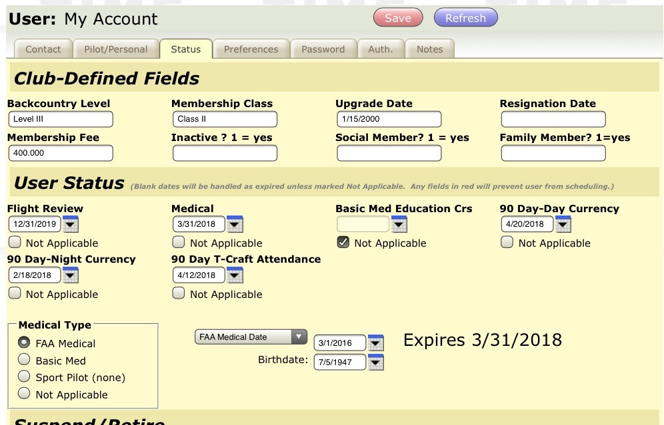
Fields have been provided in the “Status” tab of Schedule master to keep track of Day & Night 90 day Currency, and T-Craft attendance 90 day currency. The dates to be entered are the expiration date.

Slide 28
Top Attendance
(26 Club Events in 2018)
? | ? | 17
Geoffery | Bik | 12
Tad | Jones | 12
Bert | Osborn | 12
David | Nejely | 11
Scott | Cagle | 10
Tim | Ferrill | 10
Kevin | Harvey | 10
Jeff | Adams | 9
Bill | Chapman | 9
Mark | Slusser | 9
Lan | Smith | 9
David | Thomas | 9

Slide 29
Top Attendance for 2018
“Gordon Hall"

Slide 30
Fly Smart, Fly Safe
And Have Fun !
AND - Don't forget the mission abort button

Slide 31
Maintenance Director
Jim Eyre

