Slide 1
T-Craft Aero Club
Annual Report
2020
"Putting Wings On Your Dreams"

Slide 2
President
Ivan Sudac
Comments from the Peanut Gallery

Slide 3
Membership Fee
and Aircraft Rate Review

Slide 4
Membership Rate
Copies of club P& L Statement are available upon request

Slide 5
Membership Rate
The board recommends an increase Monthly Dues - $75/mo.

Slide 6
Hourly Rate Calculations
Based on the last 3 years averages.
If approved, the new rates will go into effect today, start of the February billing cycle.

Slide 7
Treasurer
Dennis Wheeler

Slide 8
Club Cash Assets – 12/31/2020
Checking: $ 45,519.40
Aerospace Reports Escrow (N121M) : $ 22,400.00
Savings (Engine Replacement): $ 24,880.66
Savings (Aircraft Replacement): $ 27,678.75
Total Cash 2020: $ 120,478.81
2019: $161,215.75
2018: $ 82,019.50

Slide 9
2020 Major Purchases
Purchased 1977 182Q N121M for $98,000
($7k Down, 91k Loan, $270 Loan Fee, $796 pmt)
New engines: ½ of 686, 89E and 21M, $75,624.83
Avionics upgrade to 64R $11,200
Avionics upgrade to 93F $9,829
Fuel Summary
Fuel Used: 17,108 gallons
Fuel Savings Over FBO Pricing @ .50/gal = $8,554

Slide 10
Secretary/Newsletter
Jim Manley

Slide 11
Records
12 Newsletters on T-CRAFT.ORG site
Provides detailed minutes of all proceedings.
6 Membership Meetings
14 Board and special board meetings.
Membership and Board meeting minutes in the file cabinets. Electronic version available on request

Slide 12
Contributions
Always looking for newsletter input
  Article ideas
  Interesting destinations
  Flight experiences
  Lessons learned
  Photos

Slide 13
Billing Director
Reggie Sellers
2020 T-Craft Billing
From 12/26/19 through 12/25/20

Slide 14
Flight Log System
Benefits
-Billing Accuracy
-Convenience
-Paperless
-Maintenance Tracking
-Review Data to Nov. 2010
-Multiple Monthly Reports
Logging Tips
-Log Before and After Flights
-Enter Hobbs and Tach Time
-Enter Fuel and Oil Information
-Enter Specific Destination
-Report Issues to 208-861-6274
-Please Read Invoice and Statement Preface Letters

Slide 15
2020 Hours and Dollars Billed
Aircraft | Hours Flown | Dollars Billed
4464R | 447.7 | 31,542
13686 | 430.4 | 28,943
9989E | 261.0 | 28,992
67375 | 244.5 | 14,800
1293F | 241.0 | 21,207
7593S | 216.4 | 26,829
121M | 0.0 | 0
2020 | 1841.0 | 152,313
2019 | 2349.8 | 210,459
2018 | 2103.7 | 176,696

Slide 16
2020 Monthly Income from Billing
(Dues, Must Fly, New Member Fees, Tax, Flight Hrs, Hanger Rental & Misc)
January 8,510
February 16,440
March 26,098
April 24,640
May 20,759
June 28,833
July 33,883
August 36,630
September 19,391
October 32,056
November 31,317
December 28,808
Total 2020 307,366
Total 2019 354,371

Slide 17
MEMBER INCOME and CREDITS
2019 2020
Total Flight Dollars Billed 209,530 152,313
Minimum Use it or Lose it 27,565 27,998
Monthly Dues 81,550 81,890
Membership (New Members and upgrades) 14,100 30,300
Member Late Fees and FC 1,062 874
Hanger Rent (2019 includes damage deposit) 18,756 15,115
Aircraft Tug Raffle 2,960
Sales Tax Collected and Paid -7,838 -7,018
Monthly Board Credit -13,677 -14,865
Oil Change Credits -1,620 -1,170
Board Approved Credits (Sponsorship, misc) -1,099 -1,118

Slide 18
Top Ten Flyers 2020 - Hours Flown
1 | ? ? ? | 88.7
2 | Elizabeth Carter | 82.5
3 | Chris Nebrigich | 74.9
4 | Kent Murri | 61.2
5 | Clay Conner | 61.0
6 | Hootan Shariat | 60.0
7 | Tad Jones | 53.9
8 | James Patterson | 52.0
9 | Eric Bridges | 43.8
10 | Regis Deglans | 40.5

Slide 19

Top Flyer for 2020
Daniel Sigler

Slide 20
VP/Safety Director
David Thomas

Slide 21
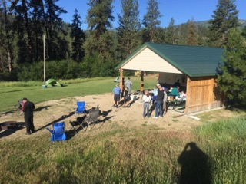
Training & Events 2020
January – Annual Review / Elections
February – MAF Experiences Presentation– Jim Manley, 42 Attendees
June 23, 2020 – Plane Wash, 42 Attendees
June 26-27, 2020 – Garden Valley Fly-In, 41 Attendees
October 5, 2020 – Plane Wash, 61 Attendees !
November 23, 2020 – Bill McGlynn Weather Presentation via Zoom, ~ 52 Attendees
Tower Tours – Cancelled due to COVID

Slide 22
Training & Events for 2021
January, 26 – Annual Review / Elections
April 11-17, Poker Run
April 17, Wings & Wheels Fly-In/Breakfast @ Emmett (S87)
April 20 –T-Craft Backcountry Presentation – Jim Hudson
May 18 – Plane Wash
June 25-26 – Garden Valley Fly-In
October 5th – Plane Wash
Tower Tours – Will start as soon as allowed.

Slide 23
Membership Director
Jim Hudson

Slide 24
Membership Status
Year End 2020
120 Members (106/19,104/18, 105/17,105/16, 83/15, 60/14)
31 People on wait list (24 last year)
28 New members (20/2019,13/18 16/17, 34/16, 29/15)
14 Resigned (18/2019, 14/2018,16/2017, 11/2016, 6/2015)
29 Suspended and/or Inactive (17)
40 Class I (33%) / 80 Class II (67%)

Slide 25
Member Ratings
End of 2020
(Previous
Year)
13 (11) Student Pilot Rating
65 (65) Private Pilot Rating
28 (18) Commercial Rating
13 (12) ATP Rating
48 (38) Instrument Rated Pilots

Slide 26
28 New Members 2020

Slide 27
28 New Members 2020

Slide 28
14 Members Resigned 2020

Slide 29
Schedule Master &
Webpage Updates
Members need to keep email, phone, change of address updated on SM.
Members need to provide copies of updated to drivers licenses, medicals, flight reviews, flight certificates for the club records
Webpage – Aircraft Fleet pdf -POH, Avionics documents, training video’s, other documents in “Index” tab.
New Webpage being developed by Scott Henscheid

Slide 30
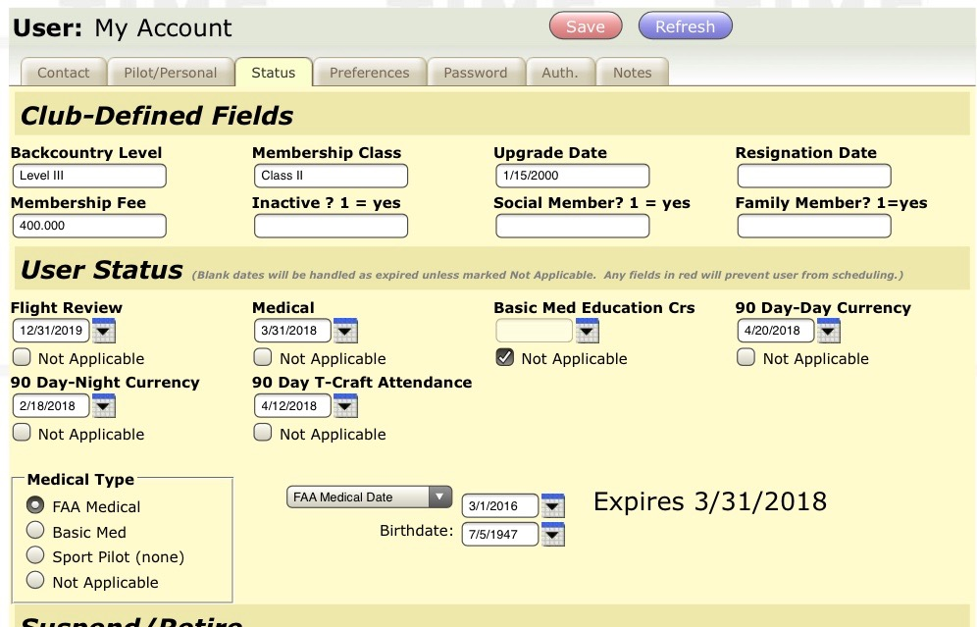
Fields have been provided in the “Status” tab of Schedule master to keep track of Day & Night 90 day Currency, and T-Craft attendance 90 day currency. The dates to be entered are the expiration date.

Slide 31
Attendance
As you know, we’ve suspended the attendance requirement and will resume as soon as we can.
No Attendance award this year.
A huge thanks to those of you who did attend the plane washes, Garden Valley Fly-in and virtual meetings.

Slide 32
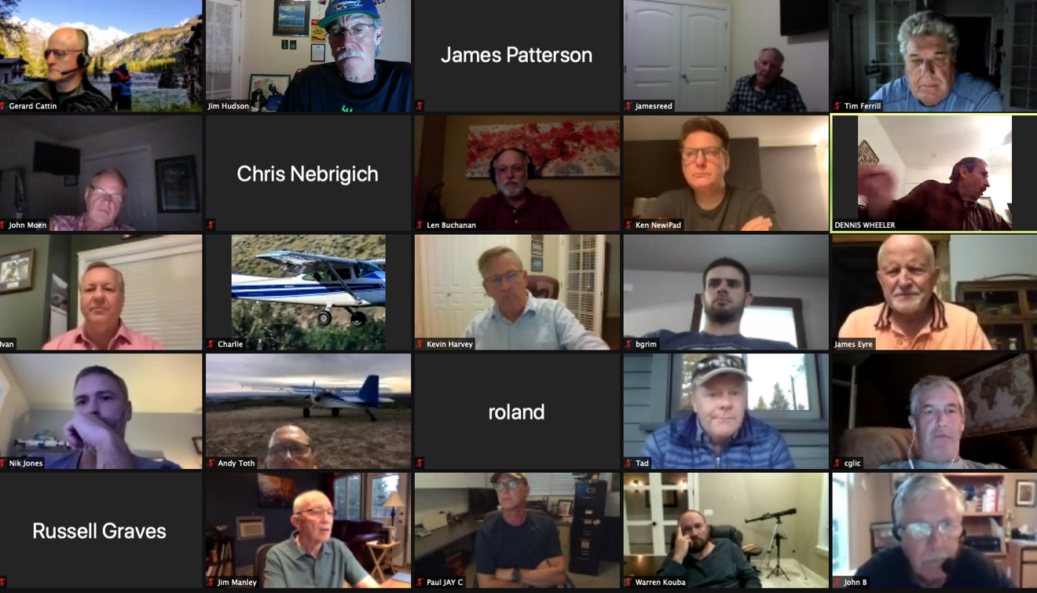
2020 Meetings

Slide 33
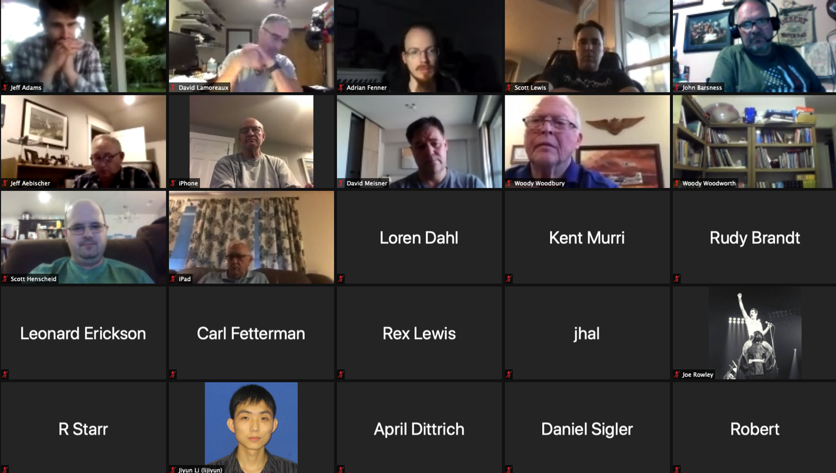
2020 Meetings

Slide 34

Fly Smart, Fly Safe
And Have Fun !
AND - Don't forget the mission abort button

Slide 35
Maintenance Director
Jim Eyre

Slide 36


Slide 37
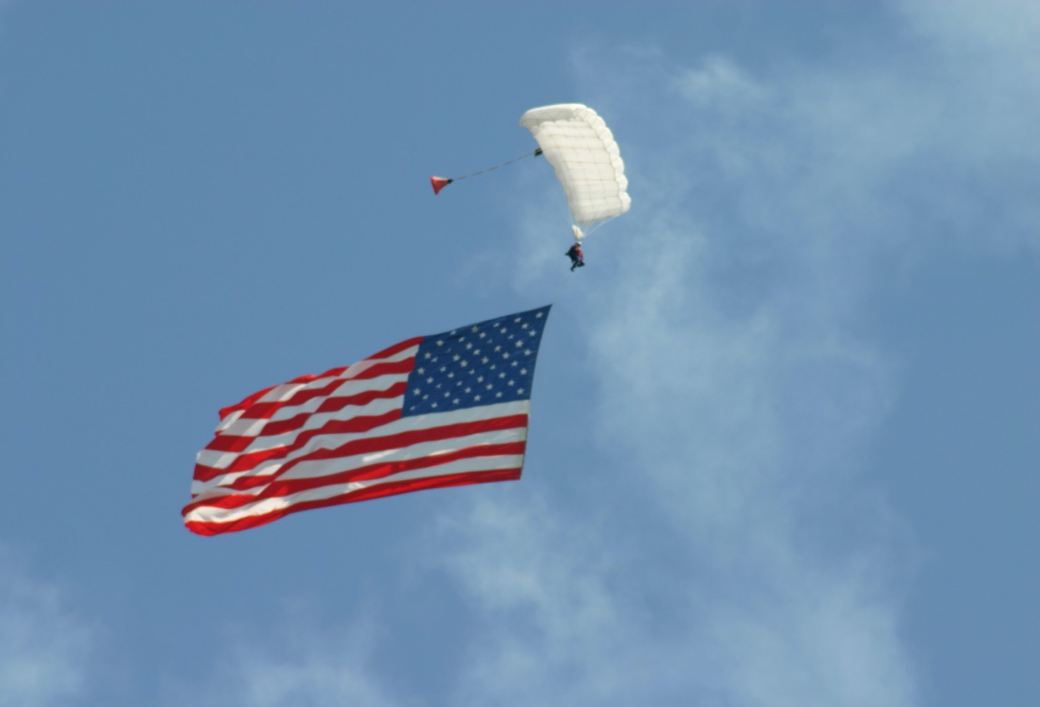
MAINTENANCE
2020

Slide 38
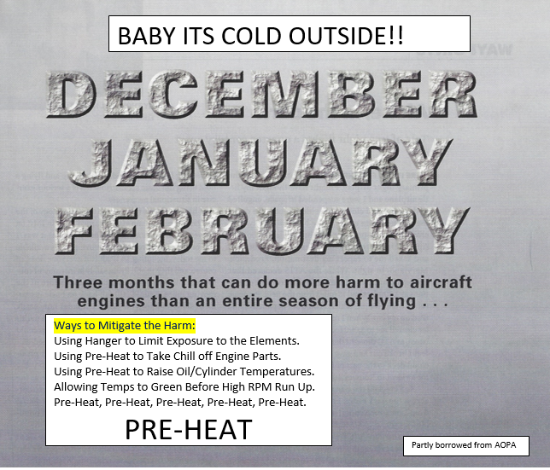

Slide 39
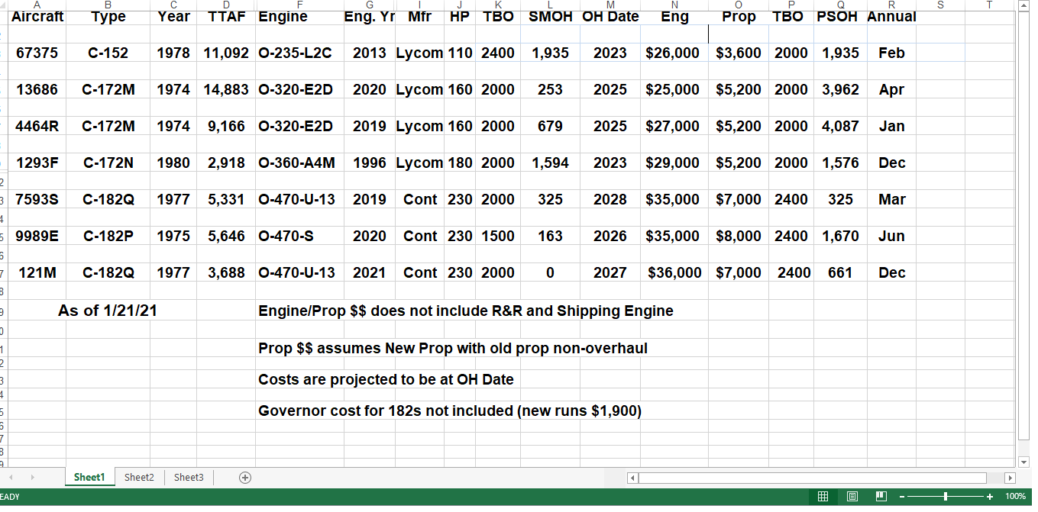

Slide 40
News Letter Articles
September 2019 – Tires – Making Them Last.
February 2019 – Carb Ice & Heat Boxes.
December 2014 – Brakes.
March 2015 – More About Brakes.
November 2016 – Winter Flying.
December 2017 – Baby It’s Cold Outside!
December 2013 – This is Stupid! Abort Button.
July 2014 – Certified Electronic Ignition (375).

Slide 41
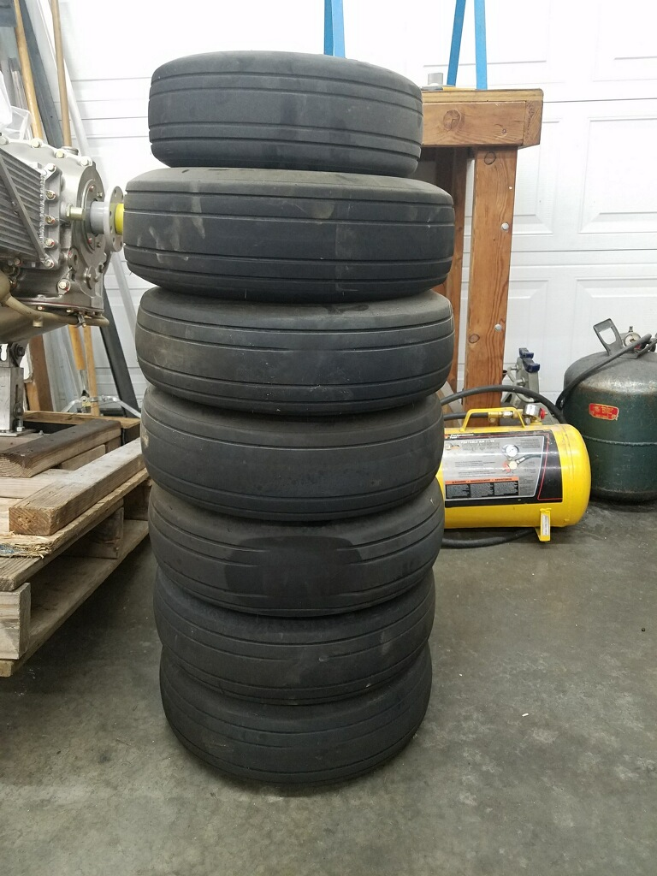
2020 YEAR OF THE TIRE

Slide 42
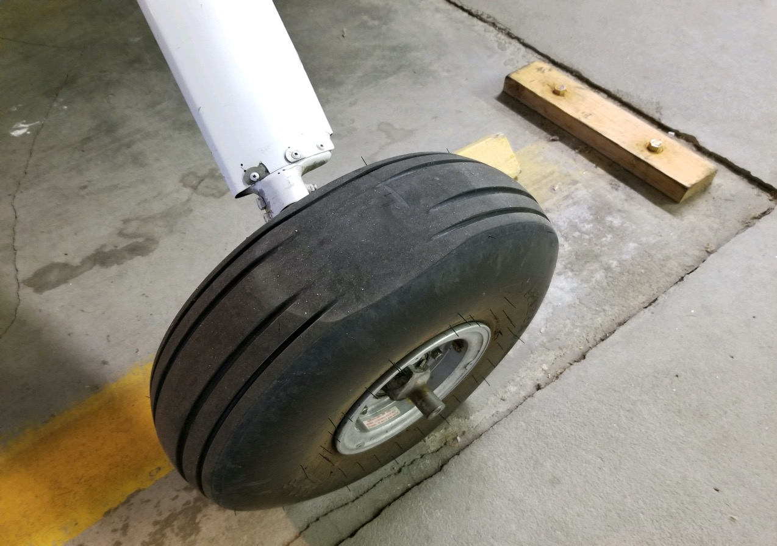

Slide 43
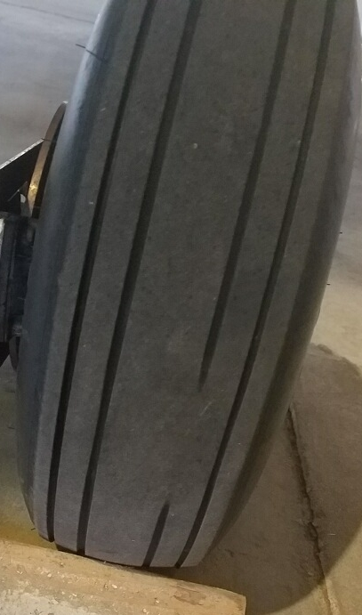

Slide 44
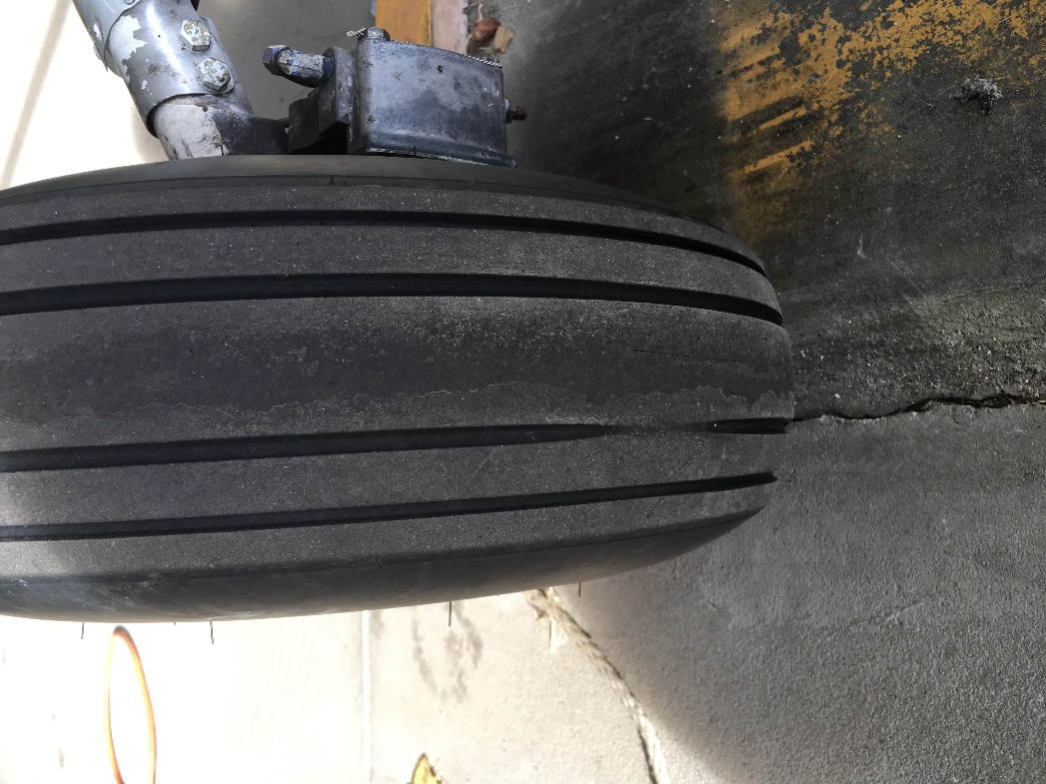

Slide 45
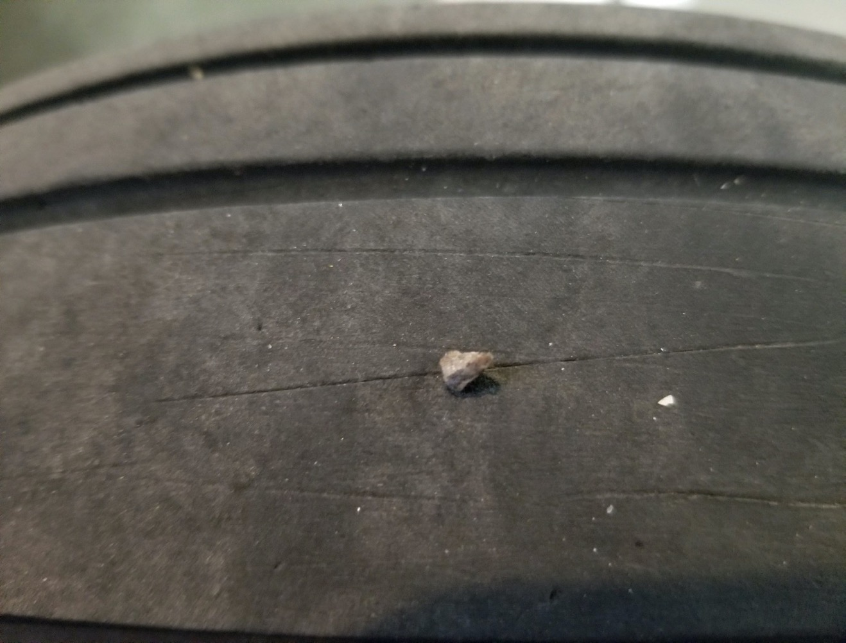

Slide 46
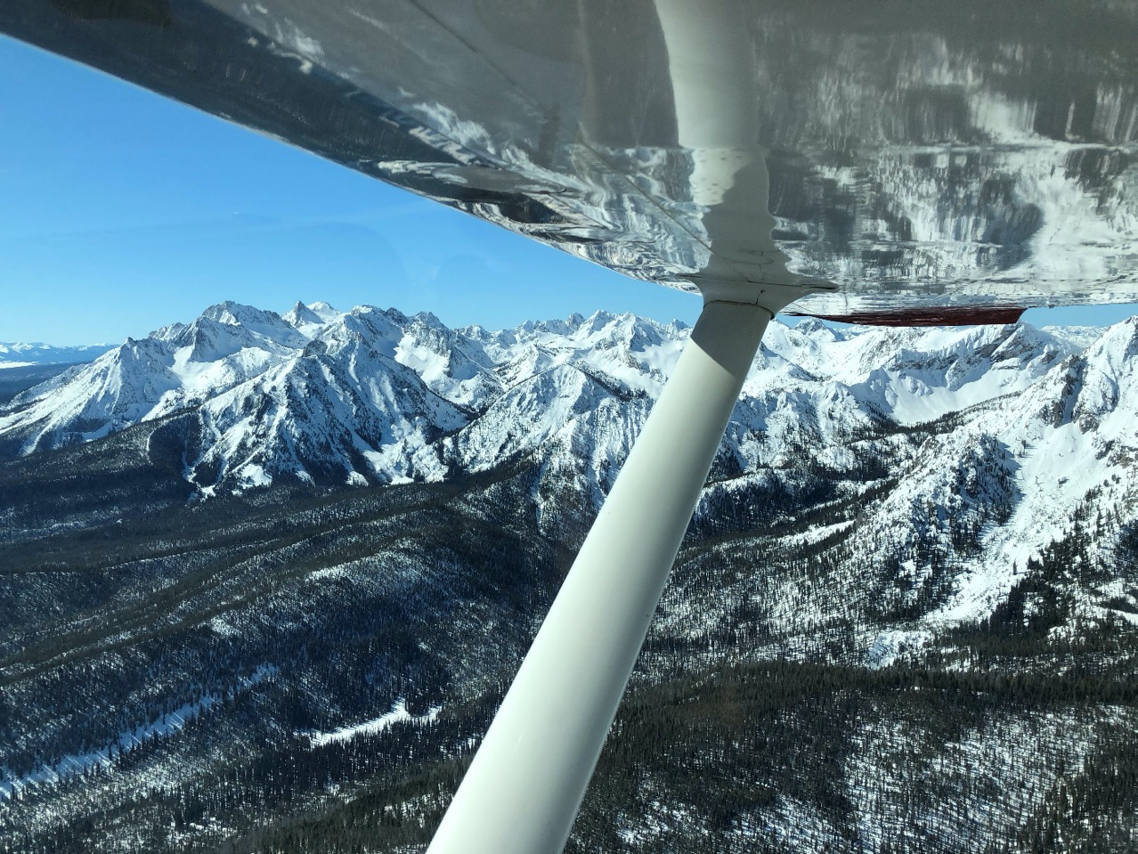

Slide 47
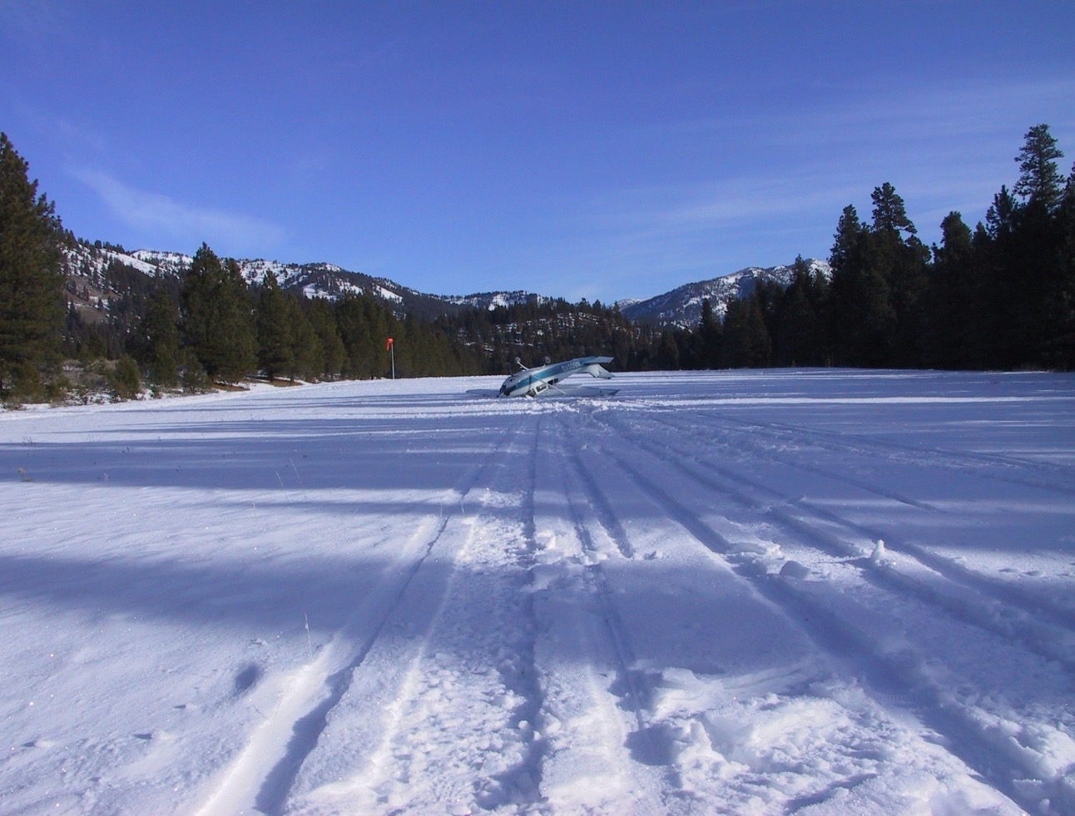

Slide 48
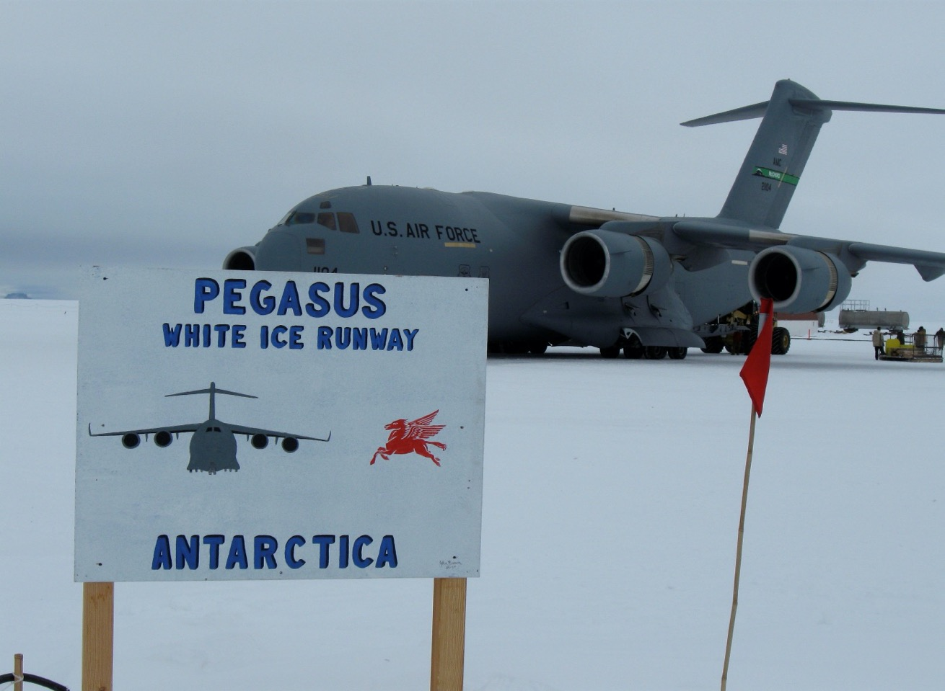

Slide 49
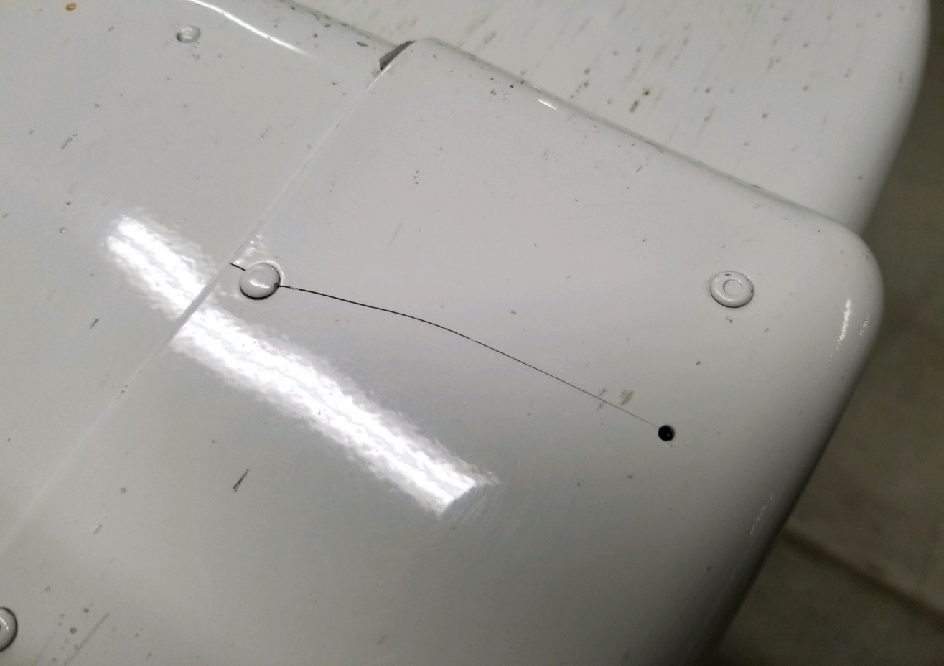
64 R
Elevator Tip

Slide 50
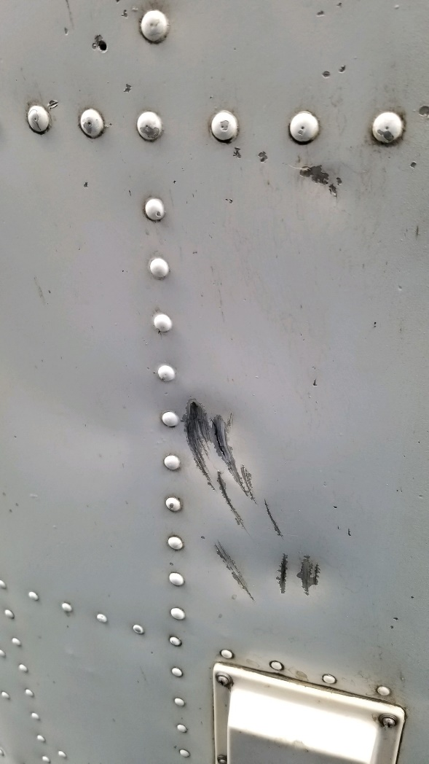
93S
Her Belly

Slide 51
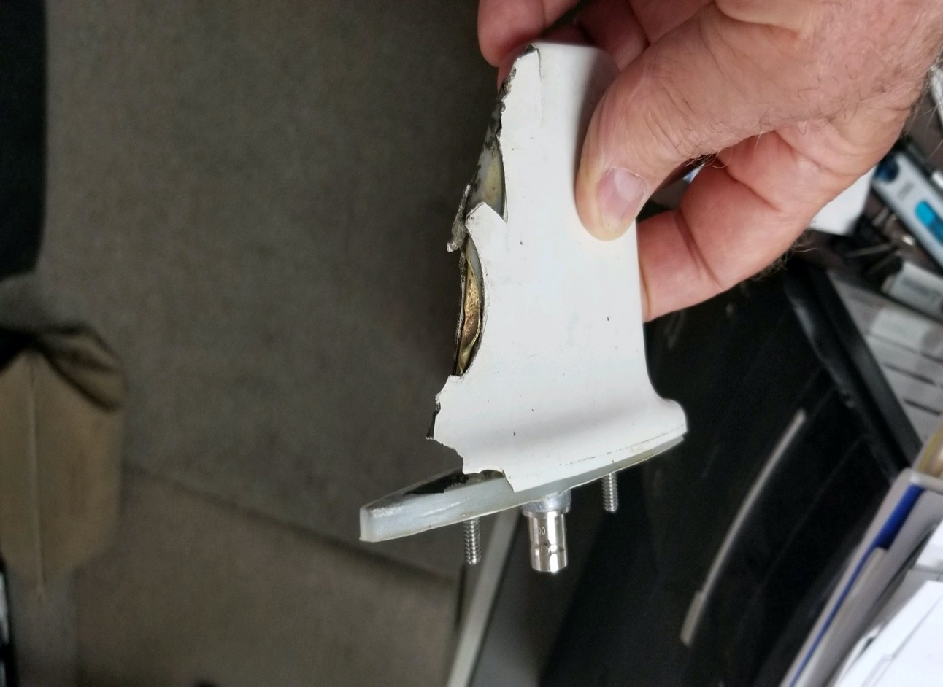
93S
Txp Ant

Slide 52
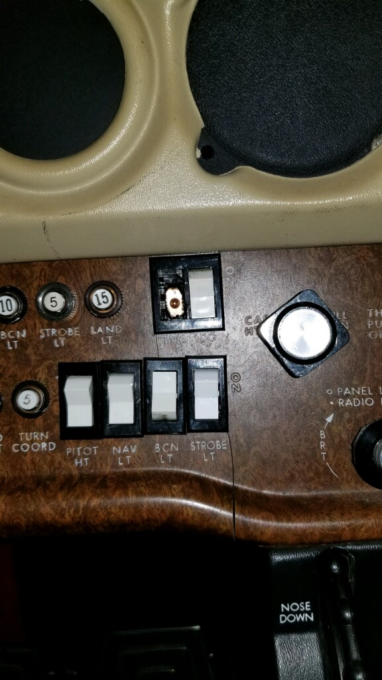
93F

Slide 53
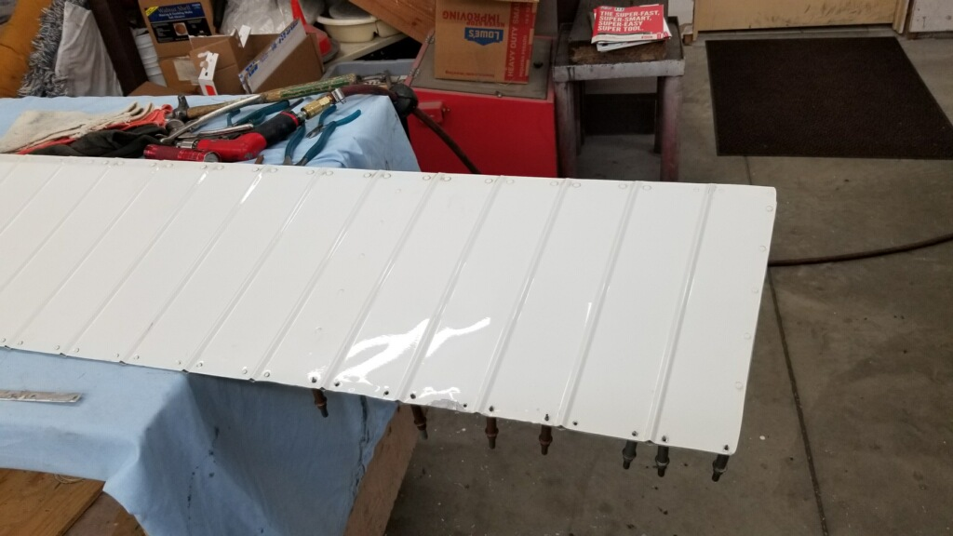
686

Slide 54
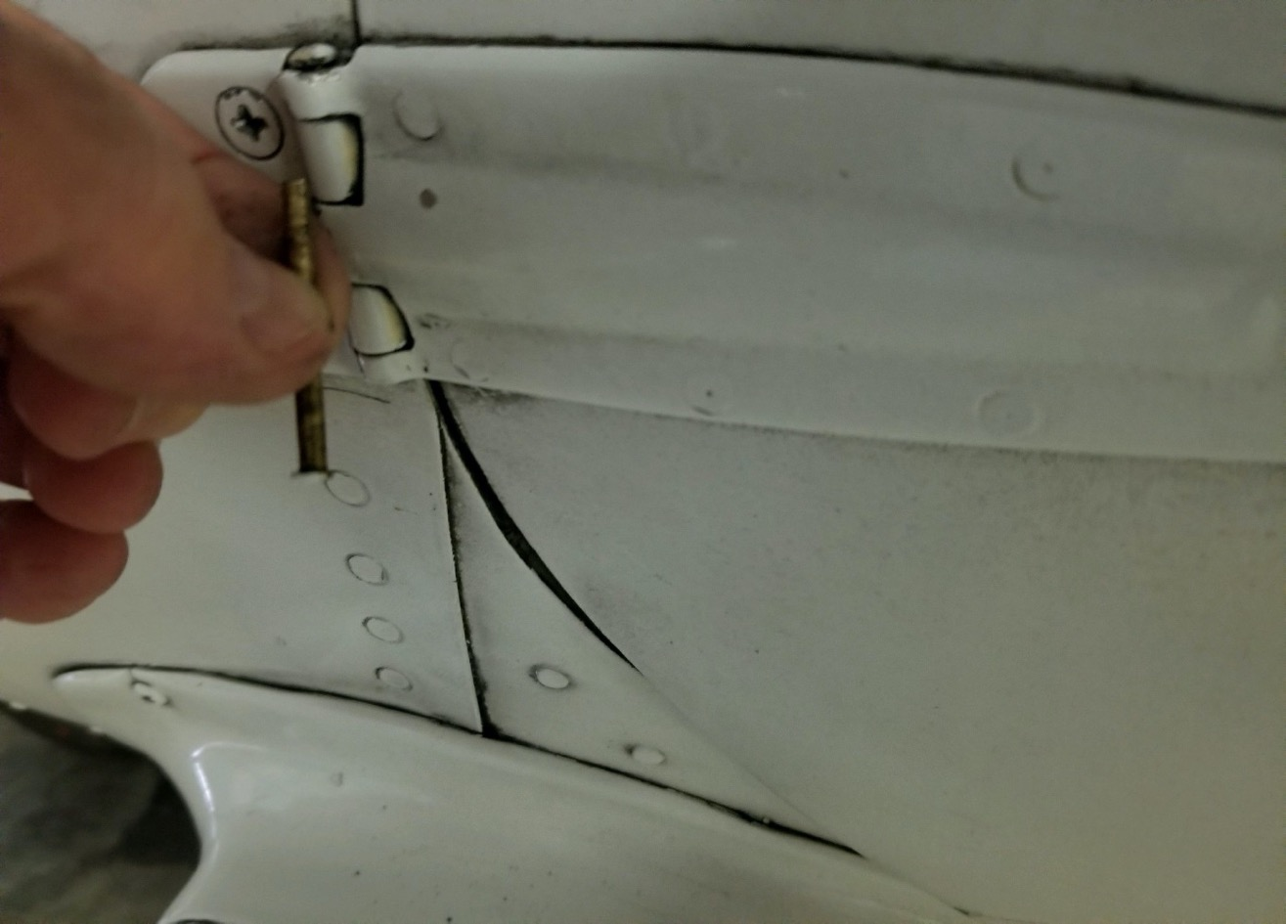
93S

Slide 55
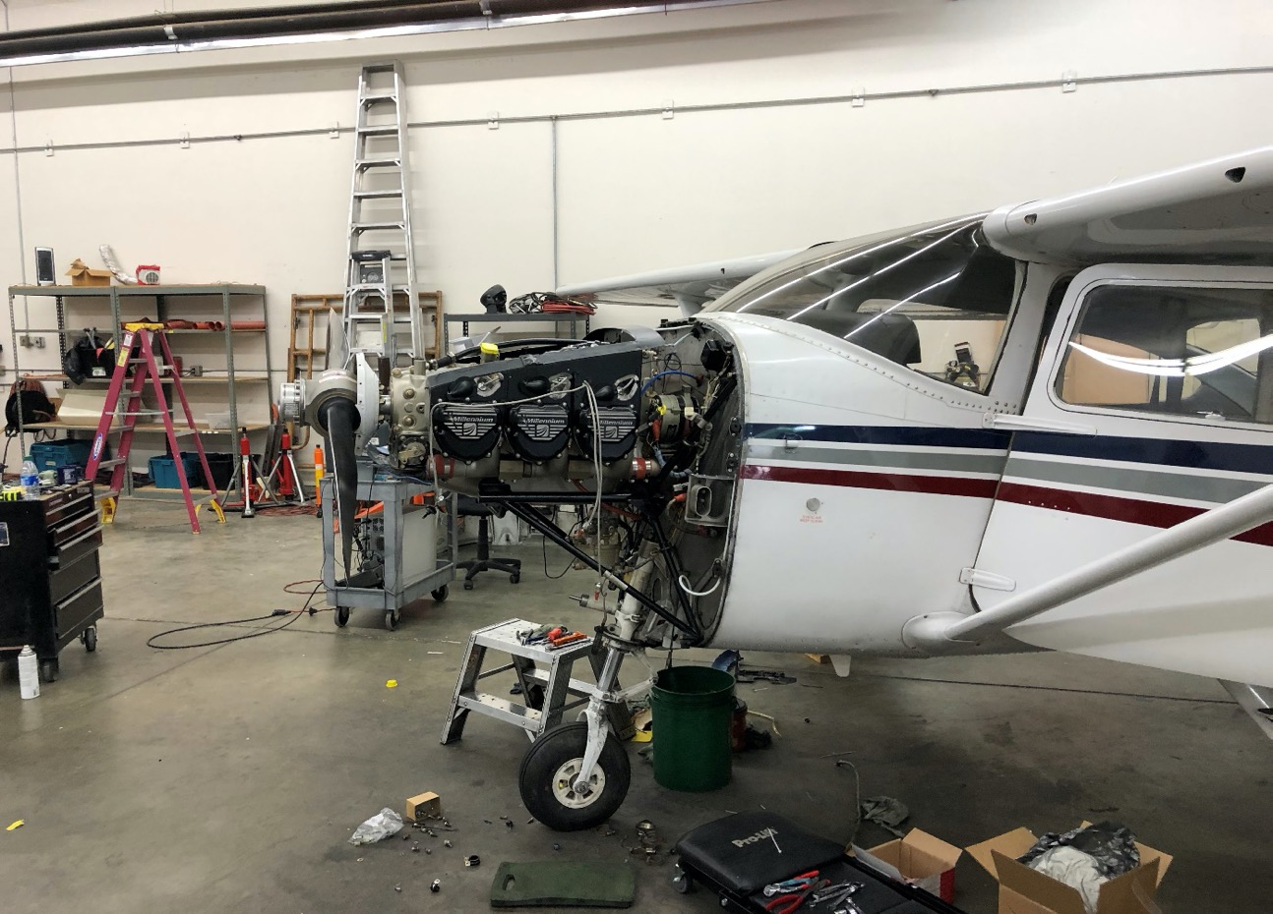
89E

Slide 56
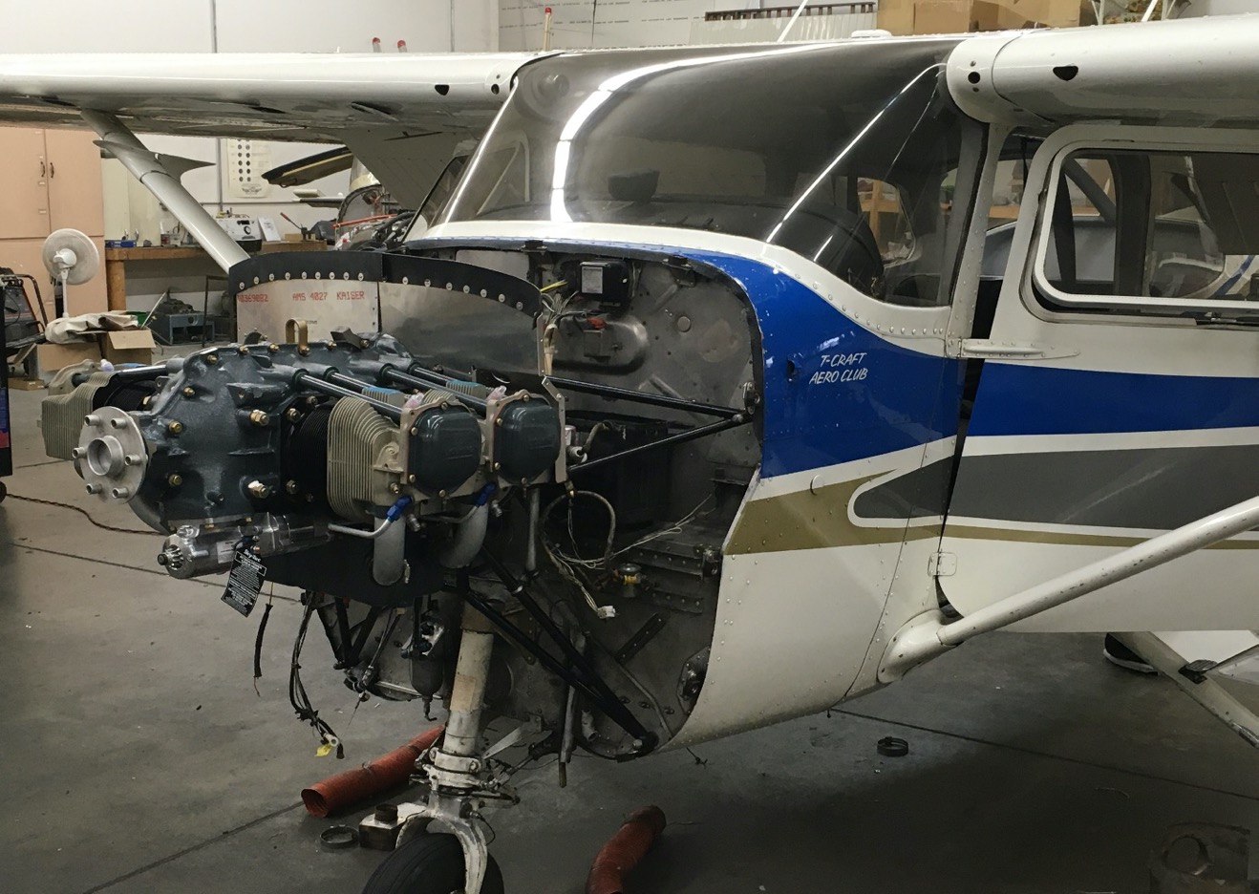
686

Slide 57
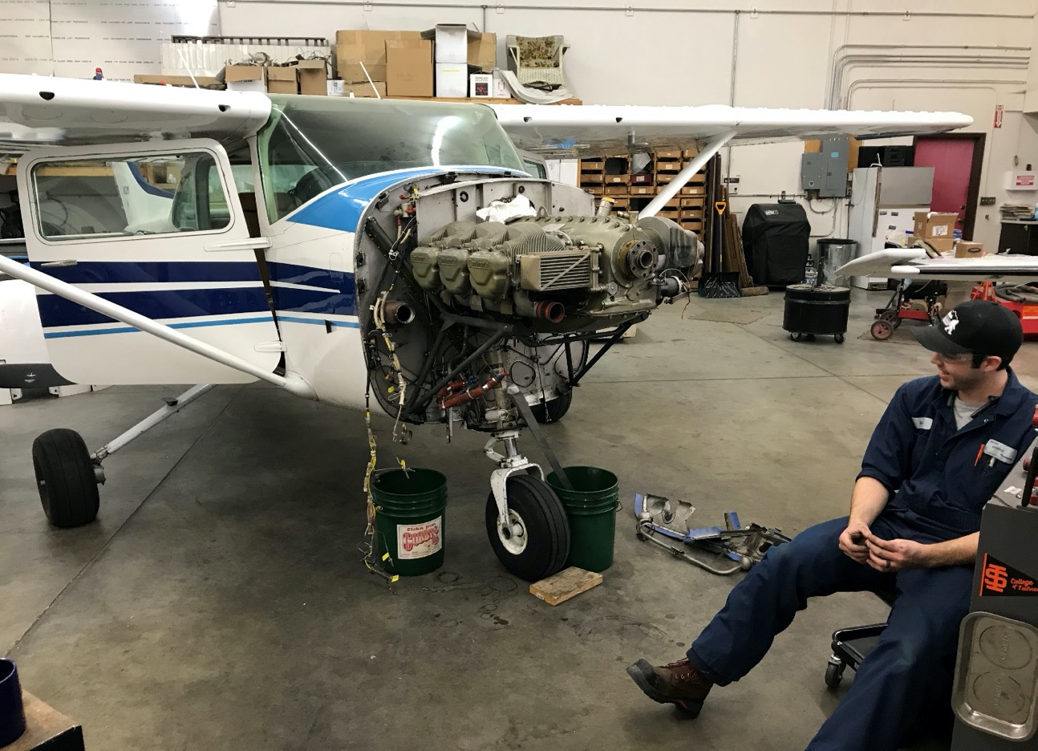
21M

Slide 58
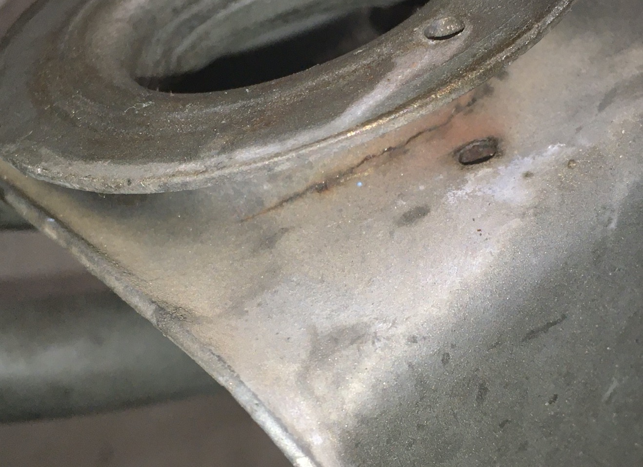
21M
Engine Mount

Slide 59
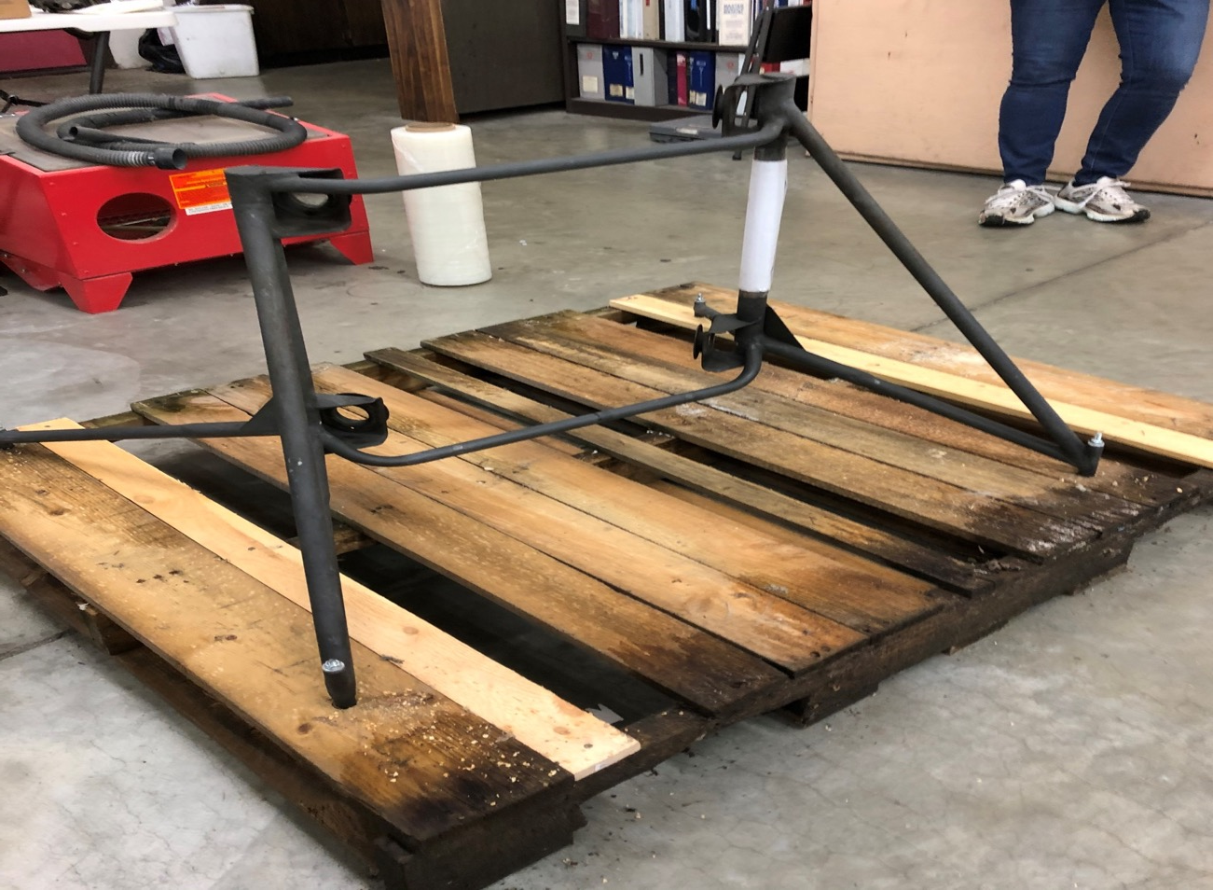

Slide 60
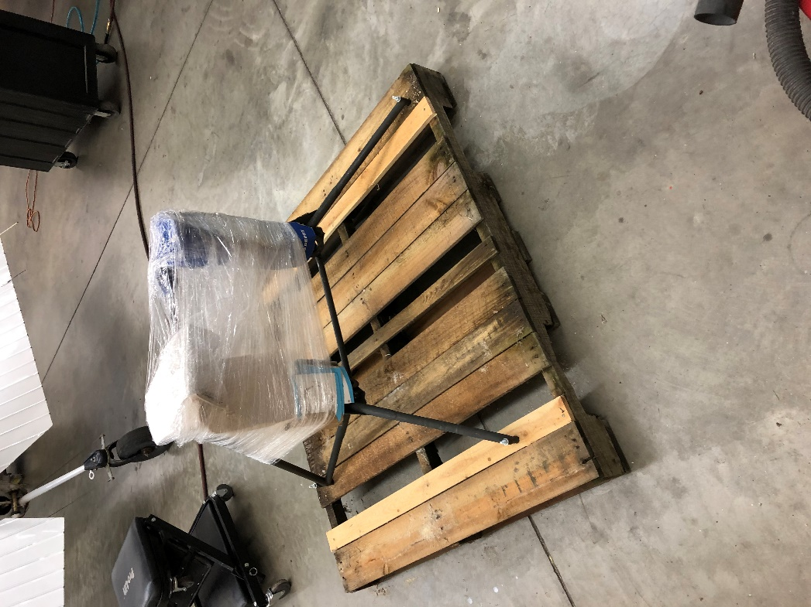
Engine Mount for 21M

Slide 61
