Slide 1
T-Craft Aero Club
Annual Report
2021
"Putting Wings On Your Dreams"

Slide 2
President
Ivan Sudac

Slide 3
Membership Fee
and Aircraft Rate Review

Slide 4
Membership Dues
Copies of club P& L Statement are available upon request

Slide 5
Membership Dues
The Monthly Dues remain the same @ $75/mo.

Slide 6
Hourly Rate Calculations
Based on the last 3 years averages.
The new rates will go into effect tomorrow, the start of the February billing cycle.

Slide 7
Treasurer
Ken Kaae

Slide 8
Club Cash Assets – 12/31/2021
Checking: $ 90,349.04
Savings (Engine Reserves): $ 49,119.47
Savings (Hull, Avionics & Paint): $ 49,558.75
Total Cash on hand 2021: $ 189,027.26
2020: $120,478.81
Banterra Bank Loan Balance for 21M $86,682.56
Remaining Hanger Loan Balance $109,426.04
Total Debt Owed by the Club $196,108.60

Slide 9
2021 Major Expenses
AvCenter (Fuel) $60,494.17
Aero Services (aircraft maintenance) $46,734.59
Skyline Avionics $15,428.00
Skyline’s amount reflects the costs of the audio panel
and transponder for 21M, and the new Garmin G-5’s for 375 and 21M. G-5’s are to be installed in Jan. 2022.

Slide 10
Billing Director
Reggie Sellers
2021 T-Craft Billing
From 12/26/2020 through 12/25/2021

Slide 11
Flight Log System
Benefits
-Billing Accuracy
-Convenience
-Paperless
-Users Can Review to 2010
-Multiple Monthly Reports
-2021 Added Maintenance Auto Texts and Emails
Logging
-Log Before and After Flights
-Enter Hobbs and Tach Time
-Enter Fuel and Oil Information
-Enter Specific Destination
-Report Issues to 208-861-6274
-Please Read Preface Letters

Slide 12
2021 Hours and Dollars Billed
Aircraft | Hours Flown | Dollars Billed
4464R | 481.0 | 39,403
13686 | 449.3 | 36,738
1293F | 291.6 | 26,449
9989E | 239.0 | 30,839
67375 | 186.3 | 14,333
7593S | 183.5 | 23,961
121M | 143.1 | 14,789
2021 | 1973.8 | 186,540
2020 | 1841.0 | 152,313
2019 | 2349.8 | 210,459

Slide 13
2021 Monthly Income from Billing (Dues, Must Fly, New Member Fees, Tax, Flight Hrs, Hangar Rental & Misc)
January 31,371
February 15,649
March 29,588
April 28,844
May 28,617
June 32,293
July 38,018
August 36,909
September 29,080
October 32,301
November 31,454
December 29,405
Total 2021 363,529
Total 2020 307,415

Slide 14
MEMBER INCOME and CREDITS DETAIL
2020 2021
Total Flight Dollars Billed 152,313 186,540
Minimum Use it or Lose it 27,998 34,943
Monthly Dues 81,890 103,649
Membership (New Members and upgrades) 30,300 16,900
Member Late Fees and FC 874 661
Hangar Rent 15,115 18,445
Monthly Board Credit -14,865 -16,157
Oil Change Credits -1,170 -949
Board Approved Credits (Sponsorship, misc) -1,118 -1,478

Slide 15
Top Ten Flyers 2020 - Hours Flown
1 | ? ? ? | 127.4
2 | David Nejely | 103.4
3 | Joe Rowley | 96.9
4 | John Szanto | 69.0
5 | Chris Nebrigich | 65.3
6 | Eric Bridges | 54.3
7 | Josh Brandt | 53.2
8 | James Patterson | 44.2
9 | Anna Grachanin | 43.7
10 | Daniel Sigler | 40.8

Slide 16
Top Flyer for 2021
Gerard Cattin

Slide 17
Secretary/Newsletter
Jim Manley

Slide 18
Records
12 Newsletters on T-CRAFT.ORG site
Provides detailed minutes of all proceedings.
9 Membership Meetings
12 Board and special board meetings.
Membership and Board meeting minutes in the file cabinets. Electronic version available on request
Photos of Garden Valley Fly-In and October Plane Wash

Slide 19
Contributions
Always looking for newsletter input
Article ideas
Interesting destinations
Flight experiences
Lessons learned
Photos

Slide 20
Director of Hanger & Safety
David Thomas

Slide 21
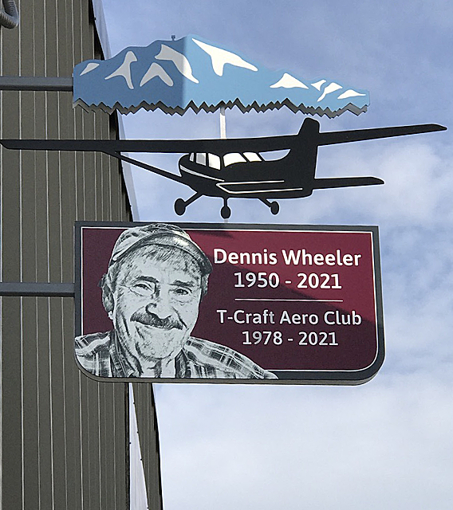
Hanger Activities
Dennis Wheeler Monument
Heater Carts
Overhead Power Cord Reels
Continuation of LED Lamp
Deployment (Approx 50% Complete).
Two new computers in club office.
New BBQ donated to the club for club
functions

Slide 22
Safety Activities
3/30/2021: Round table safety meeting with Rolland Stedham, Ivan Sudac & James Patterson.
4/20/2021: Backcountry Seminar by Jim Hudson.

Slide 23
Maintenance Director
Jim Eyre

Slide 24
Maintenance 2021

Slide 25
Based on Tachometer Readings

Slide 26
Oil Usage 2021
Based on Hobbs Readings
Plane Hours Quarts Oil
686 449.3 3.5
375 186.3 14.0
64R 481.0 1.0
93F 281.6 10.0
21M 143.1 2.0
93S 183.5 .5
89E 239.0 7.5

Slide 27
121M
Thanks to Len Erickson, for fixing clips to all tow bars.

Slide 28
686 Fuel Sending Unit

Slide 29
686 Float & Pins (hold lanyard for fuel cap).

Slide 30
686 Bent Push Rod

Slide 31
686 Cylinder damage

Slide 32
93F

Slide 33
89E

Slide 34
375

Slide 36
21M Engine Mount

Slide 37
Shipping 21M Engine Mount

Slide 38
21M

Slide 39
21M
Jeff
Mike

Slide 40
21M
Zack

Slide 41
0YD

Slide 43
Membership Director
Jim Hudson

Slide 44
Membership Status
Year End 2021
120 Members: (120/20,106/19,104/18, 105/17,105/16, 83/15, 60/14)
34 Wait list: (31 last year) 35 now
15 New members: (28/20, 20/19,13/18 16/17, 34/16, 29/15)
15 Resigned: (14/20,18/19, 14/18,16/17, 11/16, 6/15)
26 Suspended: (22%) and/or Inactive (13)
37 Class I (31%) / 83 Class II (69%)

Slide 45
Member Ratings
End of 2021
(Previous
Year)
12 (13) Student Pilot Rating
69 (65) Private Pilot Rating
28 (28) Commercial Rating
11 (13) ATP Rating
47 (48) Instrument Rated Pilots

Slide 46
15 New Members 2021

Slide 47
15 Members Resigned 2021

Slide 48
Schedule Master &
Webpage Updates
Members need to keep email, phone, change of address updated on SM.
Members need to provide copies of updated to driver licenses, medicals, flight reviews, flight certificates for the club records
Webpage – Aircraft Fleet pdf -POH, Avionics documents, training video’s, other documents in “Index” tab.
New Webpage developed by Scott Henscheid - THANKS Scott
Web Host Provider changed – Webintellects to namcheap.com
Board public emails changed to xxxxx@t-craft.org and phone numbers removed from our public webpage.
Club AME listing in the works for club member AME’s. Dr. Mark Turner and Dr Jon Miller.

Slide 49
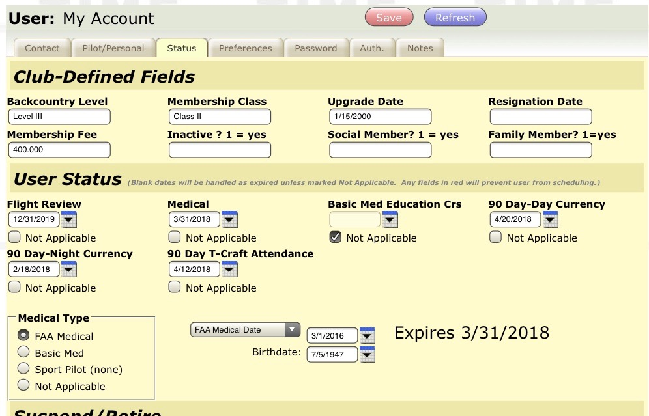
Fields have been provided in the “Status” tab of Schedule master to keep track of Day & Night 90 day Currency, and T-Craft attendance 90 day currency. The dates to be entered are the expiration date.

Slide 50
Top Attendance
(27 Club Events in 2021)
???? | ?????? | 15
Scott | Henscheid | 14
Chris | Nebrigich | 14
Scott | Lewis | 12
David | Meisner | 12
John | Moen | 12
Rob | Starr | 12
Woody | Woodbury | 12
Jeff | Adams | 11
Jeff | Aebischer | 11
Leon | Baker | 11
Adrian | Fenner | 11
Russ | Graves | 11
Gordon | Hall | 11
Kevin | Harvey | 11
Tad | Jones | 11
Dave | Miller | 11
David | Nejely | 11
Mark | Slusser | 11

Slide 51
Top Attendance for 2021
Joe Rowley

Slide 52
Club Events 2021
January – Annual Review / Elections
April 30 – Poker Run, 30 Participants
April 20 – BC Country Presentation – Jim Hudson, 54 Attendees
May 18, – Spring Plane Wash, 57 Attendees
June 18-19, – Garden Valley Fly-In, 57 Attendees
October 7, – Fall Plane Wash, Record 71 Attendees !
General Membership Meetings – Average between 50-70

Slide 53
Club Events for 2022
January 25th – Annual Review / Elections
April 10-16, Poker Run
April 19 –T-Craft Backcountry Presentation – Jim Hudson
May 17 – Plane Wash
June 17-18 – Garden Valley Fly-In
TBD 50th Anniversary of T-Craft Aero Club Celebration
October 4th – Plane Wash

Slide 54
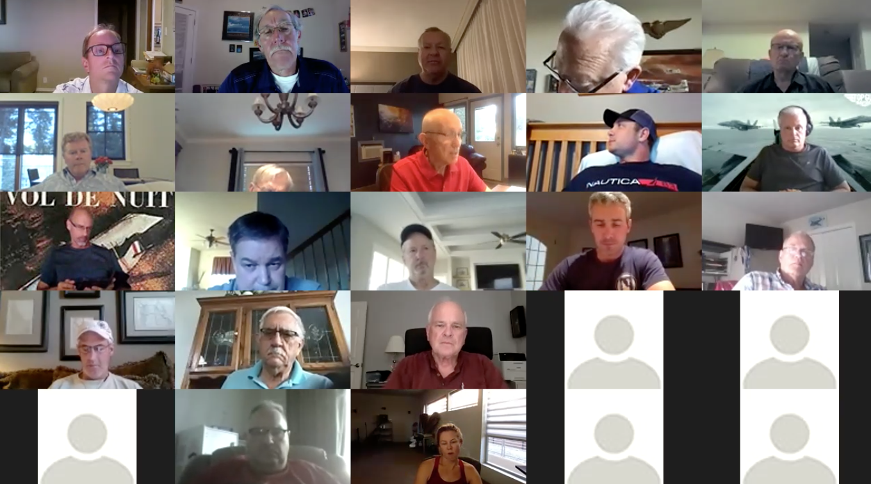
2021 Meetings

Slide 55
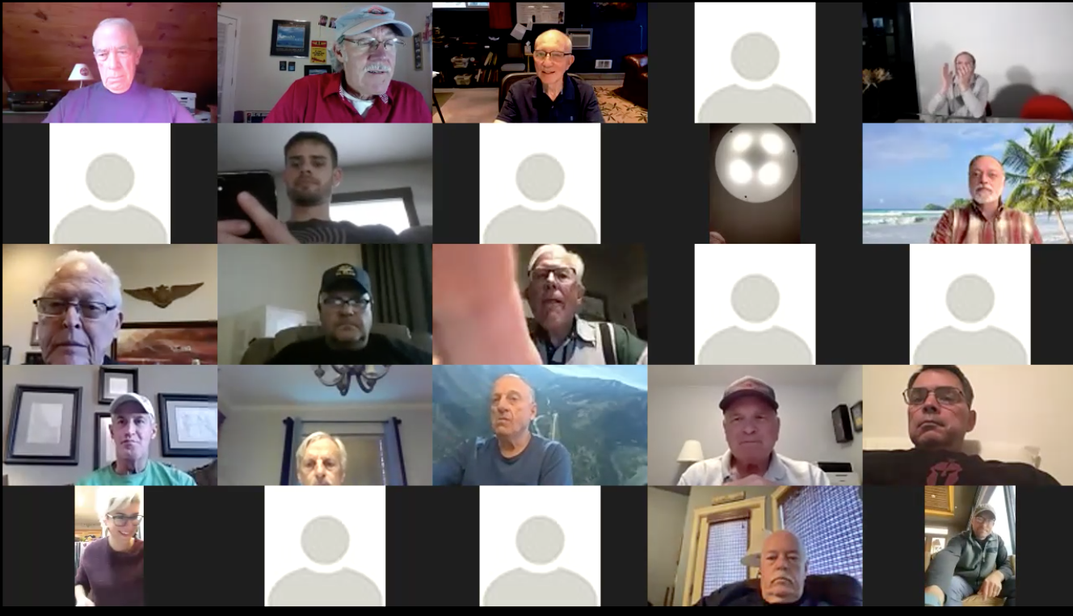
2021 Meetings

Slide 56
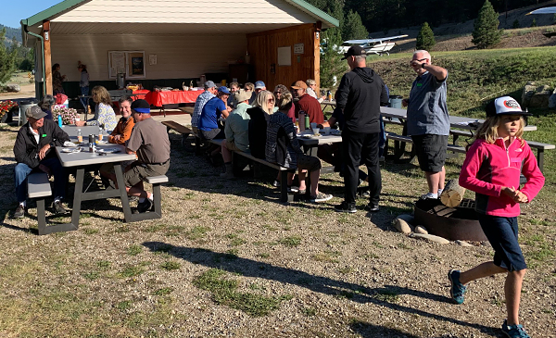
Garden Valley Fly-in

Slide 57
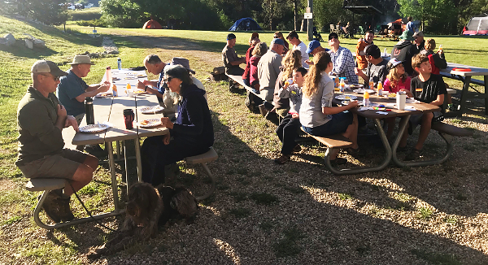
Garden Valley Fly-in

Slide 58
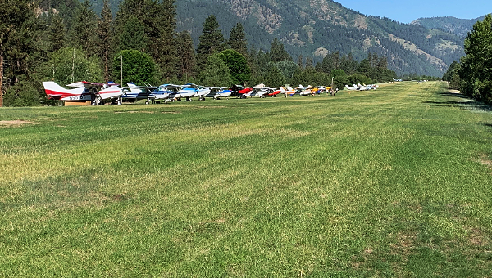
Garden Valley Fly-in

Slide 59
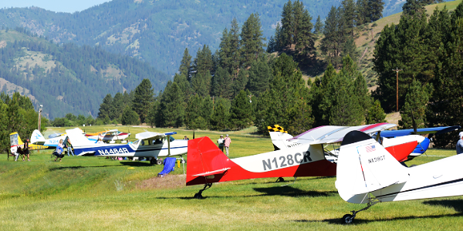
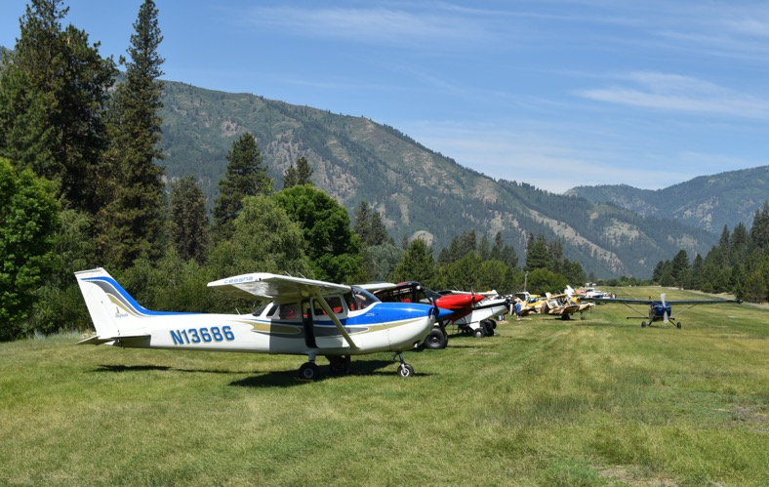

Slide 60
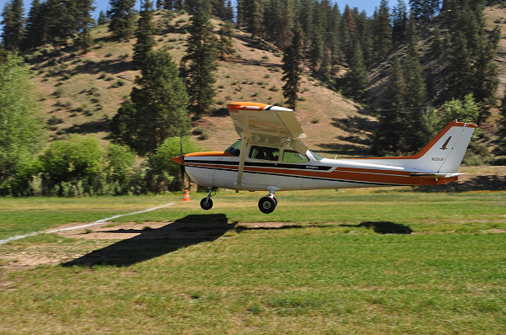
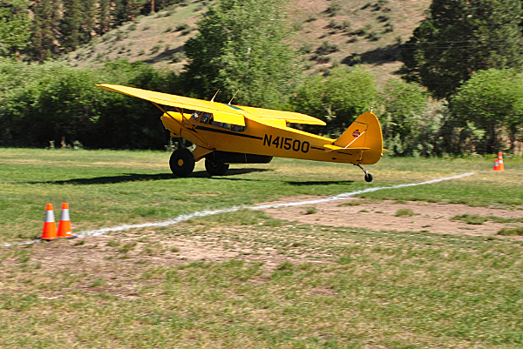

Slide 61
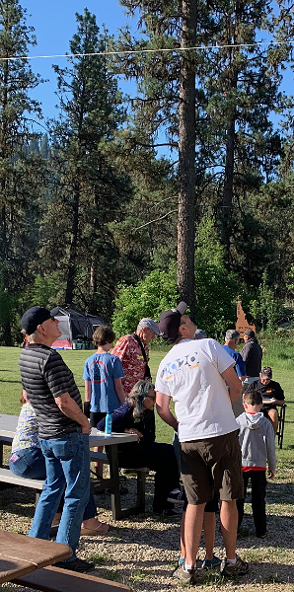
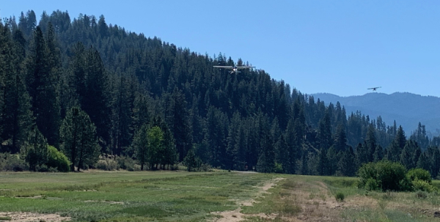
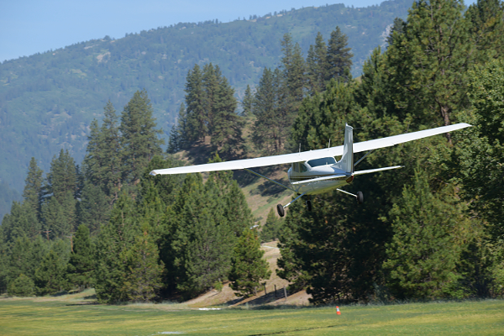

Slide 62
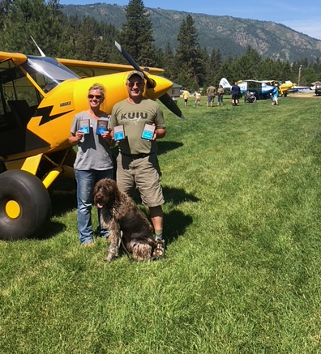
Garden Valley Fly-in
Ben (Top Gun) and Vivian (Bombardier) Brandt

Slide 63
October Plane Wash

Slide 64
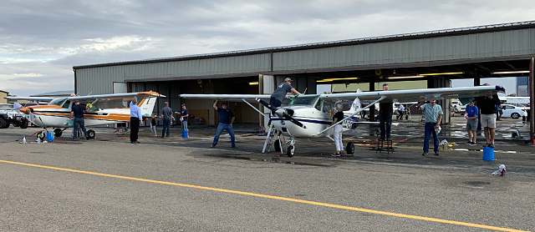
October Plane Wash

Slide 65
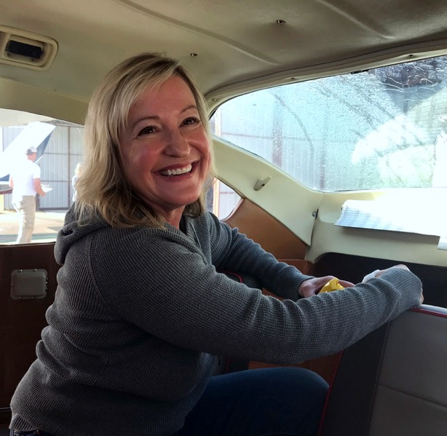
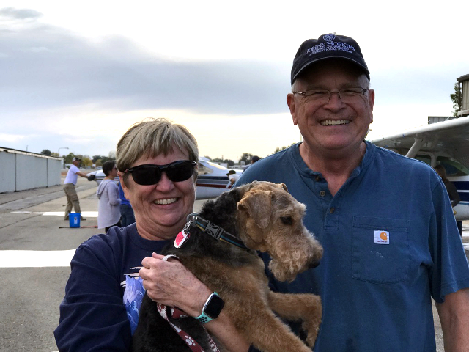
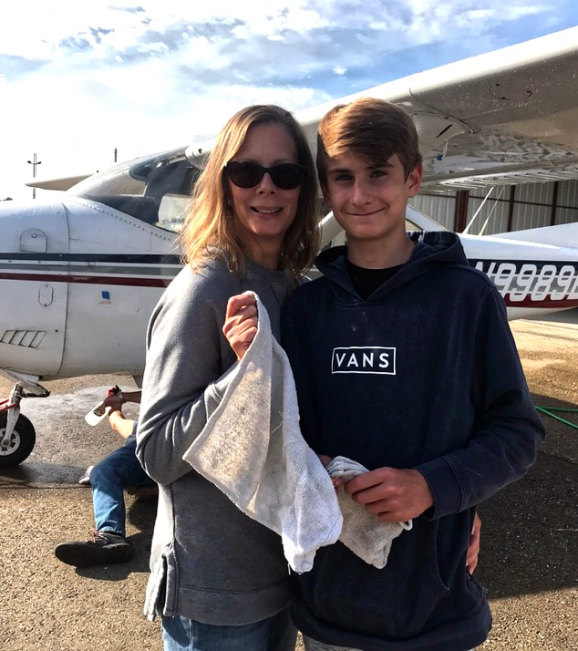
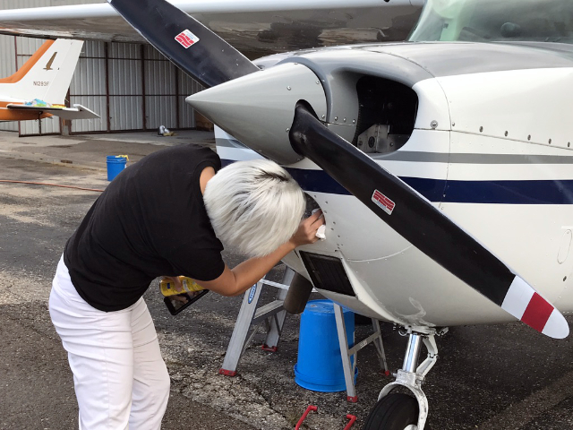

Slide 66
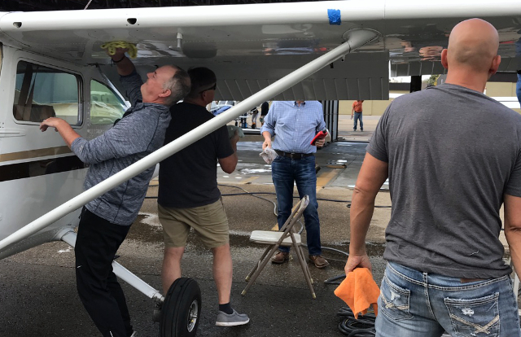
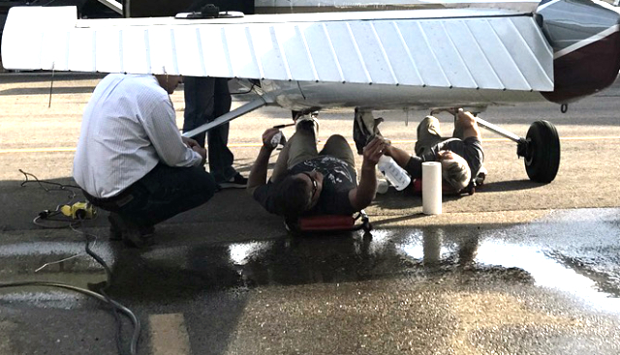
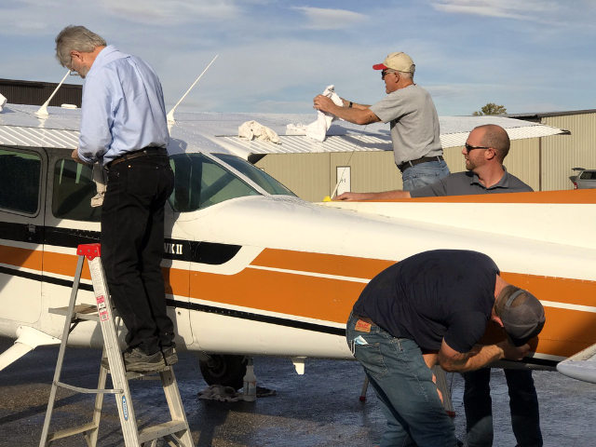
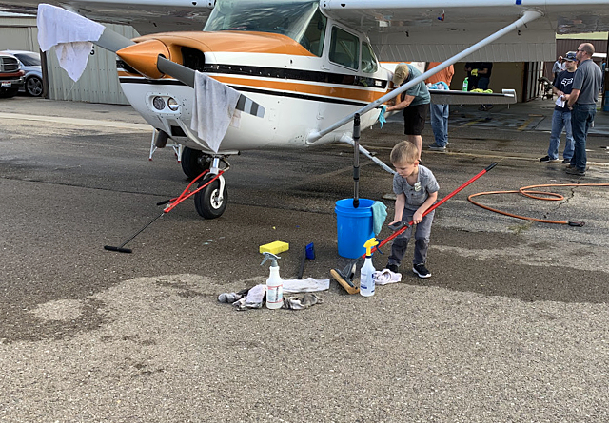

Slide 67
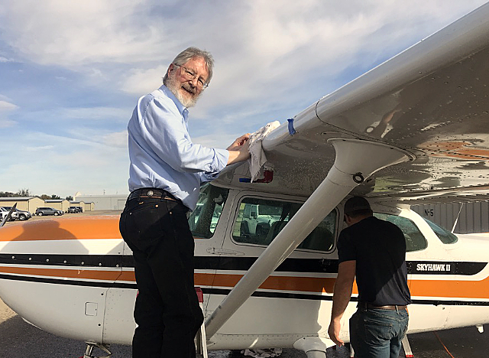
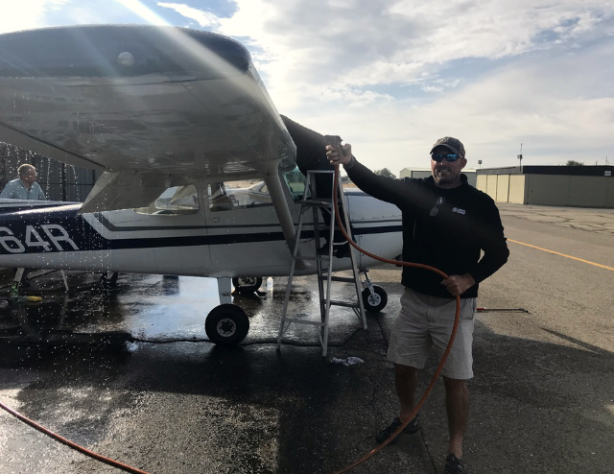
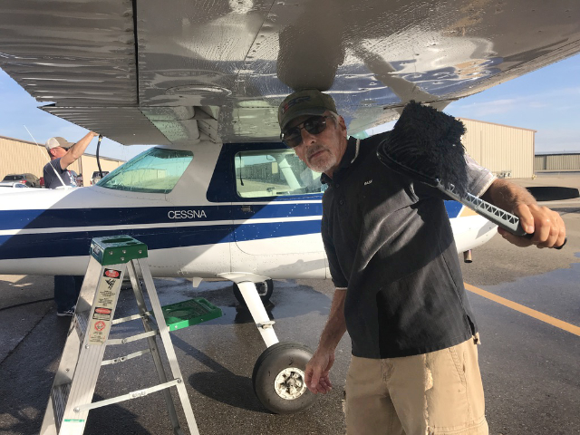
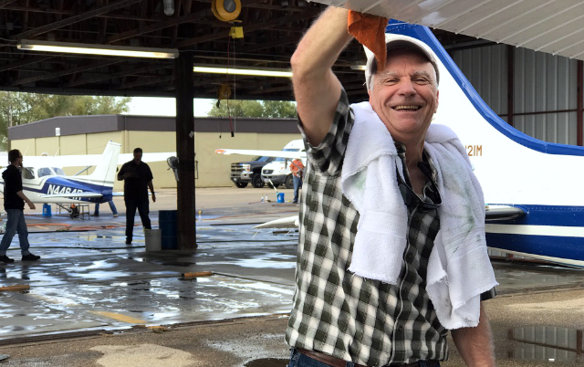

Slide 68
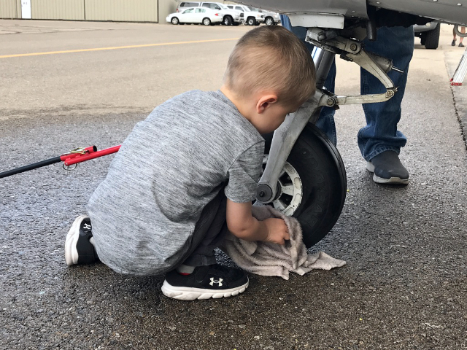
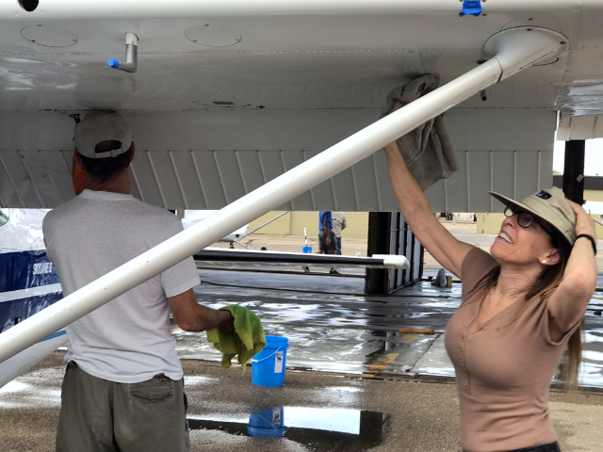
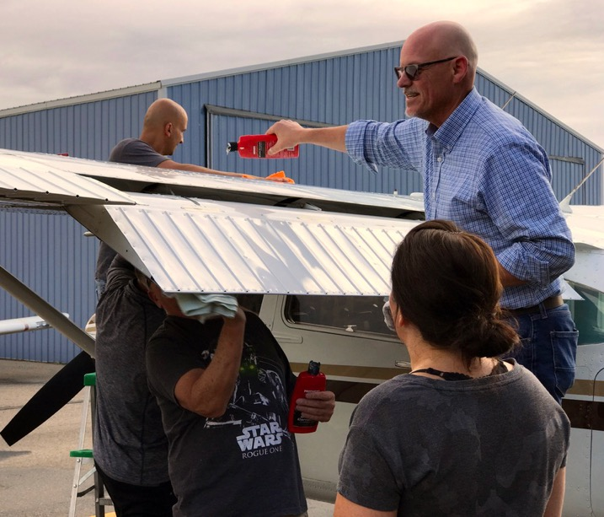
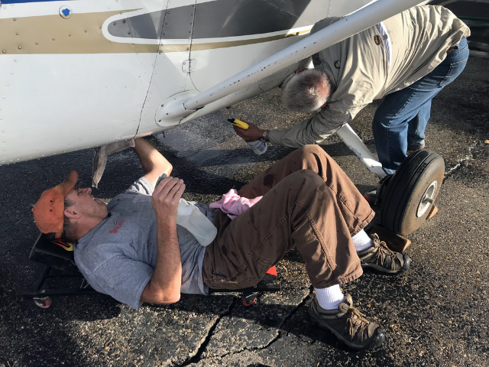

Slide 69
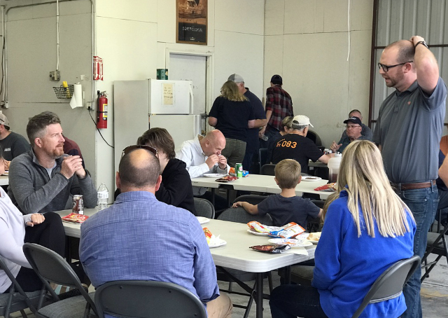

Slide 70
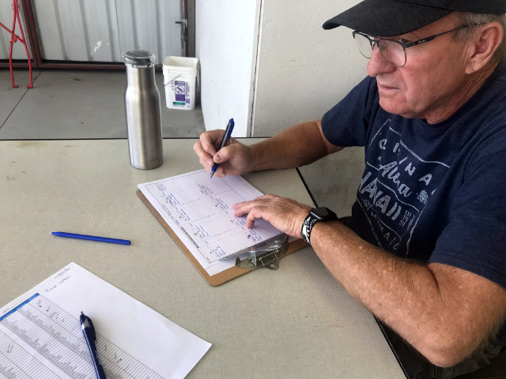
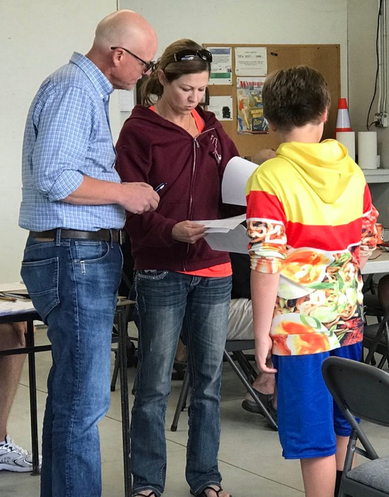
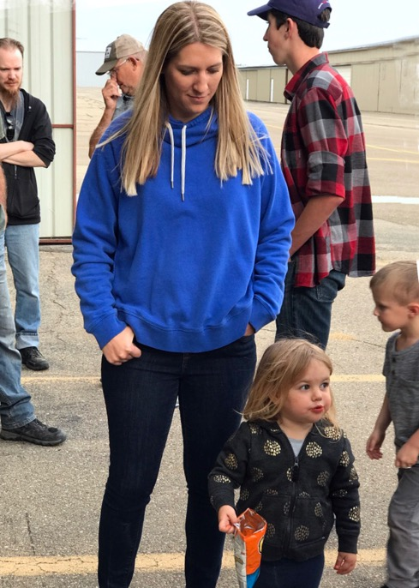

Slide 71
Fly Smart, Fly Safe
And Have Fun !
AND - Don't forget the mission abort button

