Slide 1
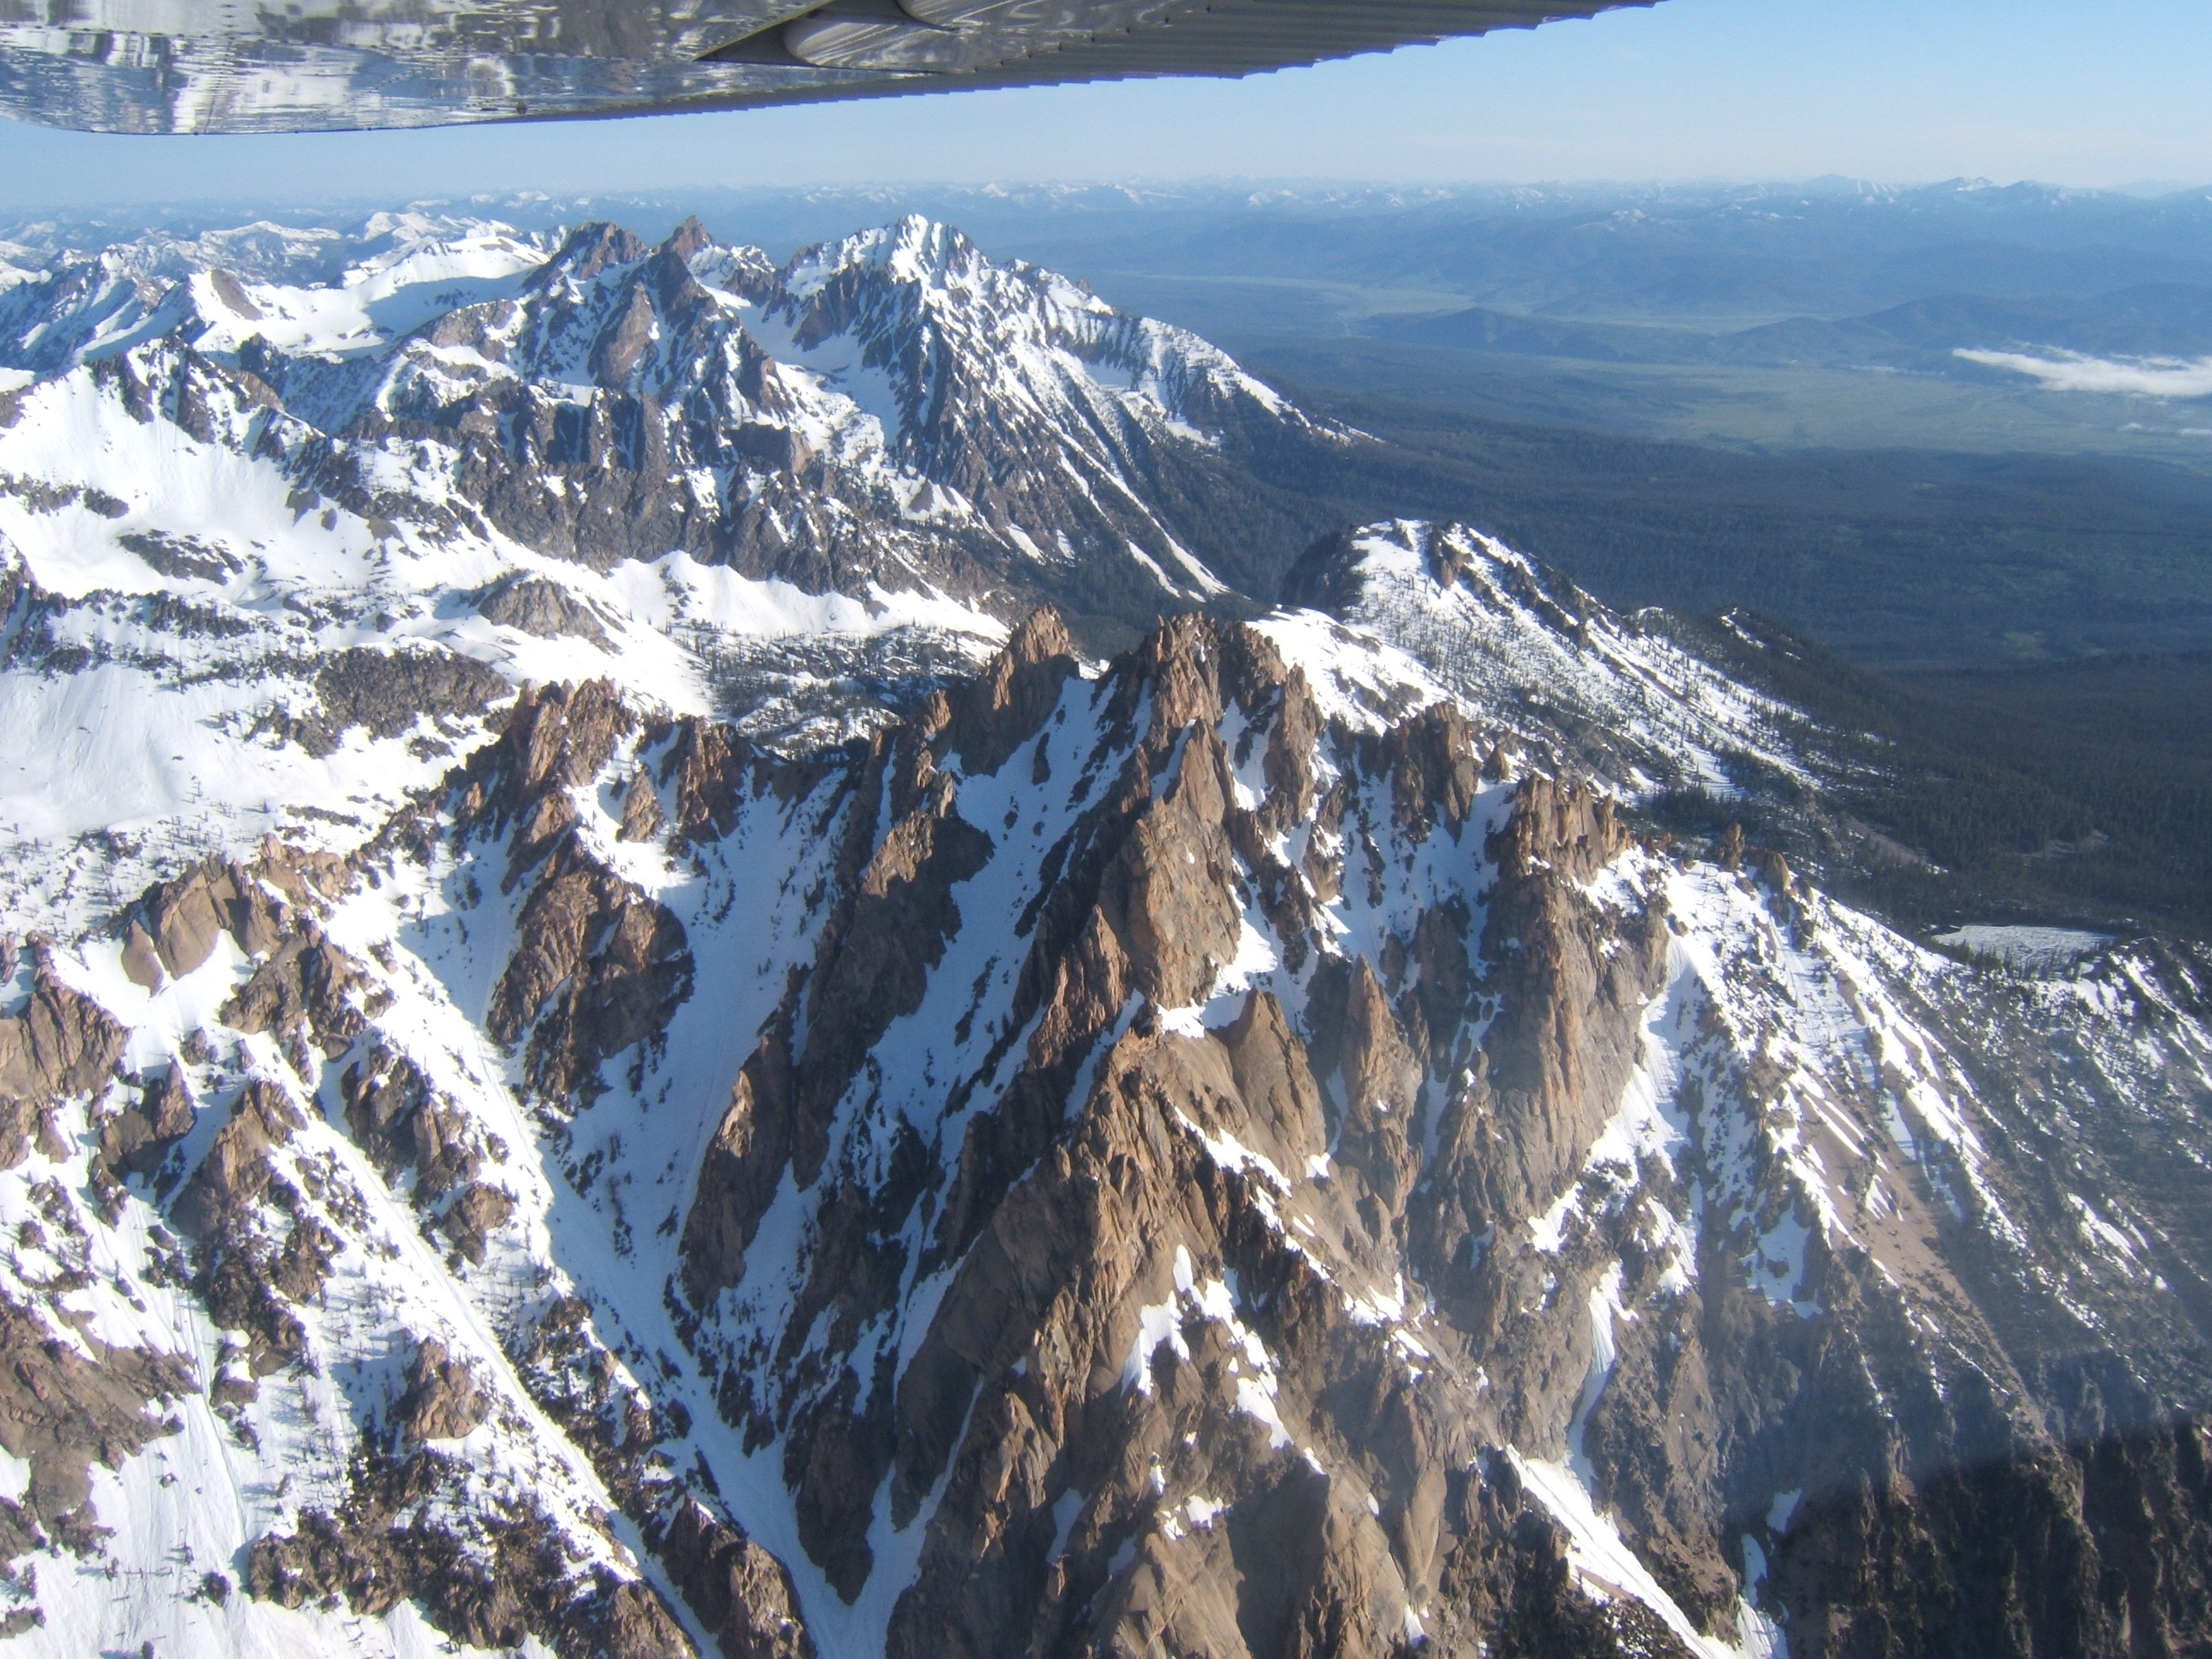
Flying The Idaho Back Country
T-Craft Aero Club
March 26, 2026
Jim Hudson
Gordon Hall
Pete Glick
Jim Manley
Notes:
The Sawtooth Mountains - just south of Stanley over Redfish Lake looking North

Slide 2
PLAN - PREPARE - PRACTICE
        Planning. - Jim Hudson
        Prepare - Gordon Hall
        Prepare - Pete Glick
        Practice -Jim Manley

Slide 3
PLAN - PREPARE - PRACTICE
Planning. - Jim Hudson
Level 1 BC Trip Plan
  Route - flight time/fuel
  WX forecast: Winds/Temps/DA
  Airport research
  Take off/Climb/Land work sheet
Homework review- Take off / climb calculations

Slide 4
PLANNING – Jim Hudson
PREFLIGNT PLANNING
GENERAL
Aircraft – Extra attention to brakes, wheels, tires, Tire Pressure. Bring tie down ropes, stakes, tow bar, extra oil, window cleaner, towels, survival and 1st aid kit, fuel measuring stick.
ROUTE PLANNING
Select destinations capable of plane performance, weight, and pilot skill.
Plan route – fly roads, rivers, valleys, meadows, airstrips – maximize emergency landing possibilities.
Choose Altitude – VFR alt. when possible, at least 1000’ over peaks, passes.
Plan alternate routes (low level) for weather, low ceilings.
Estimate flight times, fuel burn (1 hr. min reserve to refueling locations)

Slide 5
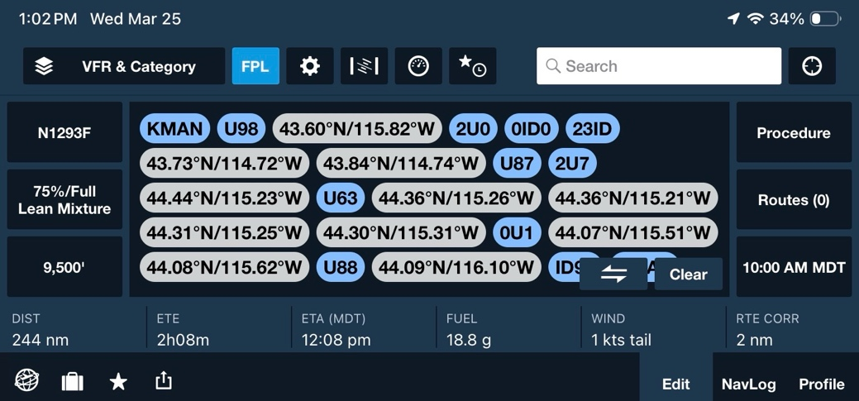
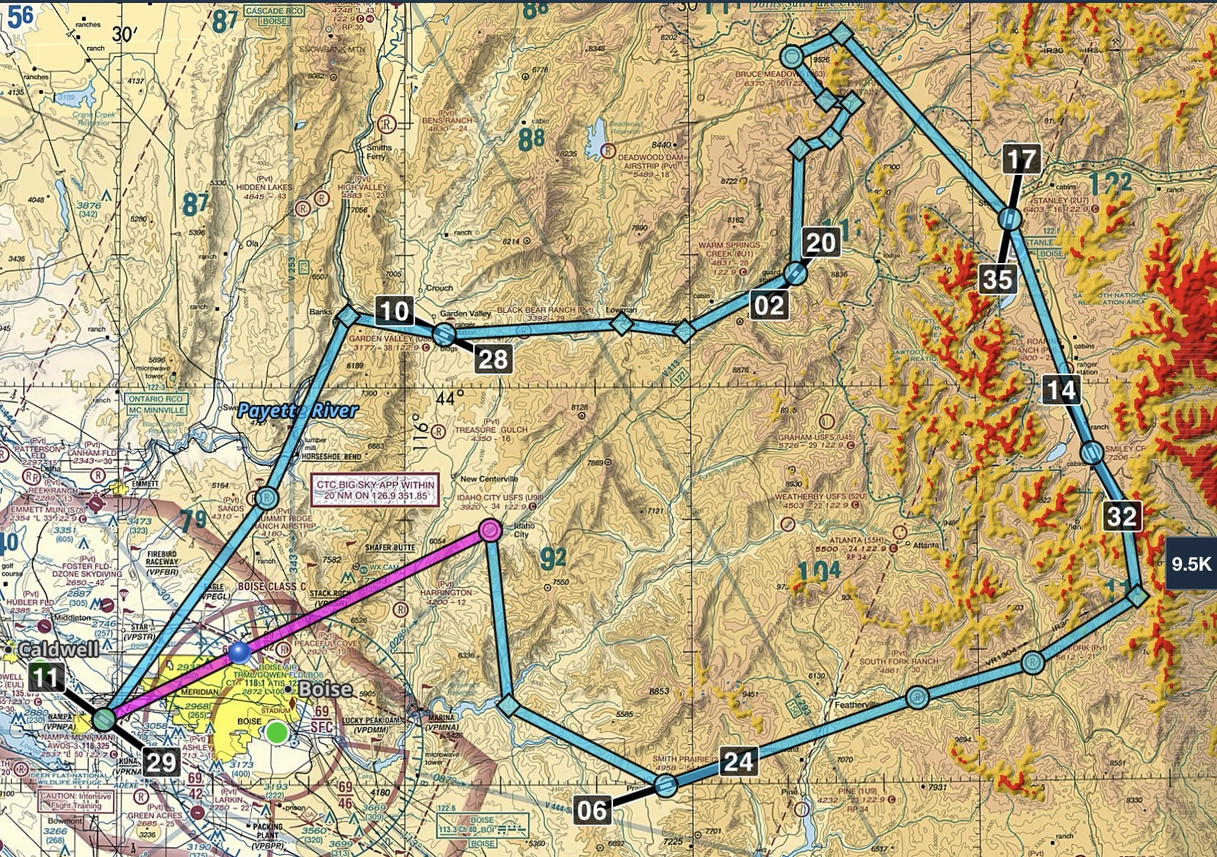
Route:
Level 1 Ck Out
U98 - Idaho City
2U0 - Smith Prairie
U87 - Smiley Cr.
2U7 - Stanley
U63 - Bruce Meadows
0U1 - Warm Springs
U88 - Garden Valley

Slide 6
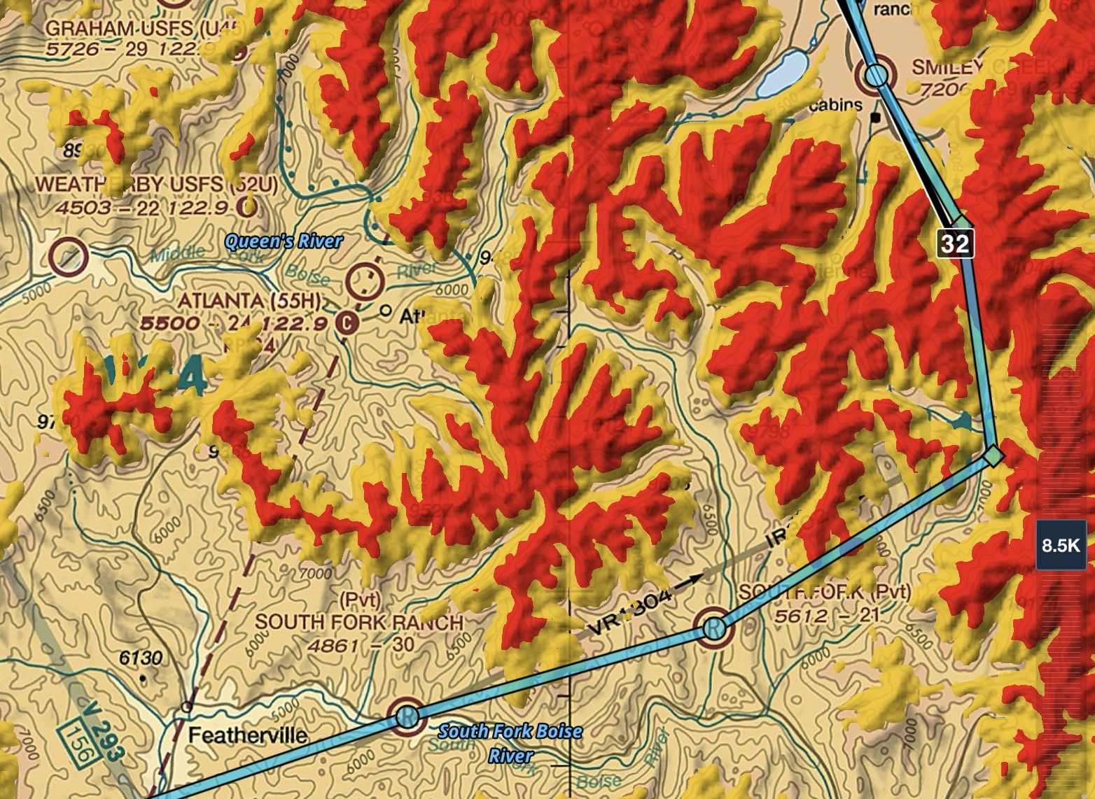

Slide 7
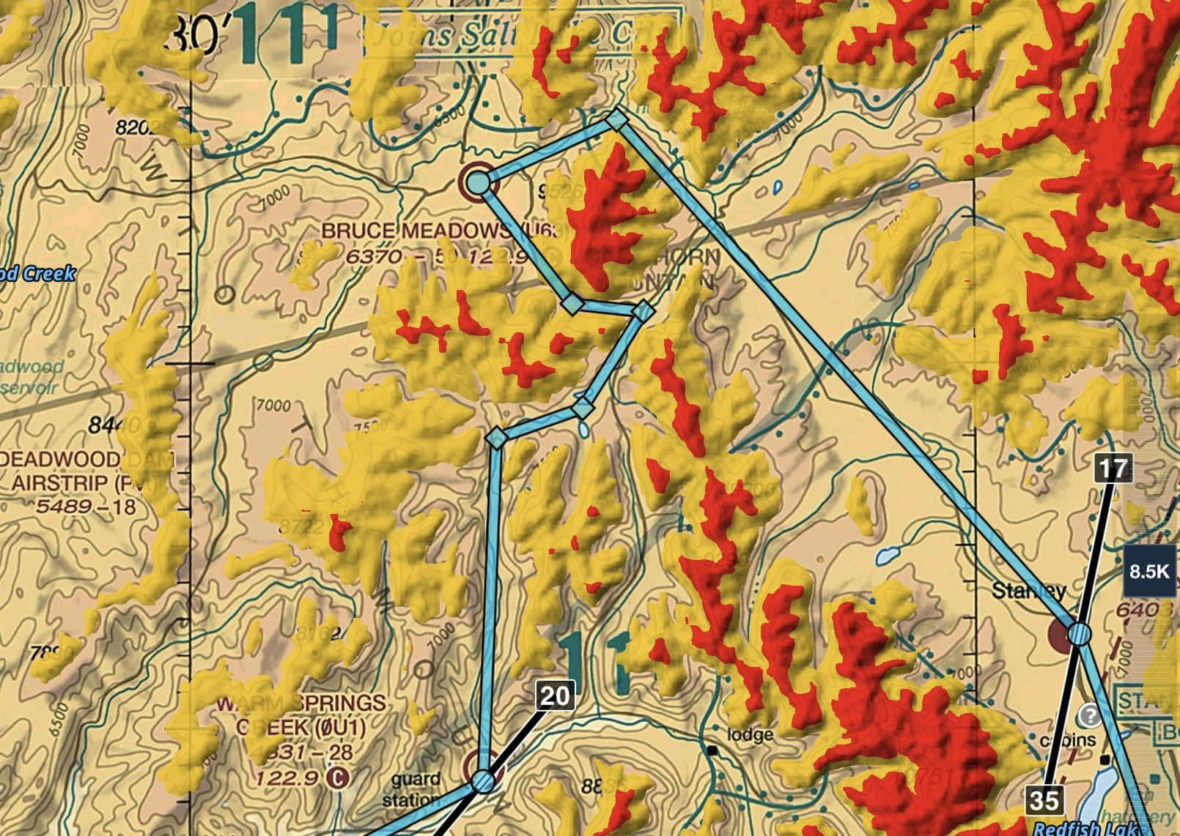

Slide 8
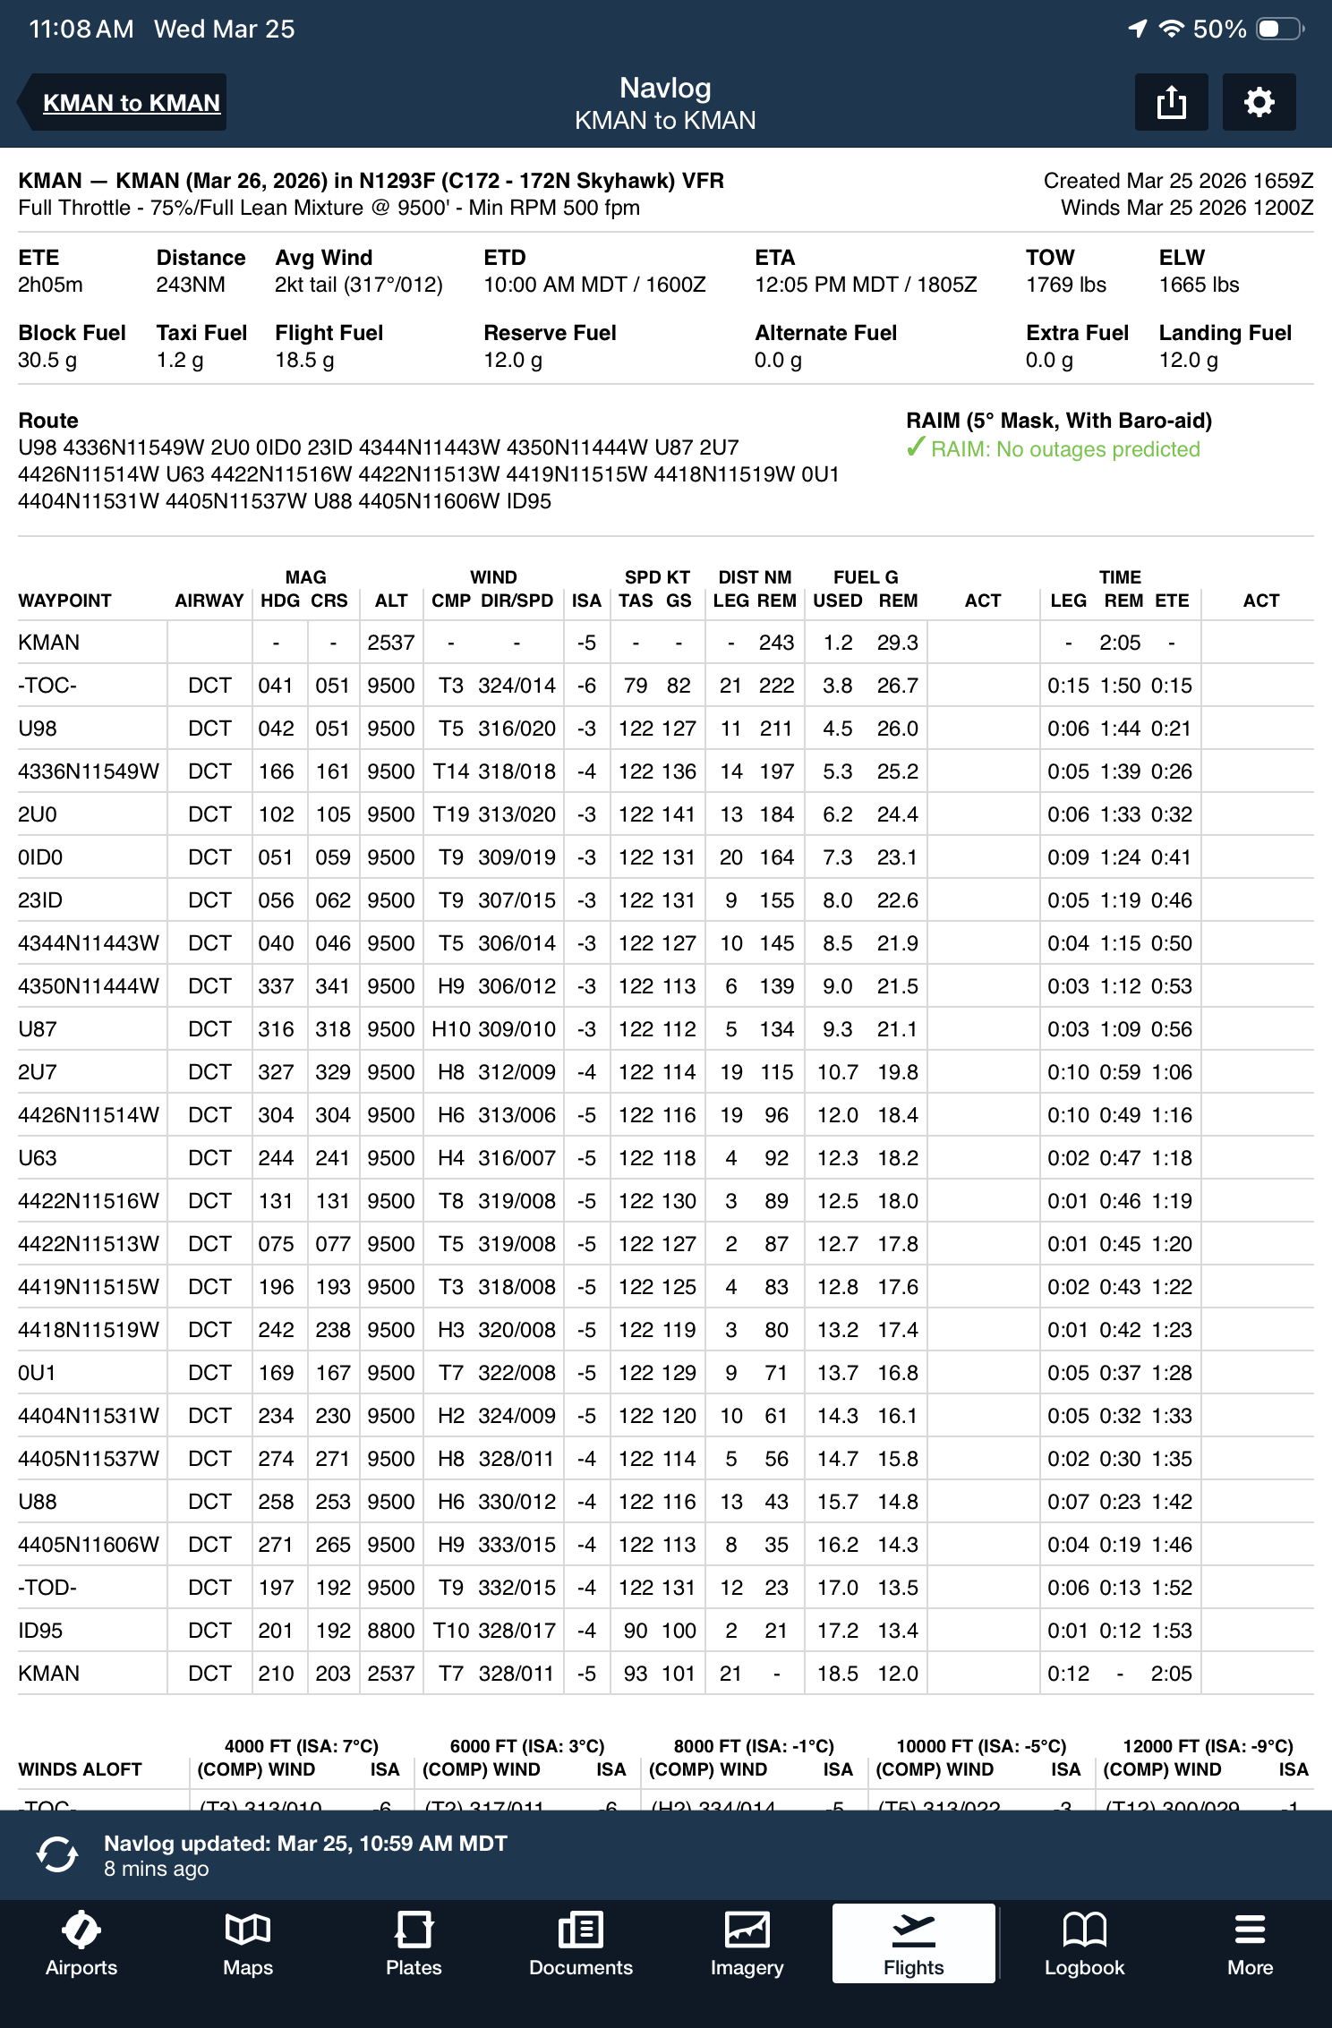
Estimated Flight Times ForeFlight Flight Log
Legs | Leg Time | Depart | Land | + Lndgs 2 ea | Total
KMAN - U98 | 21 | 10:00 | 10:21 | 12 | 33
U98 - 2U0 | 11 | 10:33 | 10:44 | 12 | 23
2U0 - U87 | 24 | 10:56 | 11:20 | 12 | 36
U87 - 2U7 | 10 | 11:32 | 11:42 | 12 | 22
2U7 - U63 | 12 | 11:54 | 12:06 | 12 | 24
U63 - 0U1 | 10 | 12:18 | 12:28 | 12 | 22
0U1 - U88 | 14 | 12:40 | 12:54 | 12 | 26
U88 - KMAN | 23 | 13:06 | 13:35 | 6 | 29
Totals | 125 (2.1 hr) |  |  |  | 215 (3.6 hr)

Slide 9
PREPARATION: WEATHER SOURCES
ASOS / METAR’S / TAF / MOS— May not be close. Will not forecast fog, valley fog, squalls, canyon turbulence.
Internet: Web Cams. / BC WX /RAW’s (remote automated WX)
1800wxbrief.com, NOAA, ForeFlight, Windy, Aviationweather.gov.
Satellite WX – Garmin In-reach
In Flight
  ADS-B (in) FIS-B – ground based
  Sirius XM WX – Satellite based.
Cell Coverage ?
  Surprisingly, some at higher altitudes ~ 9-10K’
  Not in canyons
Notes:
Q: How do you get wx for a place without wx reporting – ID/AK airport weather cams, etc.
Where am I going to go if I have a problem? Something a backcountry pilot is always thinking about, and something you should always be thinking about, too
Onboard datalink weather increases situational awareness—but know the limitations of your system. Flying over flatter backcountry areas and you probably won’t have problems with either FIS-B or Sirius XM, but if you are flying in mountainous terrain, just like VORs, the ground based FIS-B system will have limitations.

Slide 10
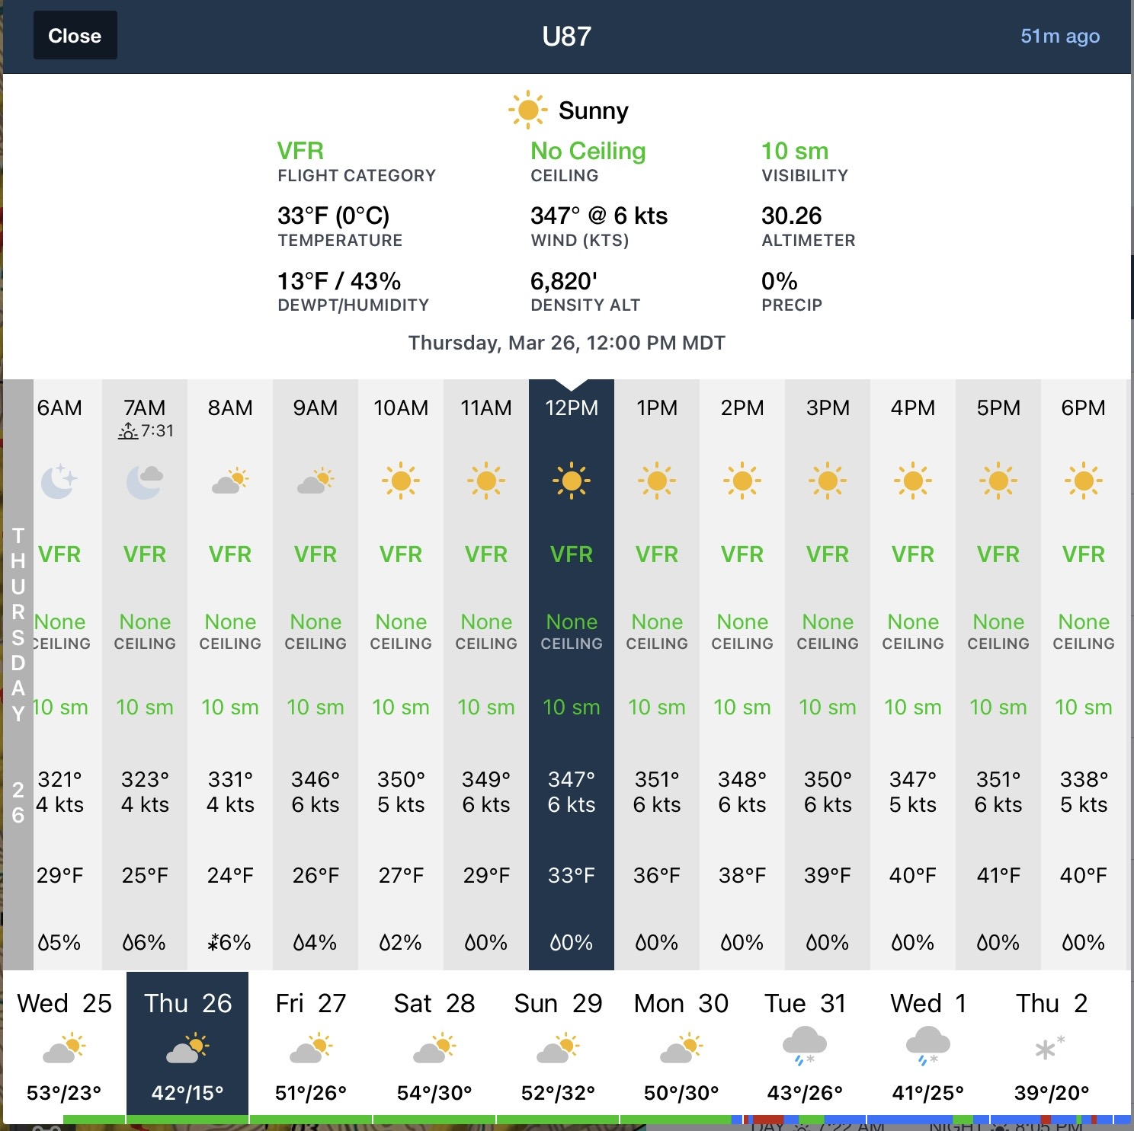
WX forecast
Do WX Briefing for overall wx, winds aloft, NOTAMS, etc.
For each airport – Foreflight
Weather / Daily option as shown.
Temps, DA, pressure at time of arrival/departure.

Slide 11
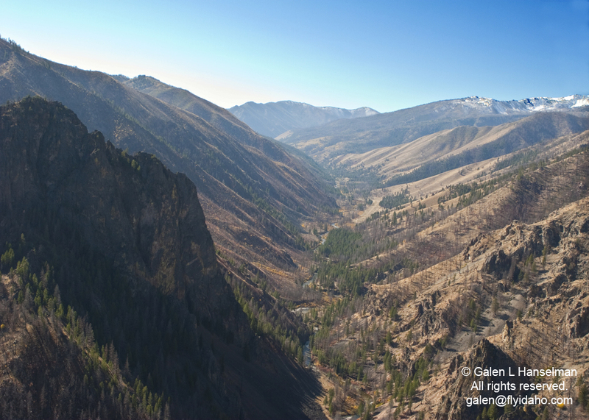
PREPARATION: ENVIRONMENT: AIRSTRIP RESEARCH
Sectional Charts.
Div. of Aero Airport Fac. Dir. Airport Operating Procedures
Fly Idaho Book
I.A.A. Website
RAF Airport Guide
None are a substitute for BC Training.
Notes:
These are things that one should do for any type of flying, however
There’s less room for ‘winging it’ in the backcountry. Because of that, more intensive preflight prep is required
You need to know your abilities, and you need to do much more research about the airstrips, weather patterns than just any flight.
"Truly superior pilots are those who use their superior judgment to avoid those situations where they might have to use their superior skills."
Good judgment comes from experience, experience usually comes from mistakes or BAD judgment (Preferably someone else’s)

Slide 12
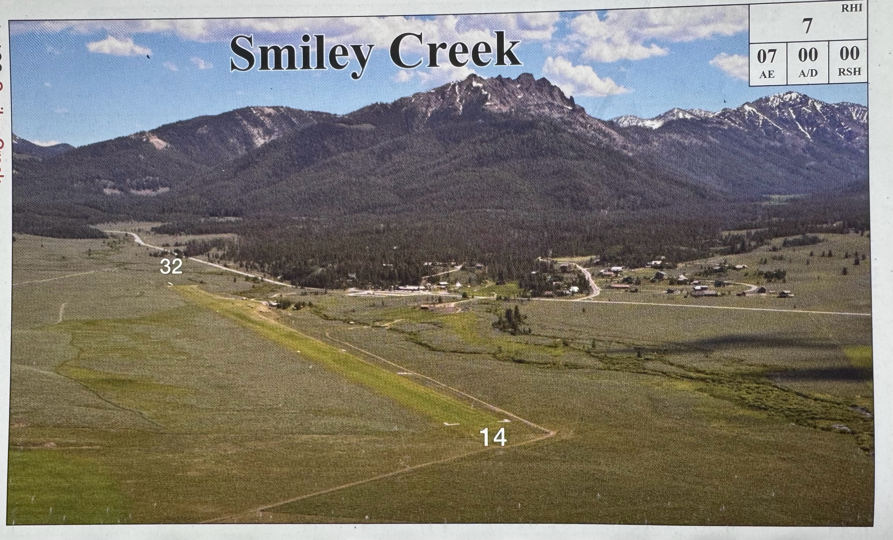
Smiley Creek
Airport Research
Fly Idaho

Slide 13
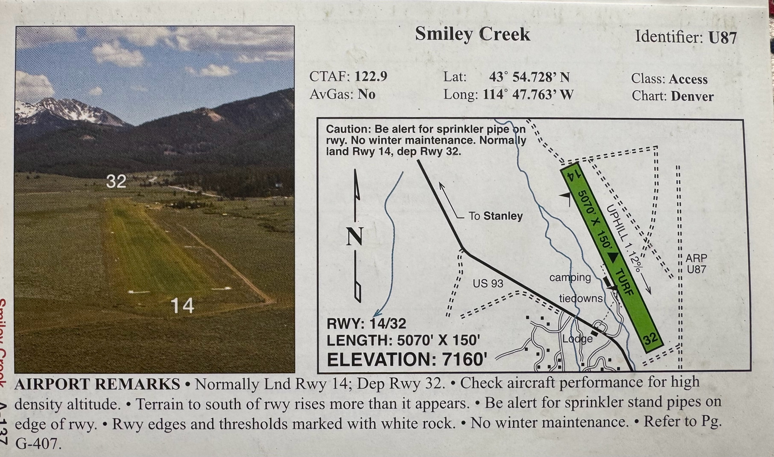
Smiley Creek
Airport Research
Fly Idaho

Slide 14
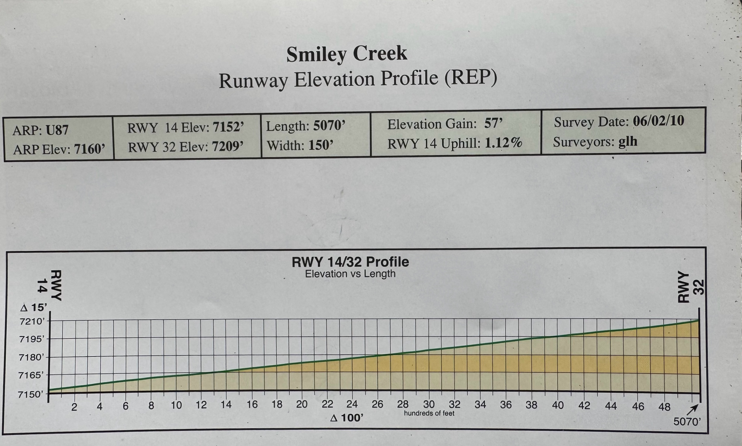
Smiley Creek
Airport Research
Fly Idaho

Slide 15
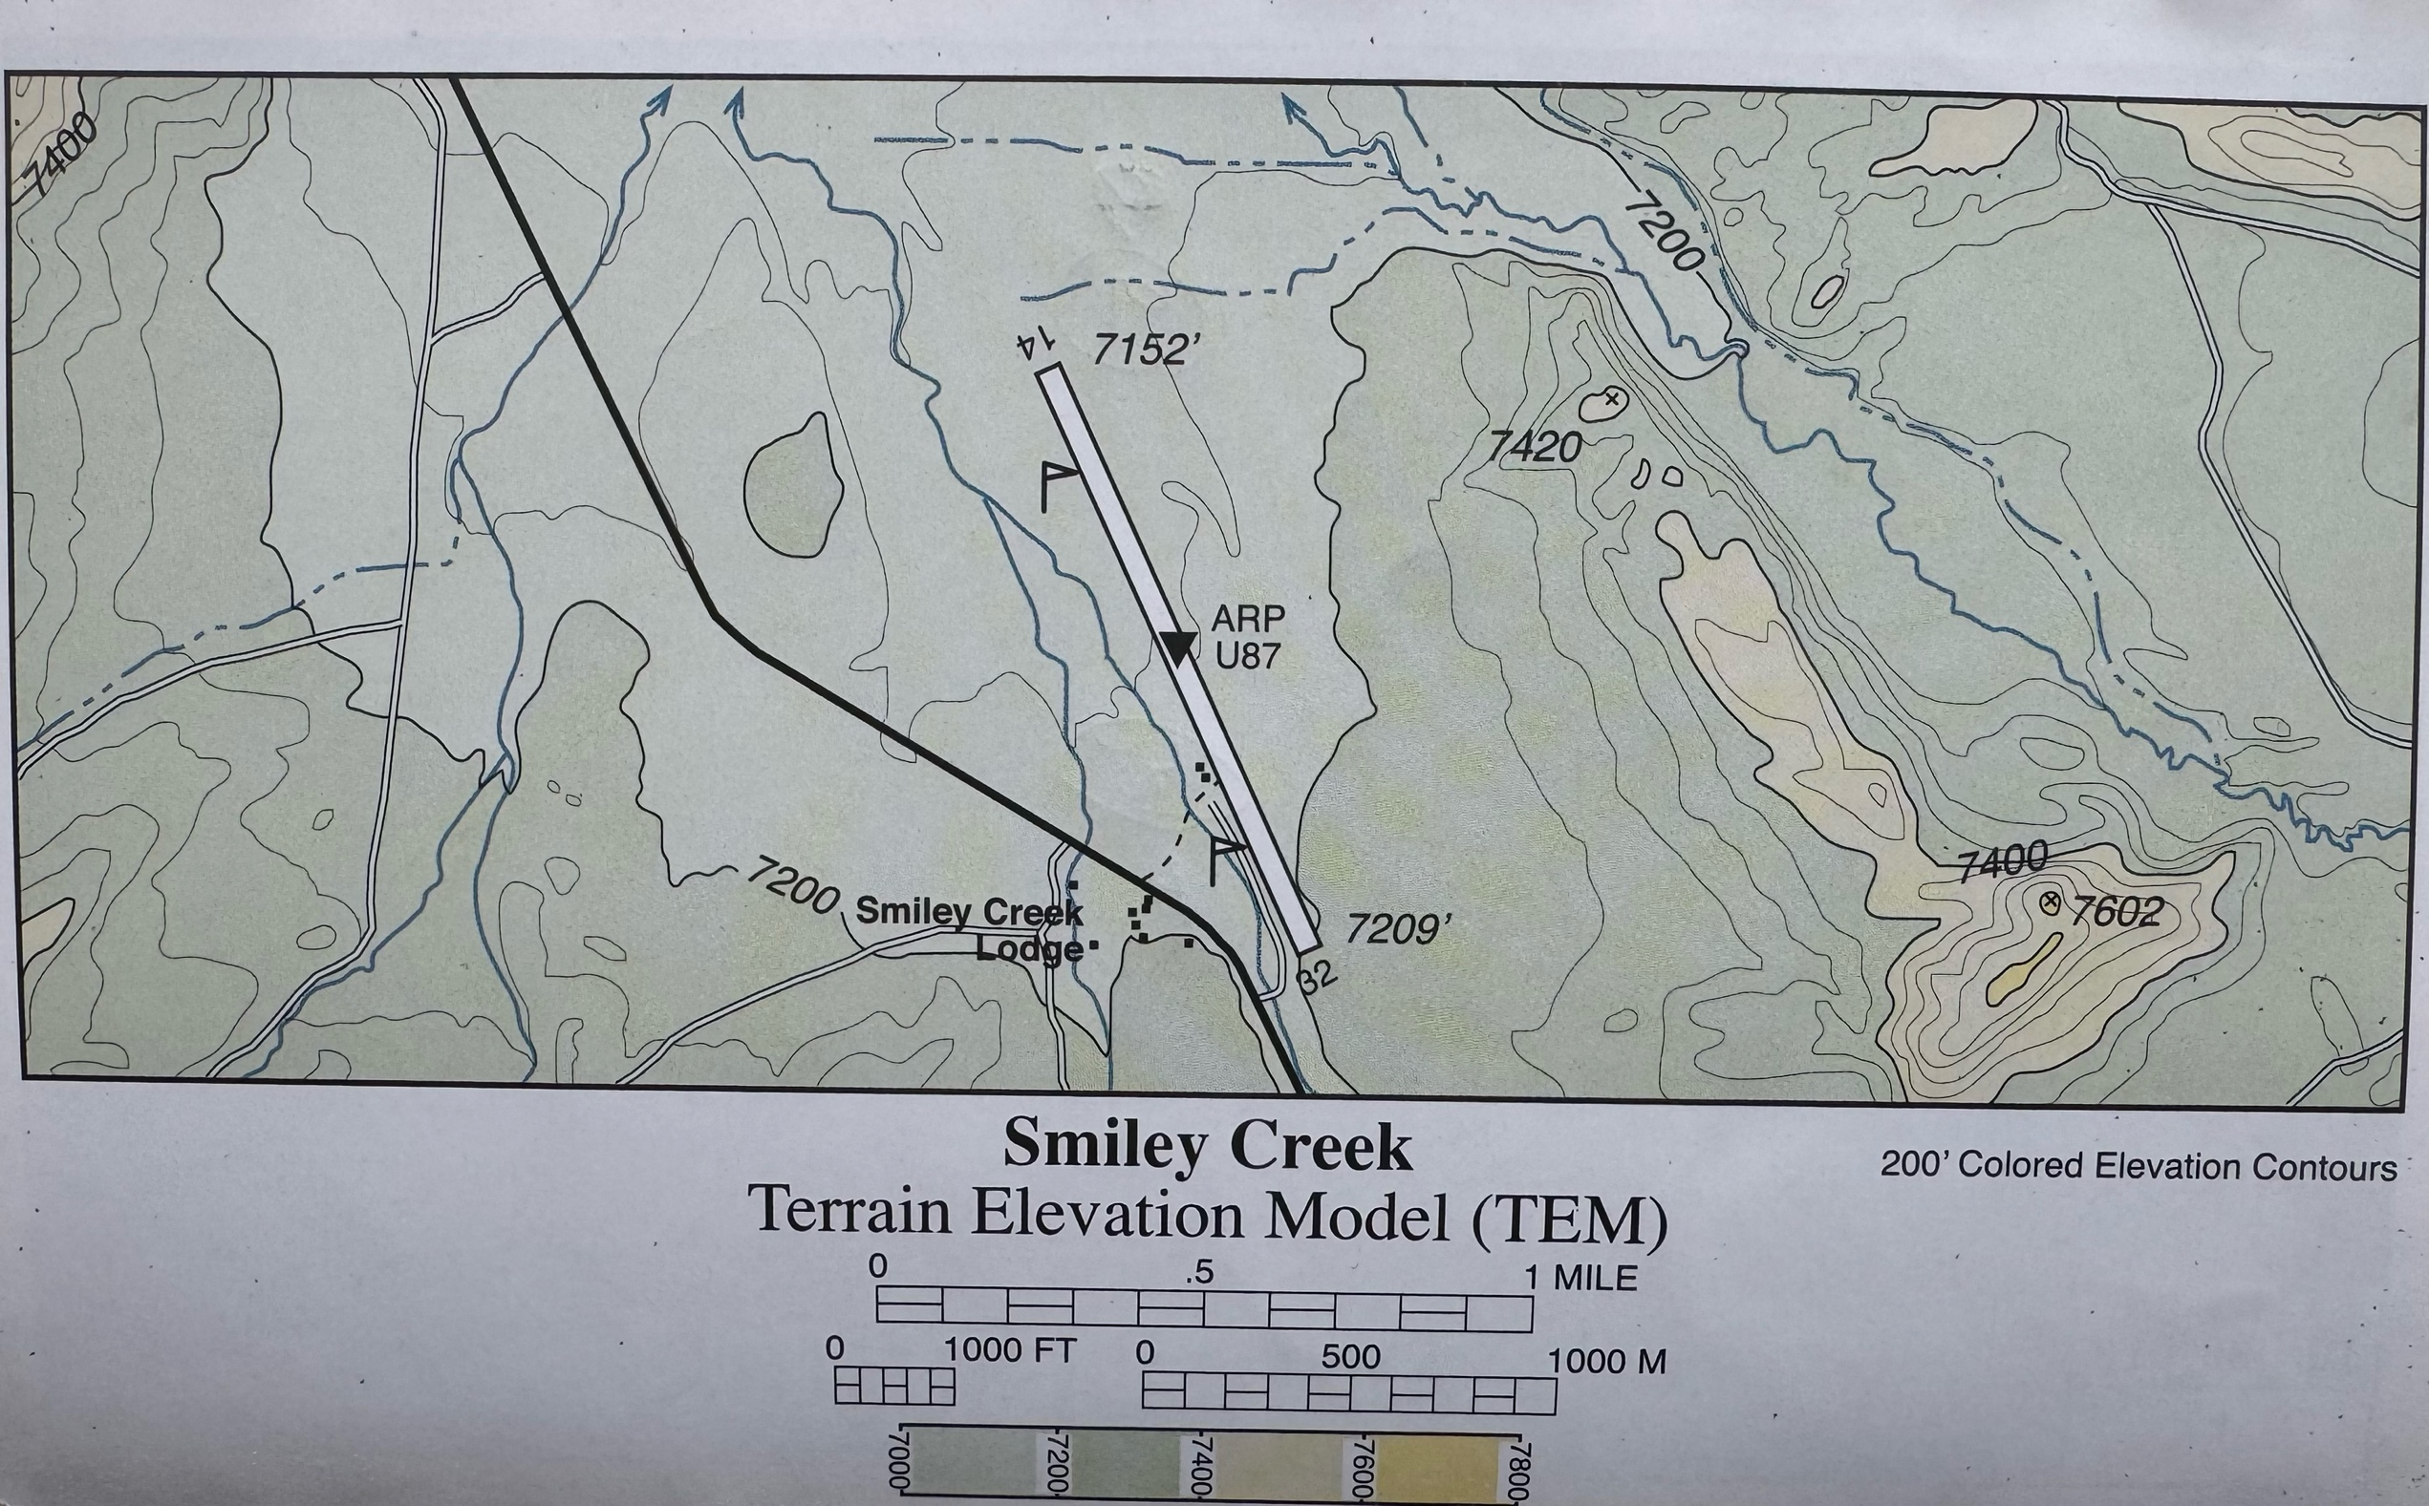
Smiley Creek
Airport Research
Fly Idaho

Slide 16
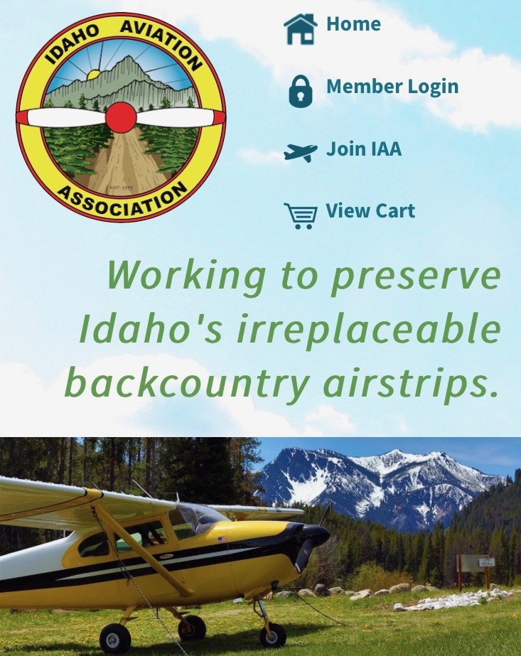
IDAHO AVIATION ASSOCIATION www.idahoaviation.com
Web cam/Wx
PIRPS
Services
Features
Contacts
Notes:
Don’t have to live in Idaho to join – If you enjoy the Idaho BC, please join and support these airstrips.

Slide 17
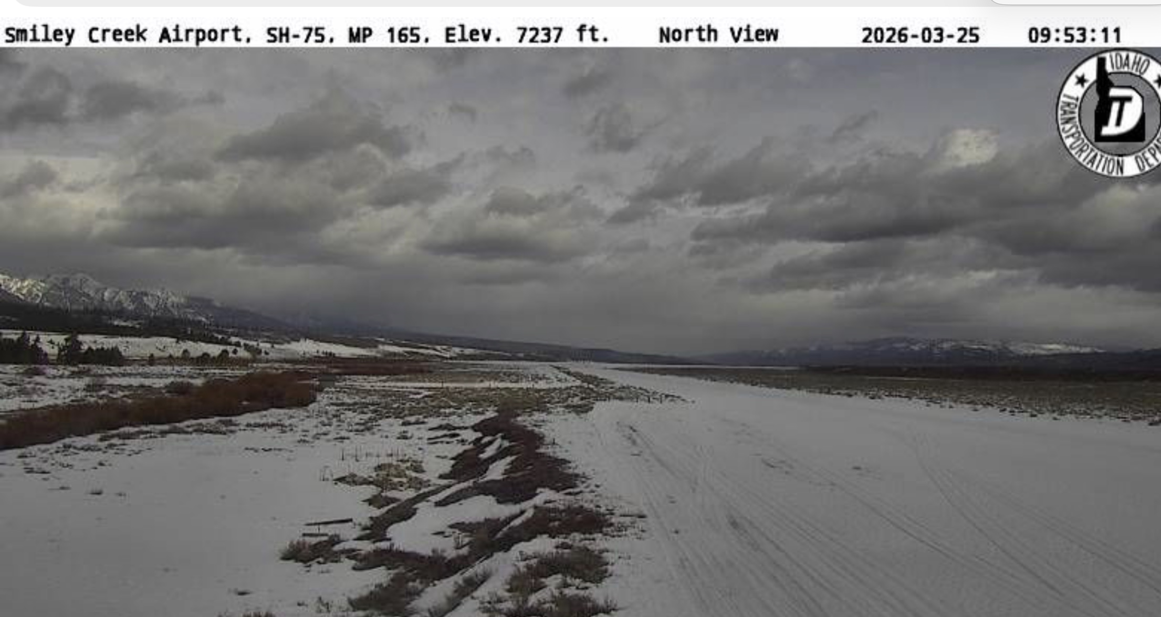
Airport Research
Web Cams

Slide 18
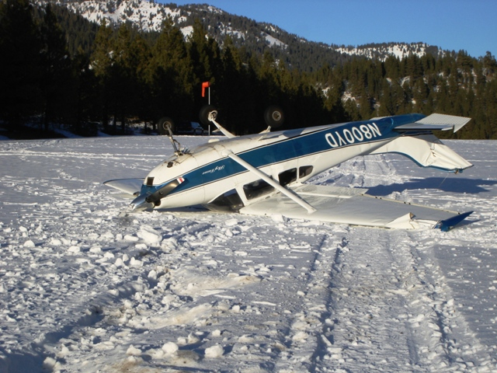
Airport Research
Oops – We don’t want this

Slide 19
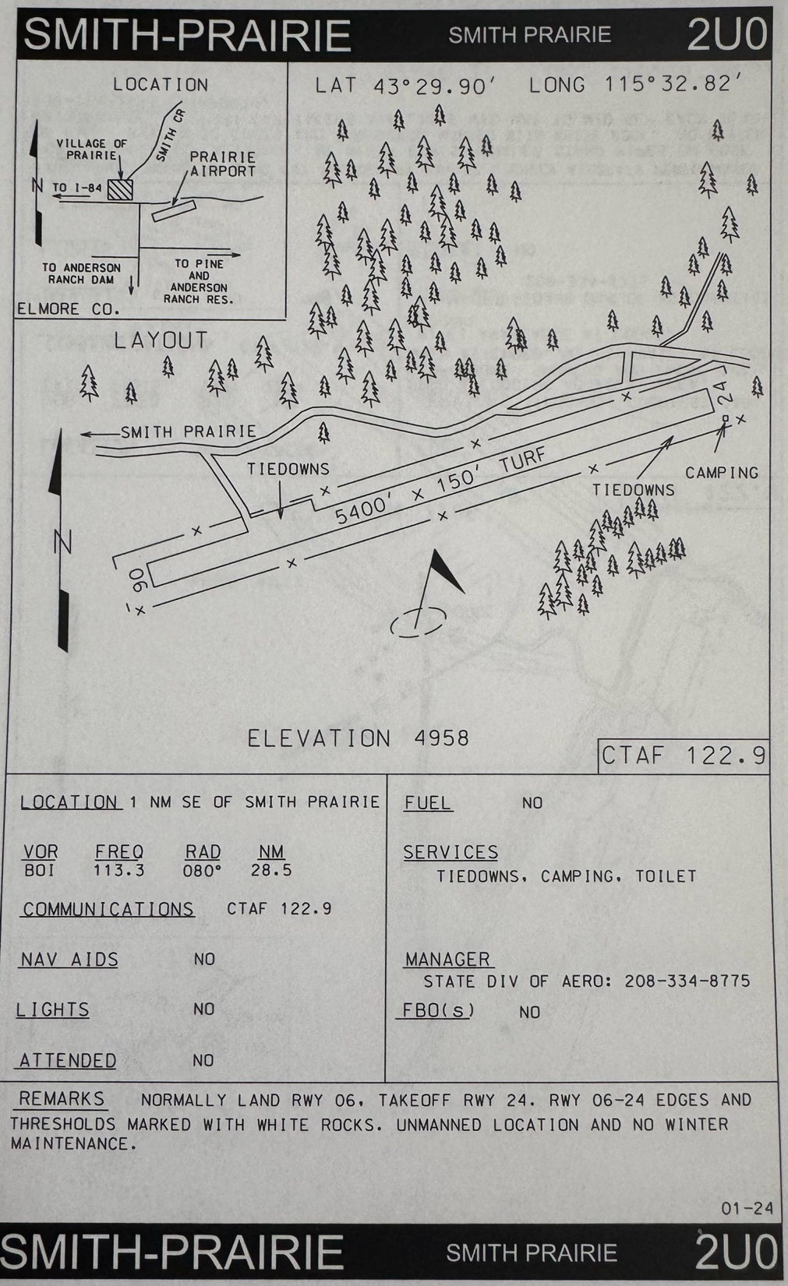
Airport Research
IDT – Airport
Facility Directory

Slide 20
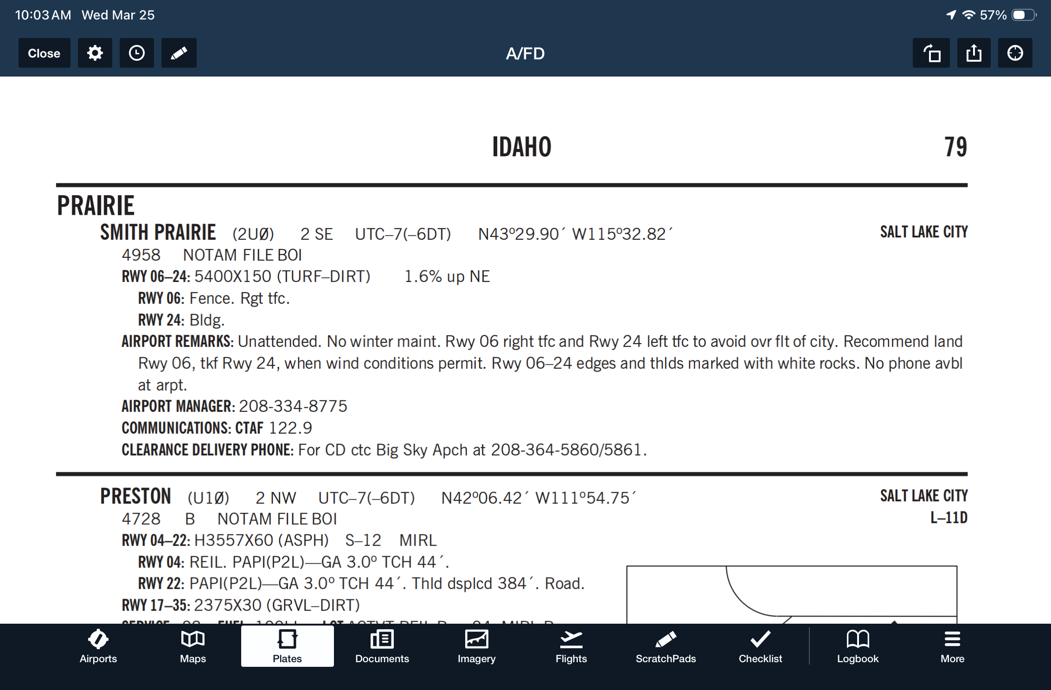

Airport Research
A/FD

Slide 21
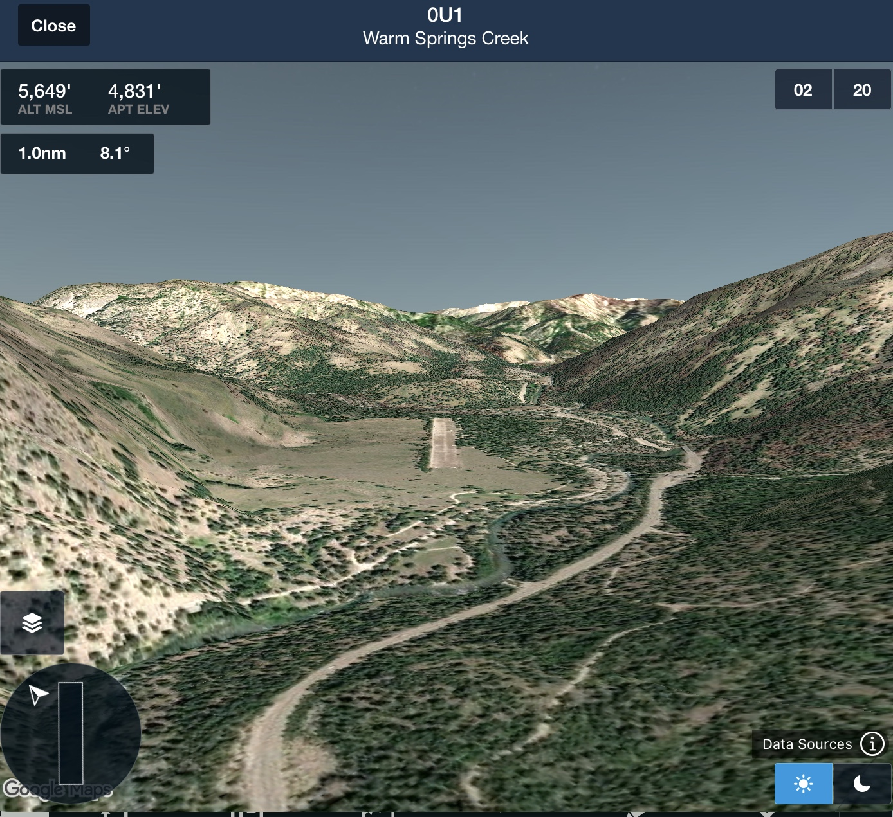
Airport Research
ForeFlight 3D or
Google Earth

Slide 22
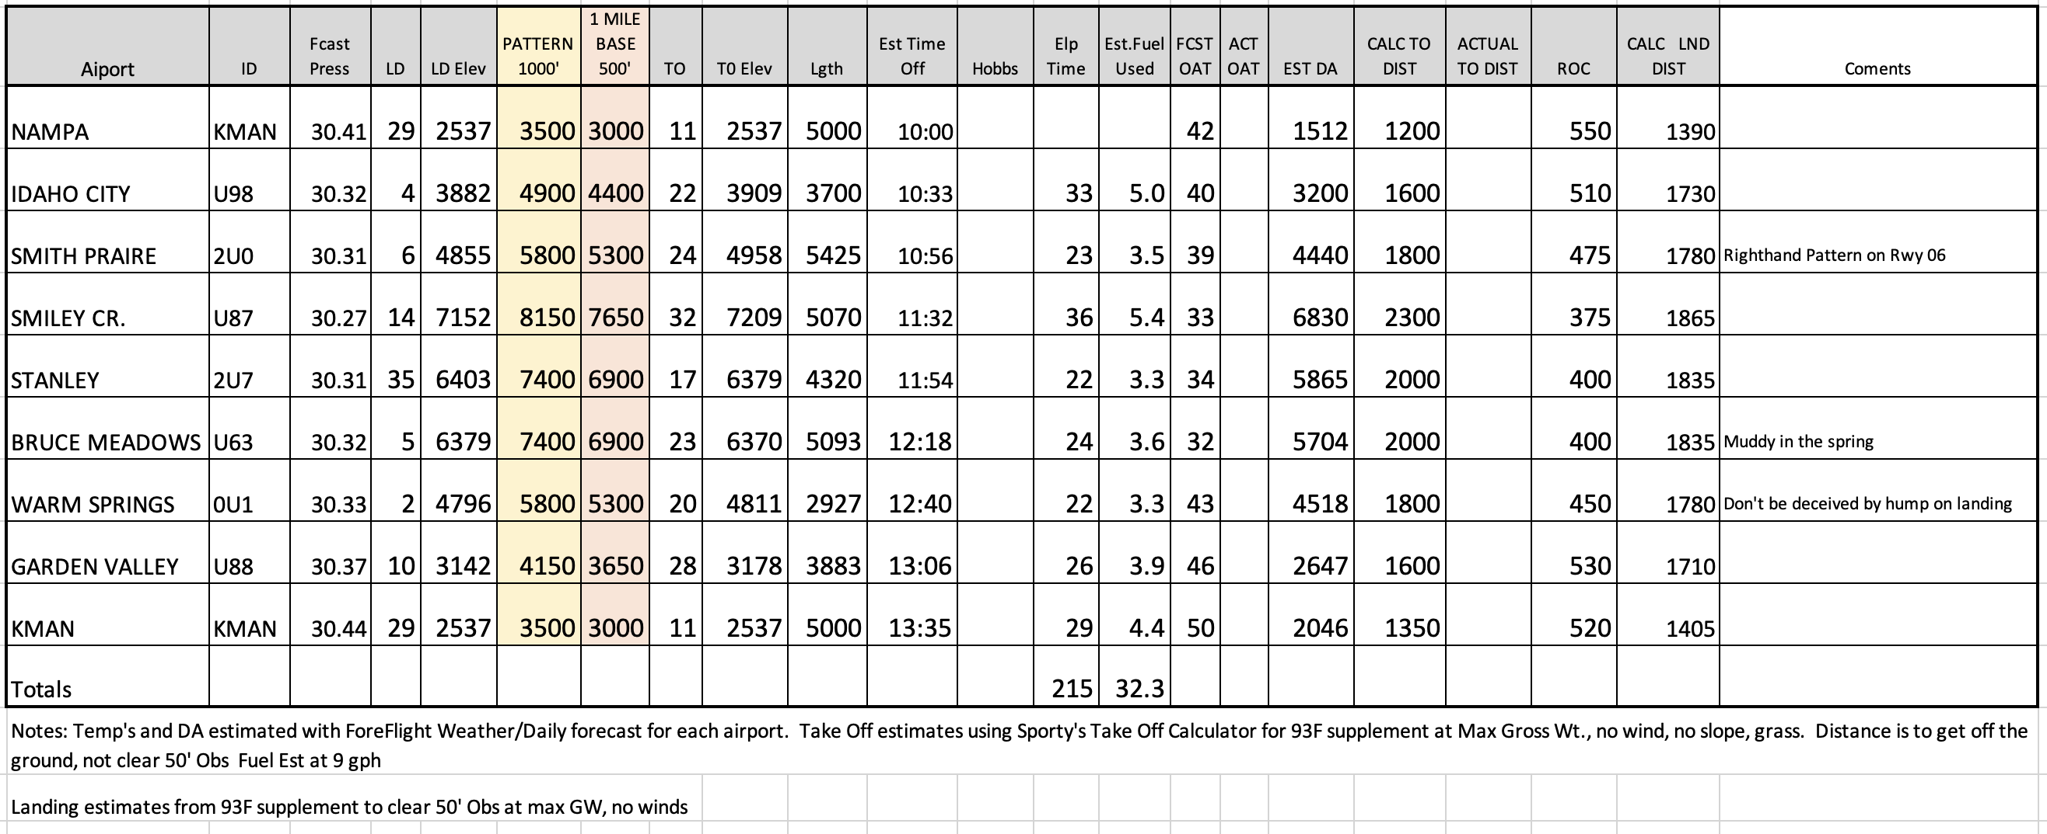
Take – Off / Landing Estimates

Slide 23
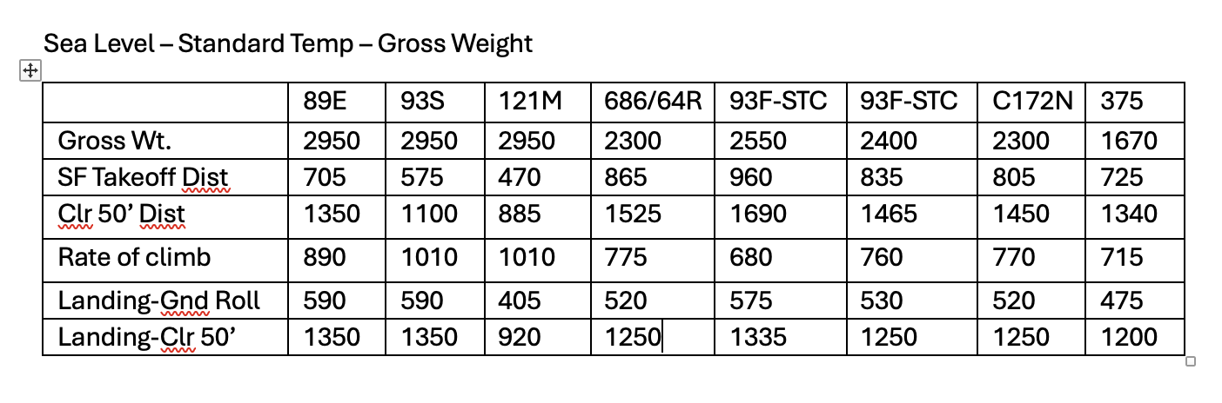
Homework.
Determine the following from the POH at KMAN and U87 (Smiley Creek) the following conditions: No wind, Gross Weight, Temp 70 deg, DewPoint 45 deg F, Pressure 30.07. .
Field Elevation KMAN 2537’ U87 7206’
Pressure Altitude ________
Density Altitude ________
Short field take-off distance ________
70% IAS at 50% mark of takeoff distance ______
Rate of climb _________
Landing Distance ________

Slide 24
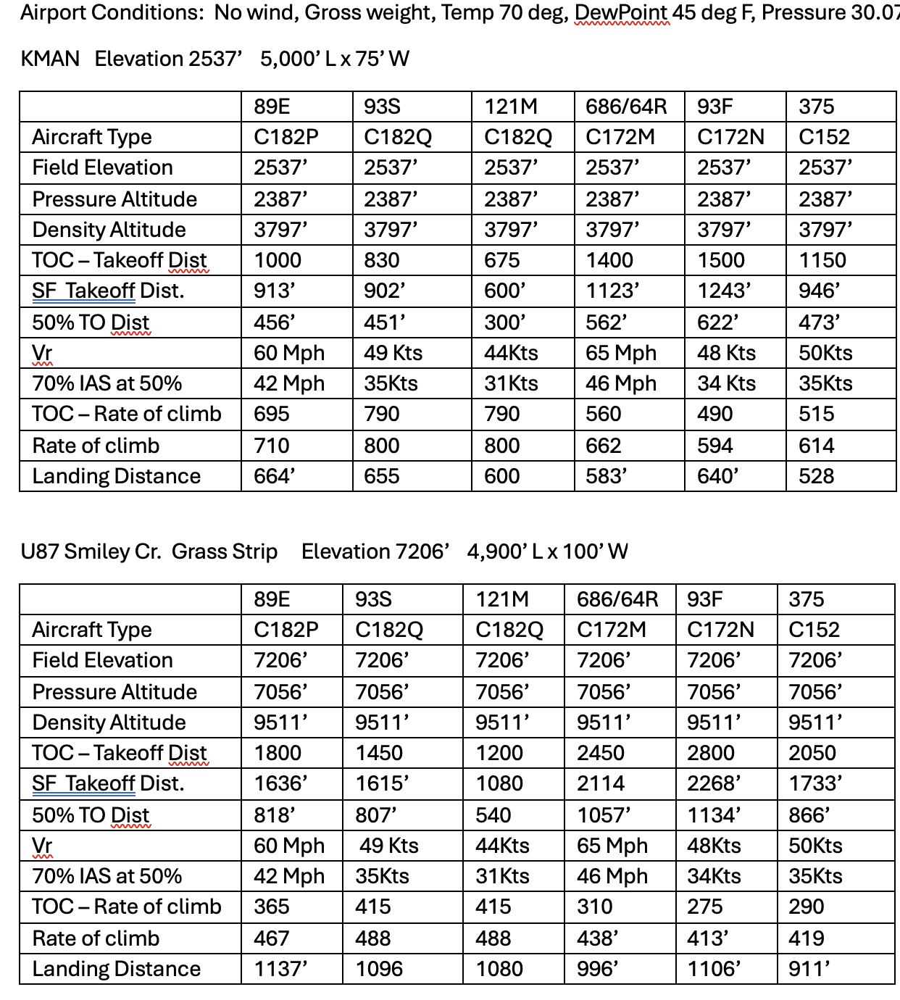

Runway slope?
Taking off in a tailwind?
Runway Surface: Grass, long grass, gravel, soft?
Effect of Weight.

Slide 25
PLAN - PREPARE - PRACTICE
Prepare - Gordon Hall
Risks - BC safety record 2X worse
High Tension Power Lines
Slack & Zip lines
Snags

Slide 26
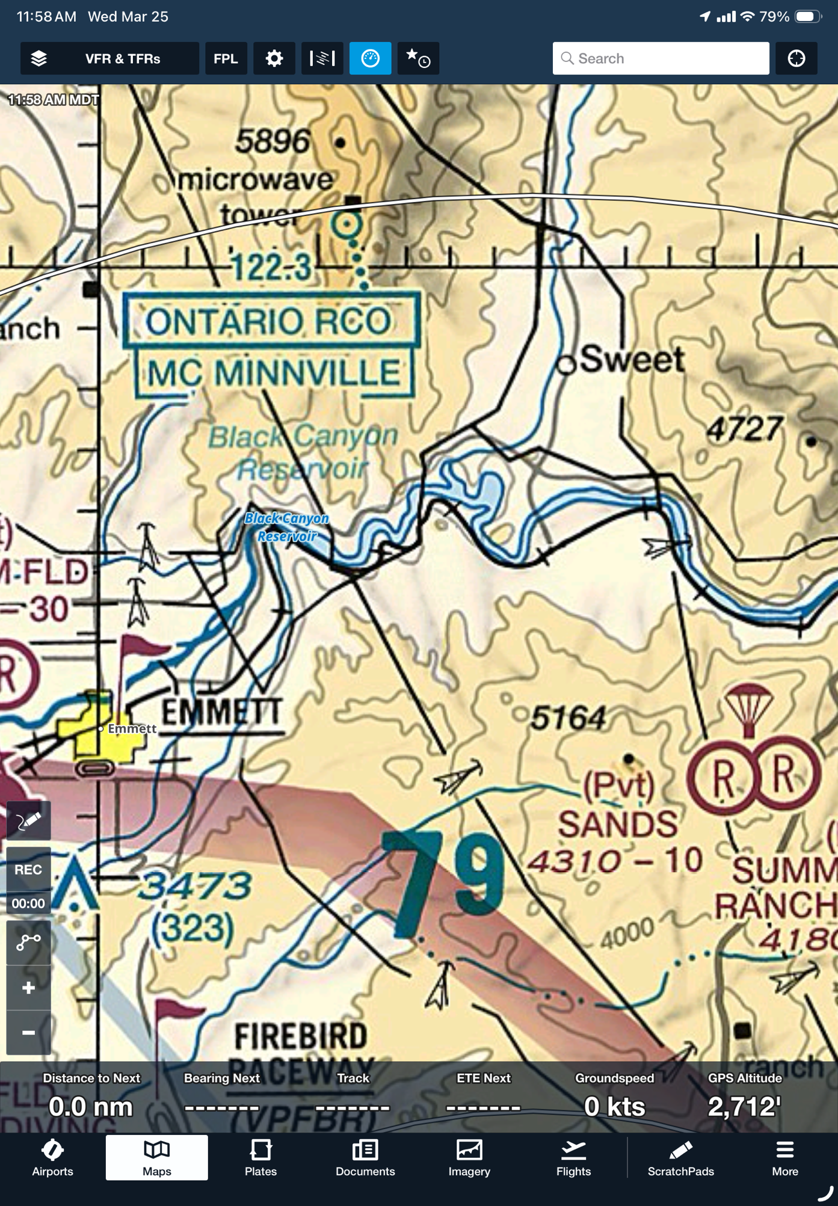

Slide 27
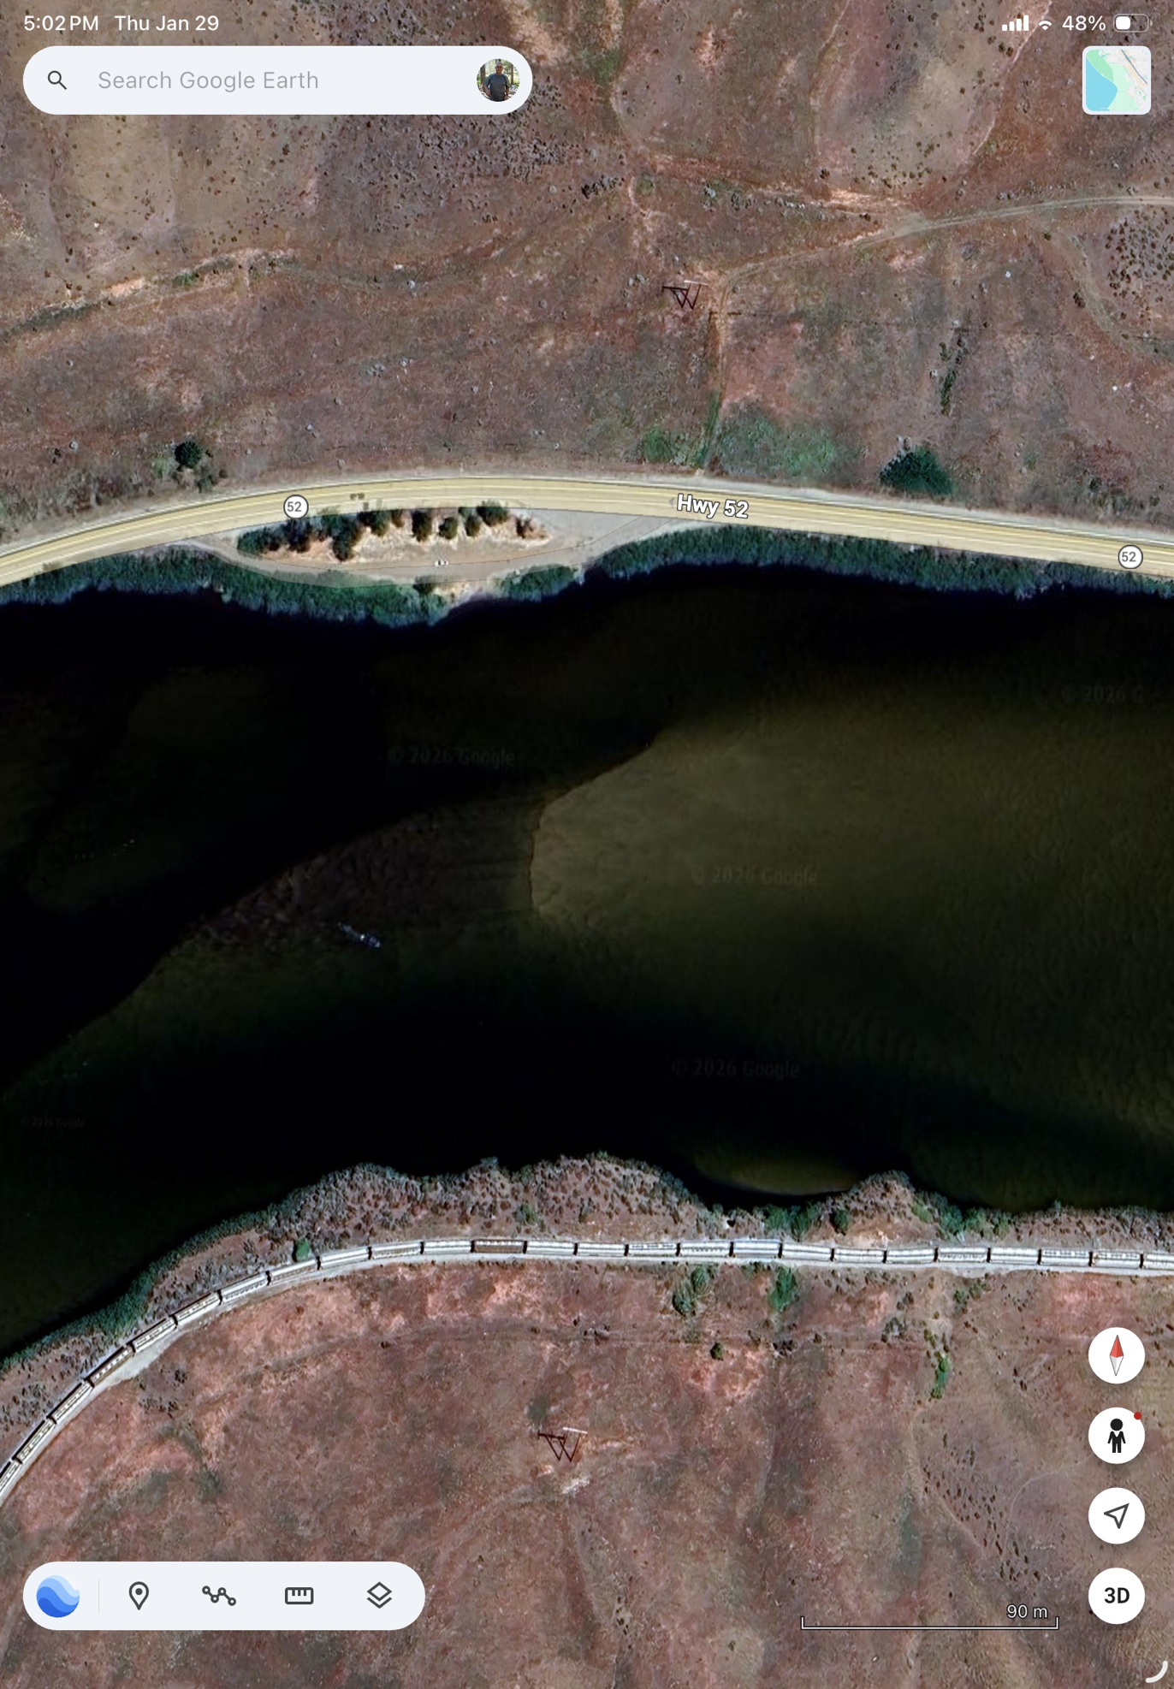

Slide 28
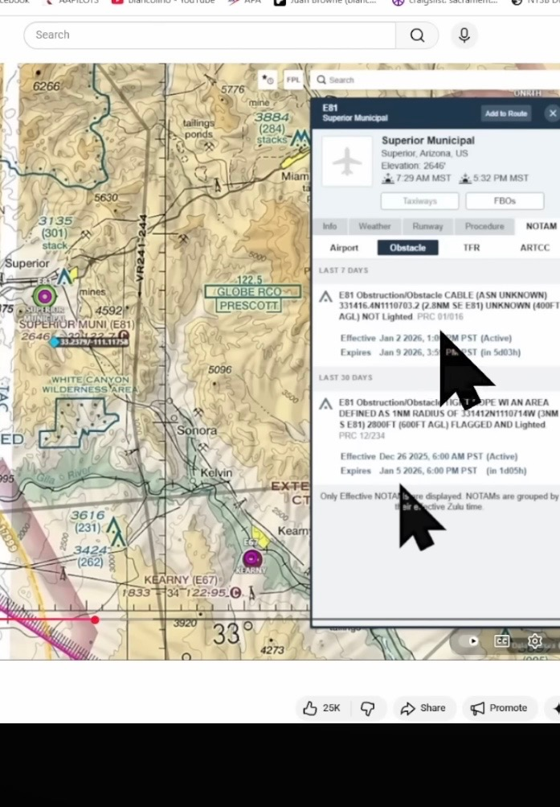

Slide 29
PLAN - PREPARE - PRACTICE
Prepare - Pete Glick
Use of Avionics
Smoke
Sun
Weather Considerations
Trees - taxiing

Slide 30
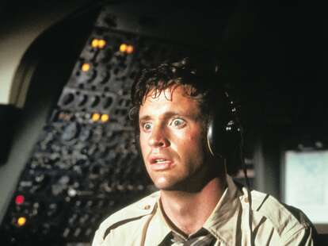
      “What’s it doing? “

Slide 31
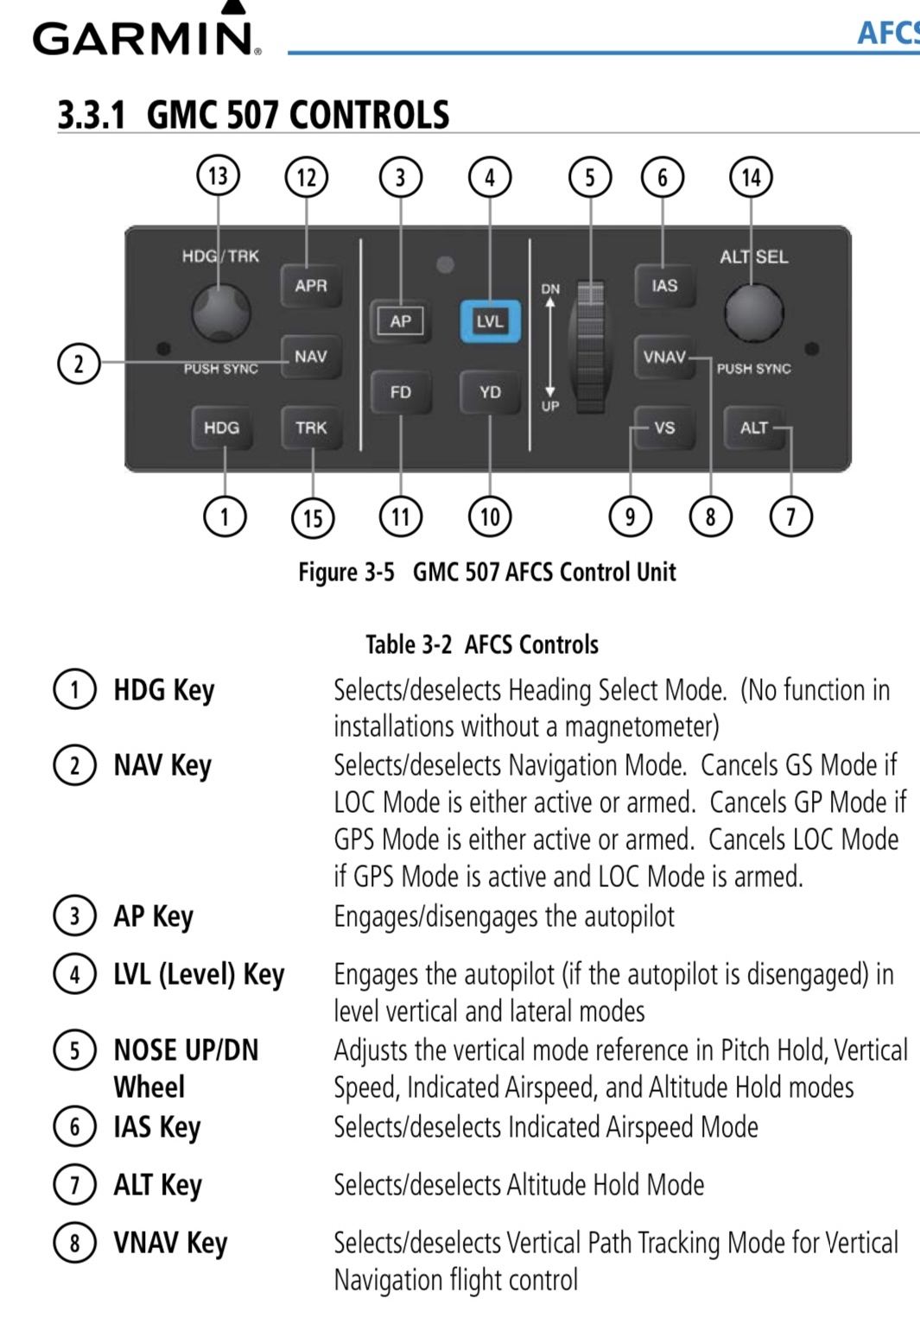
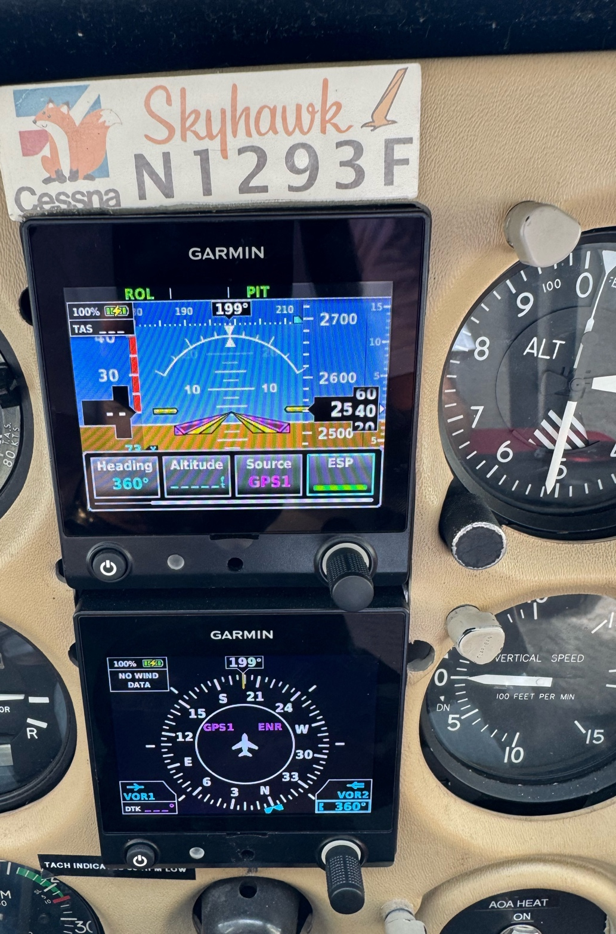

Slide 32
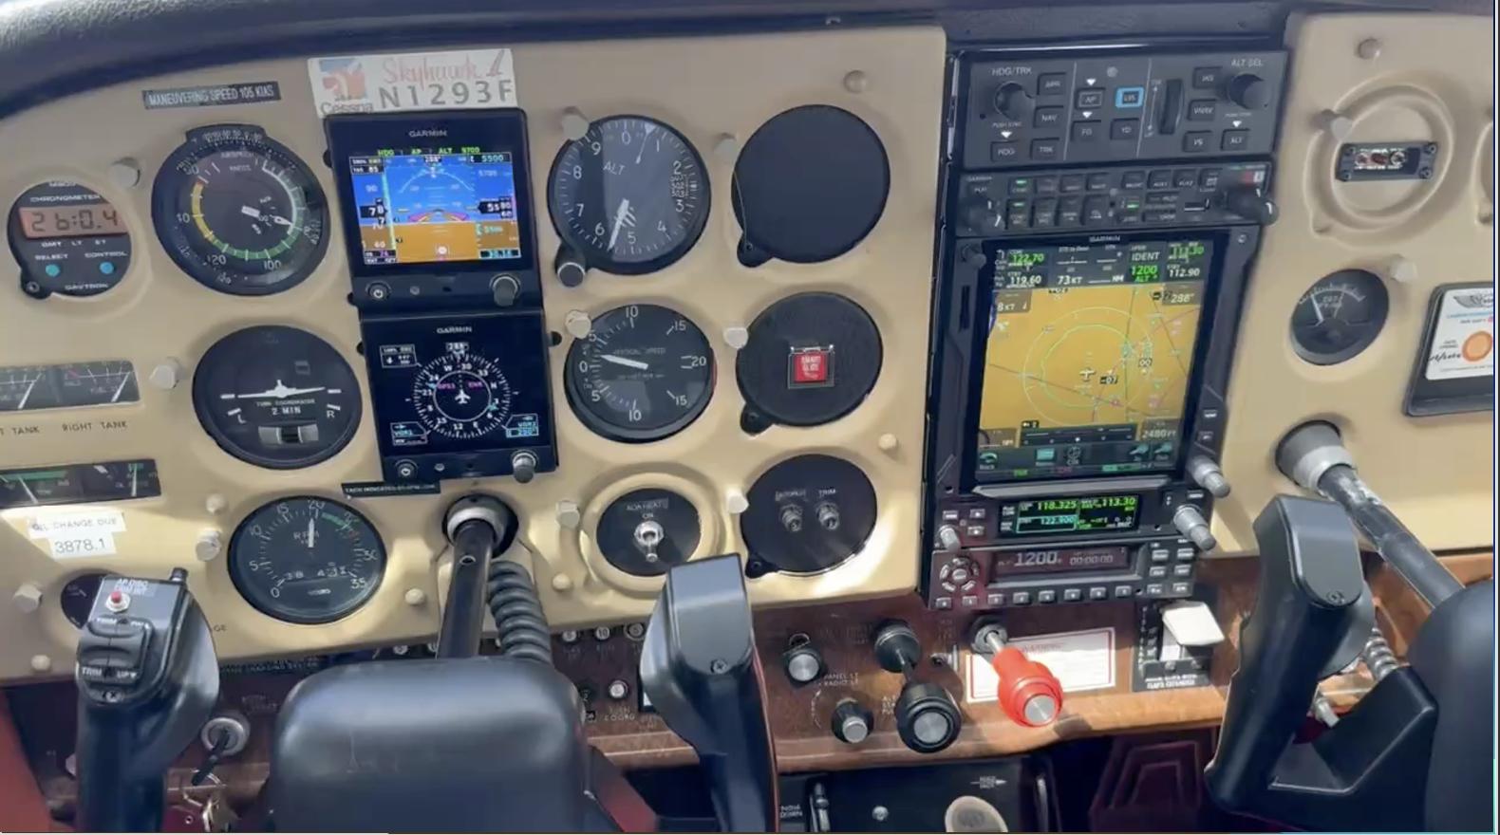
Who uses Autopilot?
What is ESP?
Smart Glide ?
Do you know how to turn ESP Off?

Slide 33
“What’s it doing? “
Use of Avionics
  Read STC and pilot guide for avionics
  Limitations - Know and comply
  Push a Button? Know what will happen
  Get some training
  Practice use in-flight in the flat lands first

Slide 34
Weather Consideration
Establish personal minimums “in mtns”
  Wind at altitude
  Enroute / destination vis
Airport Cams
Katabatic / Anabatic wind
Sun/Shade affects lift

Slide 35
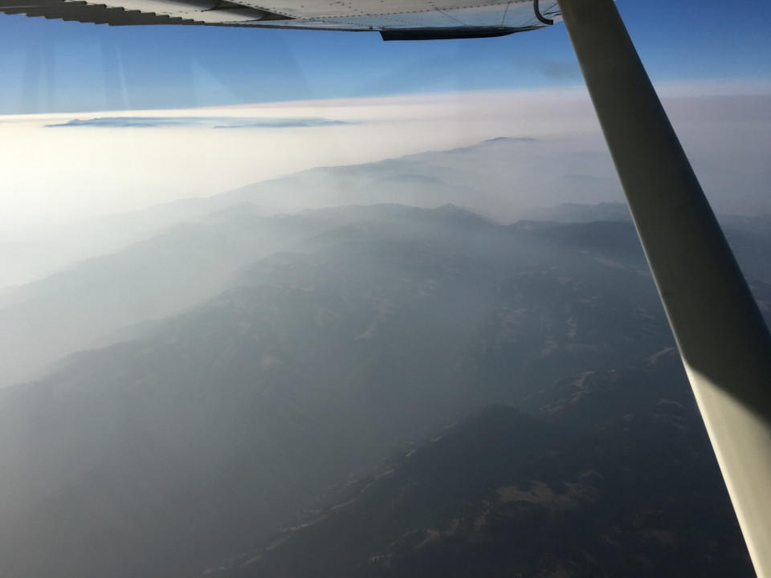

Slide 36
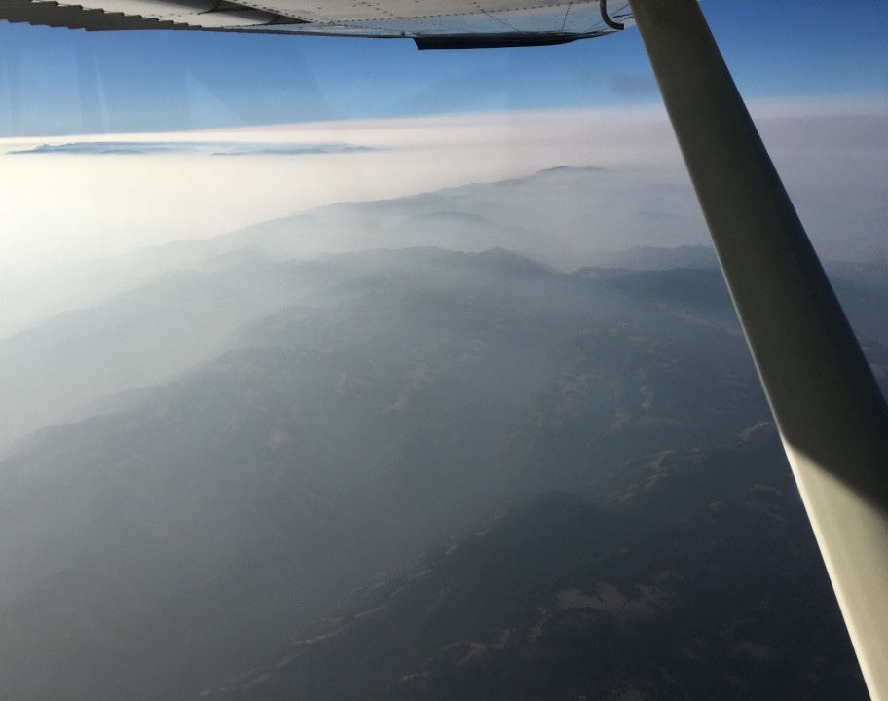
VISIBILITY in Smoke
Not always accurately forecast
Know airspace vis
ADM
Be proactive, have a Plan B
  Use it early

Slide 37

Pop up IFR clearance, KBKE 9000’ climbing 11,000 Hdg 120

Slide 38
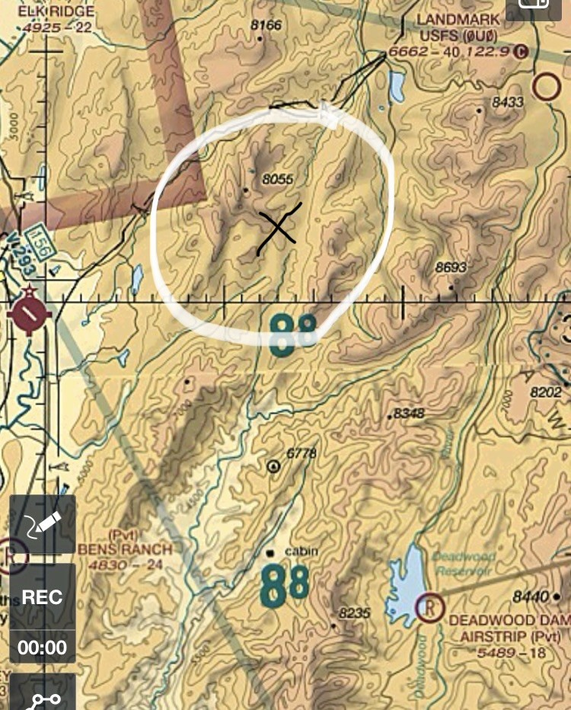

Slide 39


Slide 40
SUN
Morning vs evening
Windshield vis
  Clean (preparation)
Terrain
  Sunny / Shade / Smoke
Sunglasses – polarized??
On Final - Go around?

Slide 41
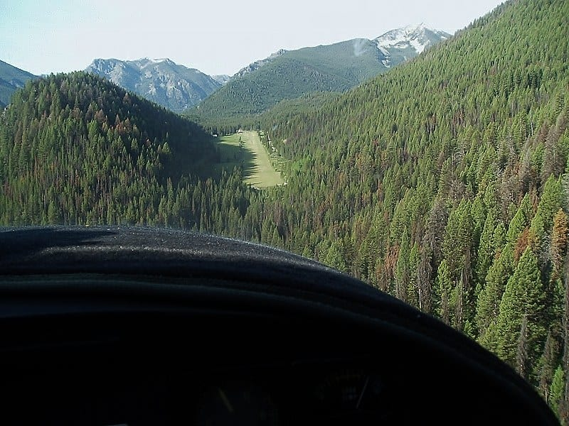
Trees
How to tell if you’re above or below?
Don’t stare
  Fixation
Taxiing?
  Clear wings/tail
This Photo by Unknown Author is licensed under CC BY-SA

Slide 42
PLAN - PREPARE - PRACTICE
Practice -Jim Manley
Currency & Personal Minimums
Airstrip Recon

Slide 43
PLAN - PREPARE - PRACTICE
Practice -Jim Manley
Currency & Personal Minimums
  Remembering
  doing a task well is
  NOT THE SAME
  As doing it well now

Slide 44
PLAN - PREPARE - PRACTICE
Practice -Jim Manley
Currency & Personal Minimums
  3 Aviator Competence Areas
    Knowledge
    Skill
    Judgement

Slide 45
PLAN - PREPARE - PRACTICE
Practice -Jim Manley
Currency & Personal Minimums
  3 Aviator Competence Areas
    Knowledge
      Easiest
      Study

Slide 46
PLAN - PREPARE - PRACTICE
Practice -Jim Manley
Currency & Personal Minimums
  3 Aviator Competence Areas
    Knowledge Currency
      NOTAMS
      New Technology
      Aerodynamics you forgot
      Different airplane
      Etc…

Slide 47
PLAN - PREPARE - PRACTICE
Practice -Jim Manley
Currency & Personal Minimums
  3 Aviator Competence Areas
    Skill
      Hand-Eye coordination
      Practice

Slide 48
PLAN - PREPARE - PRACTICE
Practice -Jim Manley
Currency & Personal Minimums
  3 Aviator Competence Areas
    Skill Currency
      Hand-Eye coordination degrades
      MAF example
        Category 2 & 3 strips daily
        After 1 week off, needed a day to spool up again

Slide 49
PLAN - PREPARE - PRACTICE
Practice -Jim Manley
Currency & Personal Minimums
  3 Aviator Competence Areas
    Judgement
      Hardest
      Character
        Do the right thing
        when no one is looking

Slide 50
PLAN - PREPARE - PRACTICE
Practice -Jim Manley
Currency & Personal Minimums
  3 Aviator Competence Areas
    Judgement Currency
      Working one area doesn’t automatically improve the other two
      Beware “Right Stuff” mind set
      Honor personal minimums contracts

Slide 57
PLAN - PREPARE - PRACTICE
Practice -Jim Manley
Airstrip recon
www.t-craft.org/documents/zoom/jim_manley.wlasso.3.28.24.mp4

Slide 58
PLAN - PREPARE - PRACTICE
All
Experience/ Never Again
Q&A
Notes:
My Never Again candidates:
Nose over at PAC(?)
Nose over at TMP
Overweight takeoff

Slide 59
Thank You
Be Safe,
Have Fun,
Don’t Do Anything Stupid !

